Slide 1
“Helping overseas doctors to progress”
Vijay Nayar
Autumn Seminar
9th October 2014

Slide 2
Issues
Challenges
Opportunities

Slide 3
Cultural factors
Communicative capability
Clinical capability
Professional culture
Developing resilience

Slide 4
Cultural factors

Slide 5
Settling, Person-Role fit
Anticipation prior to change
PREPARATION
ENCOUNTER
ADJUSTMENT
STABILISATION
Transition Cycle
(Nicholson, 1987)
Personal change, role development and building relationships
Making sense of new role, emotions

Slide 6
Sustained trust, commitment and effectiveness with role and people
Developing realistic expectations
PREPARATION
ENCOUNTER
ADJUSTMENT
STABILISATION
Positive Cycle
Personal change, role development and building relationships
Confidence in coping, enjoyment

Slide 7
Failure
Unrealistic expectationsUnreadiness Fearfulness
Reluctance
PREPARATION
ENCOUNTER
ADJUSTMENT
STABILISATION
Negative Cycle
Mismatch
Shock
Rejection
Regret
Misfitting Grieving

Slide 8
Power distance
In some cultures – quite large power distance teacher to student, led by teacher, not contradicted or criticised
In others - increasingly more self directed, encouraging to challenge knowledge
Potential implications – no experience of challenging or debate therefore unable to unpack the knowledge, difficulty with SDL

Slide 9
Potential implications
Exams are focussed on evidence of knowledge and recall vs knowledge applied to practice – requiring demonstration of critical reasoning
Need to maintain ‘face’, do not like ‘I don’t know’ – see it as a threat
Difficulty managing uncertainty

Slide 10
Individualism vs. Collectivism
Think of themselves as an individual with a focus on ‘I’
Individual excellence is nourished and celebrated
Learn to intuitively think of themselves as part of a group/family focusing on ‘we’
Unquestioning loyalty is expected and assumed

Slide 11
Implications for Educators
Be aware of your own cultural assumptions and biases
Appreciate the extent to which difficulties that arise are due to cultural factors
“Reality shock” and need to deal with unmet expectations
Induction – not only policies and procedures but also “cultural induction”

Slide 12
Cultural Induction
Raise awareness of culture
its effects on learning
its effect on performance
Discuss models of learning
Requirements of exams
Educational contract – this is not prejudice

Slide 13
Cultural Induction
Help their frustration and other emotions
Fear of failure/criticism
Self Directed Learning
Reflective practice
Managing uncertainty
Encourage resilience

Slide 14
Communicative capability

Slide 15
Barriers to communication
Language
Accent
Nonverbal cues misinterpreted
Cultural assumptions and stereotypes
Preconceptions
Attitude towards another culture
Ethnocentricity
Unconscious bias

Slide 16
Consequences of poor communication
May make people appear awkward or difficult
Lack of English can make someone appear less intelligent, or lack sense of humour
Misinterpretation
“I don’t know how to help this person”

Slide 17
Communication skills:
Deconstruct language
Problem solving skills
Overcoming artificiality and being formulaic
Interpersonal skills
Verbal and non-verbal cues
Subtleties and nuances of language
Doctor-Patient relationship

Slide 18
Calgary-Cambridge model

Slide 19
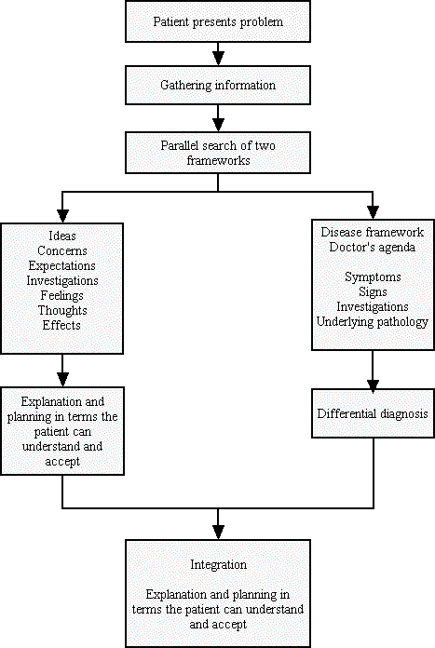
McWhinney
Disease-Illness
model

Slide 21
Clinical capability
Lower starting point
poor foundation
not met foundation standards
communication
poor clinical knowledge skills and experience

Slide 22
Early assessment
SAC scores
Early in attachment assess:
Communication skills
Knowledge base
Application of knowledge to clinical situations
Attitude

Slide 23
Tools
COTs, observation, videos
Self assessments – Manchester self rating, nPEP
CBDs and Debriefs
MSF and PSQ
Use of e-portfolio

Slide 24
Professional culture

Slide 25
Warning signs
Difficulty managing workload eg referrals, letters, path
“Disappearing Act”, lateness, frequent sick leave
Bursts of temper
Poor teamworking - “Bypass Syndrome”

Slide 26
Warning signs
Poor tolerance of ambiguity, inability to compromise, difficulty prioritising
Poor insight, defensiveness, counter-challenge
Difficulty with exams
Career frustrations

Slide 27
The NCAS performance triangle
Work context
Clinical knowledge and skills
Health
Behaviour
Notes:
27

Slide 28
Health
Mental or physical illness
Personal stress
Relationships
Bereavement
Family pressures
Financial pressures-exam fees!
Addiction

Slide 29
Environment
Workload
Lack of available training
Bullying and Harassment
Long travel times
Family commitments, here and abroad

Slide 30
Behaviour
lack of professionalism
poor motivation
poor attitude to patients
poor attitude to colleagues
not a good team member
poor insight
rudeness and arrogance

Slide 31
Early assessment
Previous and current reports
Non engagement with Epf
Sick leave
Complaints
Soft intelligence
MSF
PSQ

Slide 32
Professionalism
GMC GMP
Leadership and Teamworking
Feedback on performance-good and bad
Correct performance problems as they arise
Role modelling and Reflective practice
Develop resilience

Slide 33
Self
Known by
Unknown by
Open | Blind
Hidden | Unknown
Known by
Feedback
Self disclosure
Others
Shared
discovery
Others
observations
Unknown by
Self-
discovery
Feedback

Slide 34
Developing resilience

Slide 35
Role of Educators
Listening ear
External view
Recognise stress and help identify causes
Recognise sick doctors
Signpost to other resources
Promote resilience
Role model

Slide 36
Building Emotional Resilience
See crises as challenges to overcome; not insurmountable problems
Develop problem solving skills
Accept that change is part of life, not a disaster – be flexible

Slide 37
Building Emotional Resilience
Take control and be decisive in difficult situations - avoid procrastination
Learn to be assertive
Practise optimism and actively seek the good side of a bad situation

Slide 38
Building Emotional Resilience
Nurture a positive view of yourself - don’t talk yourself down or focus on flaws
Build positive beliefs in abilities and self esteem
Set goals and plan ways to reach them

Slide 39
Building Emotional Resilience
Look for opportunities to improve yourself: a new challenge, social situation or interest outside work
Keep things in perspective: learn from your mistakes and think long-term

Slide 40
Building Emotional Resilience
Look after yourself, through healthy eating, exercise, sleep and relaxation
Work – life balance
Surround yourself with a supportive network of friends and family

Slide 41
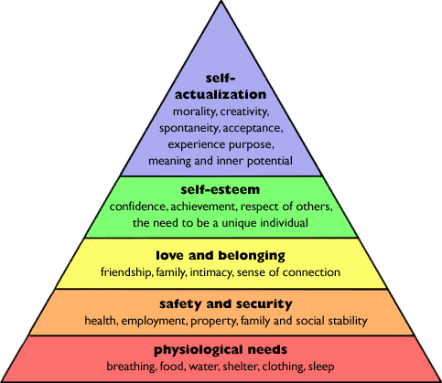

Slide 42
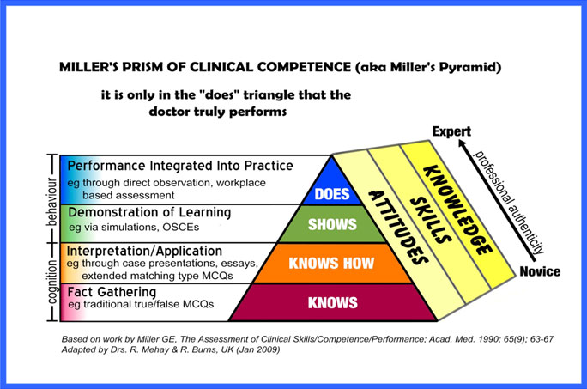

Slide 43
Useful interventions
Induction and preparatory work
Discuss their approaches to learning
Supervision and Support
Feedback on performance-good and bad
Correct performance problems as they occur
Encourage resilience

