Slide 1
Herts Urgent Care
GP Trainee Induction 2017

Slide 2
Aims of Session
GP OOH Training requirements and competencies
Progression of training
Trainee responsibilities
History of HUC
NHS 111 / OOH overview
OOH roles
Booking shifts
Overview of clinical system – Adastra
The patient journey through OOH.

Slide 3
GP OOH Training
Time Requirement
minimum one 6 hour session per month in GP posts.
Complete e-portfolio entry for each session and attach “record of OOH session” to demonstrate evidence.
Plan and book shifts early. Make sure they are evenly spread. Bear in mind new junior doctors contract requirements.
Notes:
Point one will depend on availability of OOH sessions.
At end of 4 month post 24 hours should be completed
At end of 12 month post 72 hours should be completed.

Slide 4
OOH Competencies
Care of acutely ill people:
Ability to manage common medical, surgical and psychiatric emergencies in the out of hours setting.
Understanding of the organisational aspects of NHS out of hours care.
Ability to make appropriate referrals to hospitals and other professionals in the out of hours setting.
Demonstration of communication skills required for out of hours care.
Individual personal time and stress management
Maintenance of personal security and awareness and management of the security risks to others.

Slide 5
OOH Competencies – Useful links
OOH GP Training: Guidance for GP Trainees
https://heeoe.hee.nhs.uk/sites/default/files/heeoe_ooh_training_guidance_for_trainees.pdf
Mapping of Out of Hours competencies to the GP curriculum and WPBA
RCGP - Mapping-of-Out-of-Hours-competencies.
Bradford VTS resources

Slide 6
Progression of Training
Traffic Light System:
Red Session – Direct Supervision - first 1-2 months in GP post. Usually observing or jointly consulting
Amber Session – Close Supervision months 3-5 of GP post
Green Session – Remote Supervision 6-18 months into GP post

Slide 7
Trainee Responsibilities
Booking and organising own OOH Shifts
To attend and work full shift. Non-attendance is a probity issue.
Minimum 2 weeks notice to cancel a shift.
Up to date BLS and safeguarding competence
Have nhs.net e-mail account
Bring smartcards and own equipment to shifts.

Slide 8
Who are HUC?
Not for profit organisation
HUC provides NHS 111 and Out of Hours services to the residents of Hertfordshire, Luton & Bedfordshire, Cambridge and Peterborough.
Call-handlers, clinicians and pharmacists within the 111 call centre
GP in call centre for refused ED dispositions and re-triage of green ambulances
Headquaters at Welwyn Garden City
Numerous primary care centres and visiting cars
Other services provided include:
Urgent Care Centres
GP-Led Health Centre
GP Practices
District Nurse call-handling

Slide 9
History of HUC
2007 – Herts Urgent Care founded, creating an urgent care social enterprise
2008 – Provided Out of Hours unscheduled care throughout Hertfordshire
2012 - Extended to include NHS 111 for Hertfordshire
2012 – Commenced providing an in-hours home visiting service for East and North Herts CCG
2013 – Provided NHS 111 service for Cambridgeshire and Peterborough
2016 – Commenced providing Integrated Urgent Care service for Cambridgeshire & Peterborough
2017 – Commenced providing Integrated Urgent Care service for Bedfordshire & Luton
2017- Commenced providing the Luton Town Centre Practice and Walk-in Centre
2017 – Commissioned to provide the new Integrated Urgent Care Service across Hertfordshire

Slide 10
Clinical Team
Clinical Leads for GP Trainees
Dr Rafid Aziz - rafid.aziz@hertsurgentcare.nhs.uk
Dr Yasmin Al-Sam –
yasmin.al-sam@hertsurgentcare.nhs.uk
For Clinical Queries:
Clinical.managementT@hertsurgentcare.nhs.uk

Slide 11
Clinical Resources Team
Hertfordshire 01707 385933
Luton & Bedfordshire 01707 384983
Cambridge & Peterborough 01707 385932
clinical.resources@hertsurgentcare.nhs.uk
bedfordshire.rotas@hertsurgentcare.nhs.uk
peterborough.rotas@hertsurgentcare.nhs.uk

Slide 12
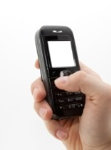
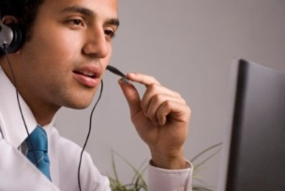
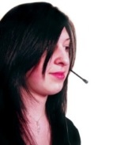
Overview of NHS 111
Caller dials 111
Caller dials their own GP out of hours
111
NHS 111 call handling team
GP
NHS 111 Clinical Advisor
Assessment
Transfer to Ambulance Service
999
Disposition
Self care advice
Electronic Directory of Services (DoS)
Crisis Response
Midwife
GP
ED
Pharmacy
GP OOH
UCC
WIC
Nurse
Intermediate care

Slide 13
Targets
Patient calls NHS 111 -> NHS Pathways assessment
Disposition reached (DX code)
Various timeframes from 20 minutes to several working days
Directory of Services then interrogated by NHS Pathways to highlight available services
Speak To and Face to Face dispositions
Following targets apply (Adastra supports monitoring)
Telephone triage
20/30/60 minutes
OOH base consultation
2 or 6 hours
Home visit
2 or 6 hours
Comfort Calling
Call to check no deterioration just before breach occurs
Courtesy Calling
Call to advise that doctor is en route to home visit and opportunity to check that no deterioration

Slide 14
Shift Roles
Telephone Triage/GP 111/MCAS
Base
Visiting
Redeye GP (overnight shifts)

Slide 15
Which shifts can be booked?
ST1 Trainees can book shifts on Monday – Friday evenings only.
ST2 Trainees can book shifts Monday-Friday evenings, Saturday, Sunday and Bank holidays PM only.
ST3 Trainees can book shifts anytime.

Slide 16
Booking shifts with HUC online Rotamaster
The website address is:
www.huc-online.com
Enter username and
password to login

Slide 17
HUC online Homepage

Slide 18
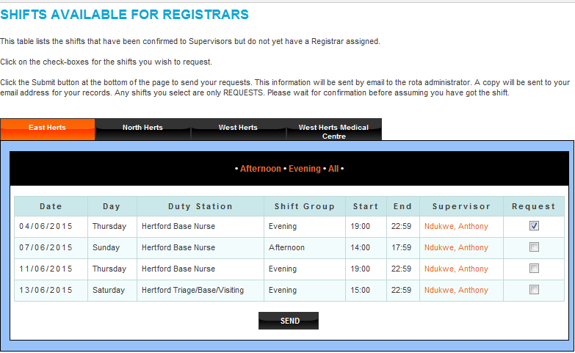
Booking shifts with a Trainer

Slide 19
Things you will need for shifts
NHS Smartcard
Own equipment - Stethoscopes, auriscopes, opthalmoscopes, tendon hammers, sphygmomanometers, thermometers.
Login details for Adastra

Slide 20
The Patient OOH Journey
Overview of Adastra
OOH consultation skills and practical advice

Slide 22
Before the Consultation
It is important to get in to the habit of making the following checks using a standardised approach before you telephone a patient, call them into the consultation room or go out onto the home visit
Patient demographics – 3 point check
Confirm patient identity
Number of contacts
In past few days, week, month
Medical History tab
Check this and complete it if not populated – helped with future consultations
Works with prescribing module and will flag interactions, allergies etc
Previous encounters
Valuable information regarding consulting behaviour, past medical history etc
Special Patient Notes (SPNs)
Reading these is mandatory, important info regarding end of life plans, safeguarding, violent patients, those seeking drugs of misuse etc

Slide 23
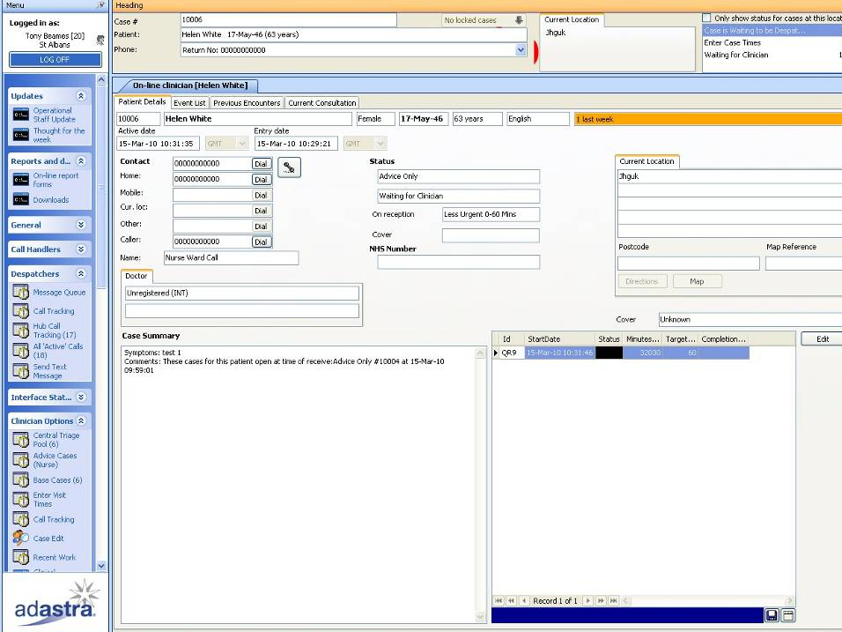
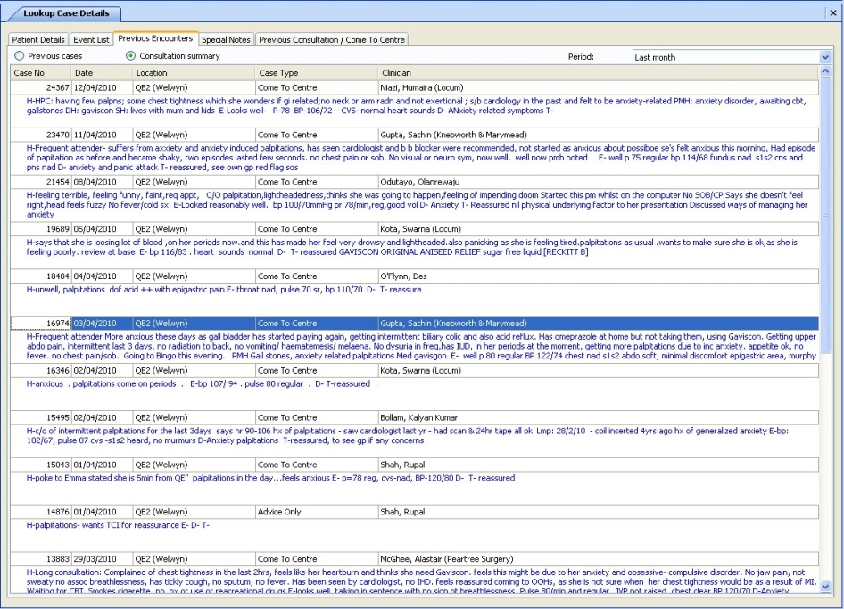
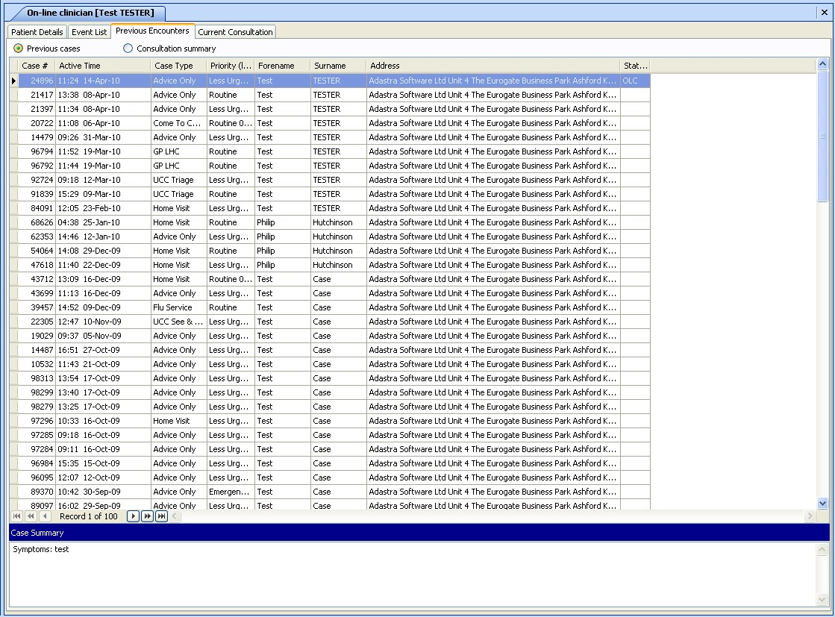

Slide 24
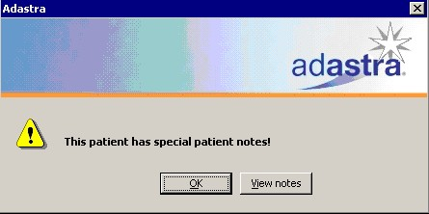
Special patient notes

Slide 25
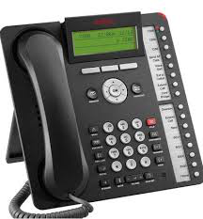
Telephone Triage Process
All cases are received via NHS 111
Pathways assessment is visible in Adastra record
Ensure that you review medical history, previous encounters and SPNs
All calls are recorded
State your name and role and check patient’s details (ensure check name, date of birth and first line of address)
Summarise the reason the patient called 111 to check understanding
Use silence and allow the patient to talk
Open questions then close down and EXCLUDE RED FLAGS
Ask about PMH/medications/allergies
Decide IF needs to be seen and if so WHEN (routine vs urgent)
OOH base appointment or home visit
If closing with advice then check patient’s understanding and agreement and record clear specific safety netting

Slide 26
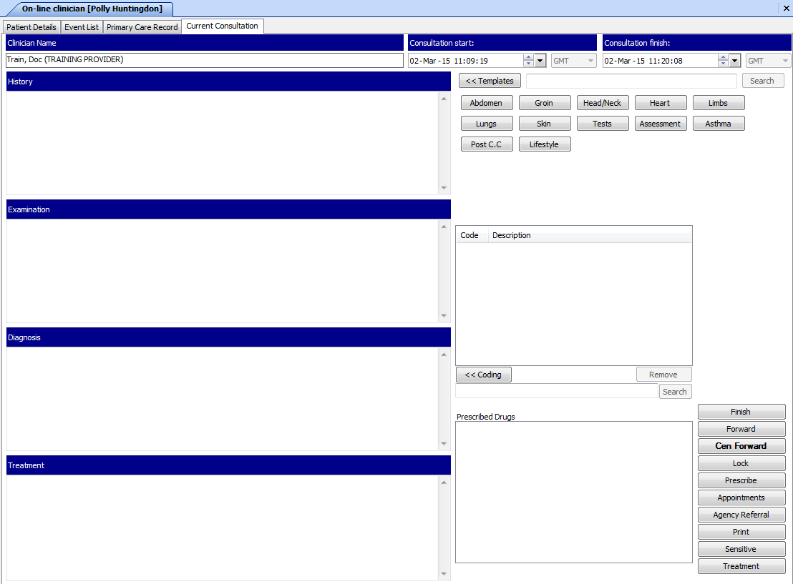

Slide 27
Telephone Triage Tips
ALWAYS speak to the patient if possible – be very careful with histories from relatives, paramedics etc
Be aware of patient’s ideas, concerns and expectations
Beware febrile chidren, rashes and abdominal pain
Do not jump to conclusions / diagnose too early
Make detailed notes
Always try and persuade patients who need a F2F consultation to come to base
BUT if they need to be seen and they refuse to come to the base they MUST be visited!
Resist telephone prescribing for new conditions – it is risky

Slide 28
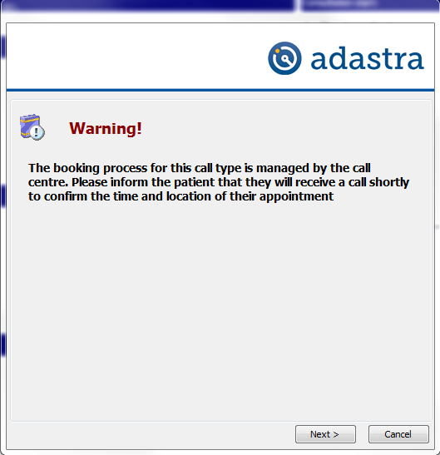
Booking a face to face appt/home visit

Slide 29
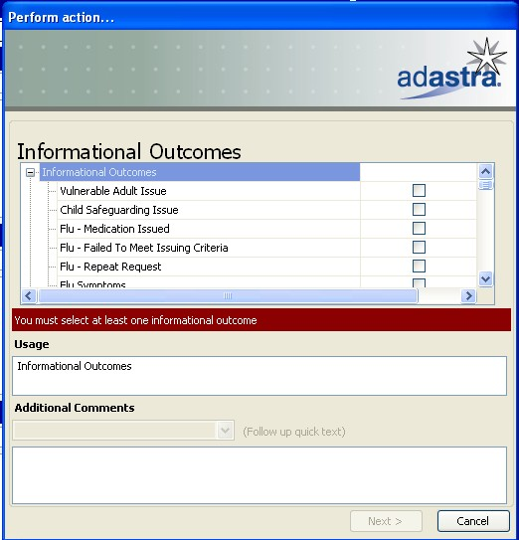
Finishing a case

Slide 30
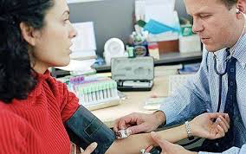
Face to Face appointments at urgent care centres
Traditional face to face consultations at base
Booked appointments and also walk in illness patients
Don’t be too relaxed in approach – there are still risks:
No access to medical records
No knowledge of the patient
Reliant upon the history obtained from the patient
A need to take the patient at face value
Keep detailed records
Significant negatives
Red flags
PMH/medications/allergies
Differential diagnoses
Management plan
Safety netting – timely and specific

Slide 31
Home visits
Reserved for patients who require a face to face assessment and who are:
Too unwell to come to the OOH (e.g. nursing home patient with SOB)
Immobile or bedbound (e.g. MS patient with UTI, housebound elderly patient with vomiting)
Palliative care
Unable to attend the OOH due to circumstances e.g. single mother with younger children etc
High risk mental health patient
Routine 6 hours
Urgent 2 hours
You will regularly be faced with patients who insist on a home visit
Negotiation and a rational discussion will be required including other methods of transport (public transport, friends and relatives etc)
BUT……..ultimately the clinical needs of a patient who requires a face to face consultation during the OOH period must come before any disagreement about their ability to come to base.
The OOH Visiting Service
Car and driver
ARemote
Medications
Equipment

Slide 32
Home visiting tips
Guidance on patient refusal/inability to attend base
Before offering a face to face consultation, clinicians should establish whether it necessary during the out of hours period.
If this is the case, then we would recommend that the patient is always seen, and that there is no retraction of this decision if transport is unavailable. As clinical responsibility for this patient rests with the assessing clinician, it is safer to undertake an occasional ‘unnecessary’ home visit than to deviate from safe clinical practice. This is particularly true when dealing with children and other vulnerable groups (those with complex needs, the elderly).
If you encounter a situation where you feel unhappy with a request to visit, or if you find yourself dealing repeatedly with a specific patient, then please contact the Urgent Care Clinical Lead to discuss further.

Slide 33
Home visiting – Other Strategies
Assure patients that a face to face will occur
Consider prefacing your suggestion of a face to face consultation (especially with parents of children) with the phrase “as you seem concerned we should see your child…”
Tell patients that although as clinicians we are always happy to visit patients in their homes, that this reduces the opportunities for other patients to be seen and it would be helpful (especially the housebound elderly and patients dying of cancer) if they could please come to base
Ask them to ring round their friends / relatives and see if they can find someone to drive them to base, but assure them that you will ring back within 30 minutes to see how they are getting on with this.
The call back must then be made

Slide 34
More tips for home visiting
Be careful about changing a colleague’s home visit decision or the priority (unless as part of a need to manage demand and prioritise cases)
Security – the triaging clinician should alert visiting GP to potential concerns, driver may be used as chaperone – if cannot assure GP safety then consider joint visit with police
NB mental health cases
Failed home visits – if a GP cannot make contact with a patient at a home visit and patient cannot otherwise be traced, must consider gaining entry by police

Slide 35
Failed Patient Contact
Policy used where unable to contact a patient by telephone and/or at a visit.
Clinicians should assess the information at hand to determine whether routine or urgent case.
General points for ALL cases if no answer on telephone:
Review previous encounters/calls to check whether any other numbers available
Contact 111 to check details correct
Contact LAS and local EDs to check whether patient has been transferred
Consider contacting next of kin/relatives

Slide 36
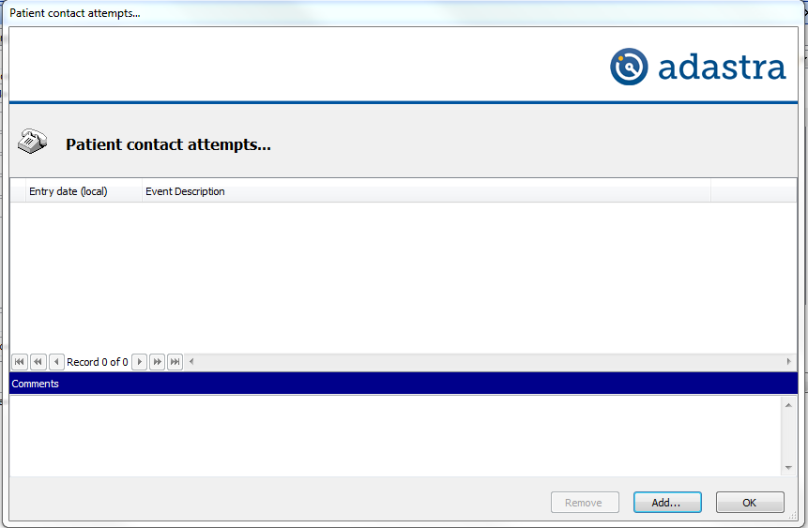
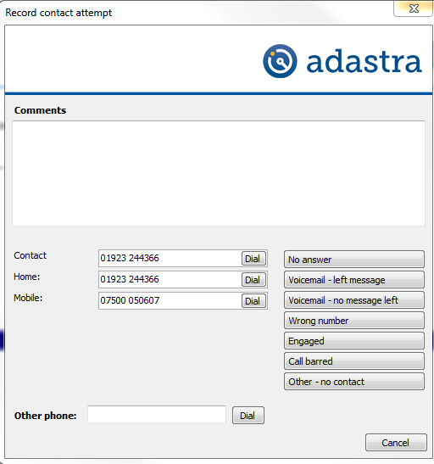
Logging a failed contact

Slide 37
Failed contact – Routine/Low risk cases
Make 2 attempts 20 minutes apart over one hour
Log each call on Adastra by pressing the telephone icon on patient demographics screen
If no contact risk assess case and either close case (e.g. leaving answerphone message with call back advice and document information to be passed to own GP) or pass for OOH visit

Slide 38
Failed contact – high risk cases
Make 3 attempts every 10 minutes for 30 minutes
Check telephone number by looking up previous calls, asking 111 to check number – note that you have done this
Check whether patient has contacted LAS and contact local hospitals
If still unable to contact patient pass for urgent visit
If not able to contact patient at the address contact police to gain entry in light of urgent priority
GP to remain at address until police arrive

Slide 39
Did not attend
Where patients are > 60 minutes late for their booked appointment the case will return to the GP callback list to be contacted to check on well-being
GP telephones patients and assesses
If patient declines appointment (e.g. states that they are better) GP to document this and close case
Otherwise if patient wishes appt or GP advises that it is clinically necessary appropriate appt is booked

Slide 40
Finishing a case

Slide 41
3 Strike rule
This policy is aimed at reducing the risk to patients associated with repeated contacts with healthcare services and ensuring that deteriorating clinical conditions are detected and acted upon appropriately
The Principle
Any patient who has made 3 or more contacts with a Healthcare Professional (not only OOH GP) during an acute episode of illness by telephone OR face to face must be seen face to face in OOH
This can be at the base or by home visit
There should be a low threshold for onward referral / admission
Exceptions
Patient refusal (must document clearly)
Where contact is part of a pre-agreed management plan or follow-up
Extenuating circumstances e.g. hoax caller

Slide 42
Special scenarios
Out of Hours

Slide 43
Confirmation of death
Police Doctor: 101
First a reminder:
Certify complete a death certificate (OOH has no role)
Confirm confirm that life is extinct but not the issuing ofa death certificate (OOH has a role)
Was death expected?
An expected death may be defined as death which follows a period of illness which had been identified as terminal and where no active life prolonging treatments are in place or planned
Expected deaths at home
Unless a community nurse or other appropriate healthcare professional is available then the OOH GP should visit the patient to confirm death. This should be done on a routine basis but as soon as practically possible. This situation should be handled very sensitively.
Expected deaths at Nursing & Residential Homes
Residential Homes - required to call in a community nurse or the Out of Hours service to verify death. Where a call is made to OOH via 111 then a GP visit should be undertaken.
Nursing Homes - may have staff on duty who have been appropriately trained and who are deemed competent to verify death and can do so. In the event that there is no appropriately trained staff on duty the OOH GP should visit to confirm death

Slide 44
Prescribing for OOH patients
Basic principles
For patients with a booked appointment at the OOH following GP triage all prescribing is to be completed on an FP10
Medications from stock will be permitted only when pharmacies are closed
Please pay attention to National and Local prescribing guidance e.g. local anti-microbial guidance
Do not lower your threshold for prescribing – prescribe only if a clear indication to do so
Medications should be prescribed generically
Patients should be encouraged to obtain over the counter products from the pharmacy

Slide 45
Record keeping of Prescriptions
Past medical history, medications and allergies must be recorded (preferably on the Medical History tab)
Prescriptions must contain correct dosage instructions and quantity
Handwritten prescriptions to be used only when IT fails
Prescribing module in Adastra must ALWAYS be used – never free text

Slide 46
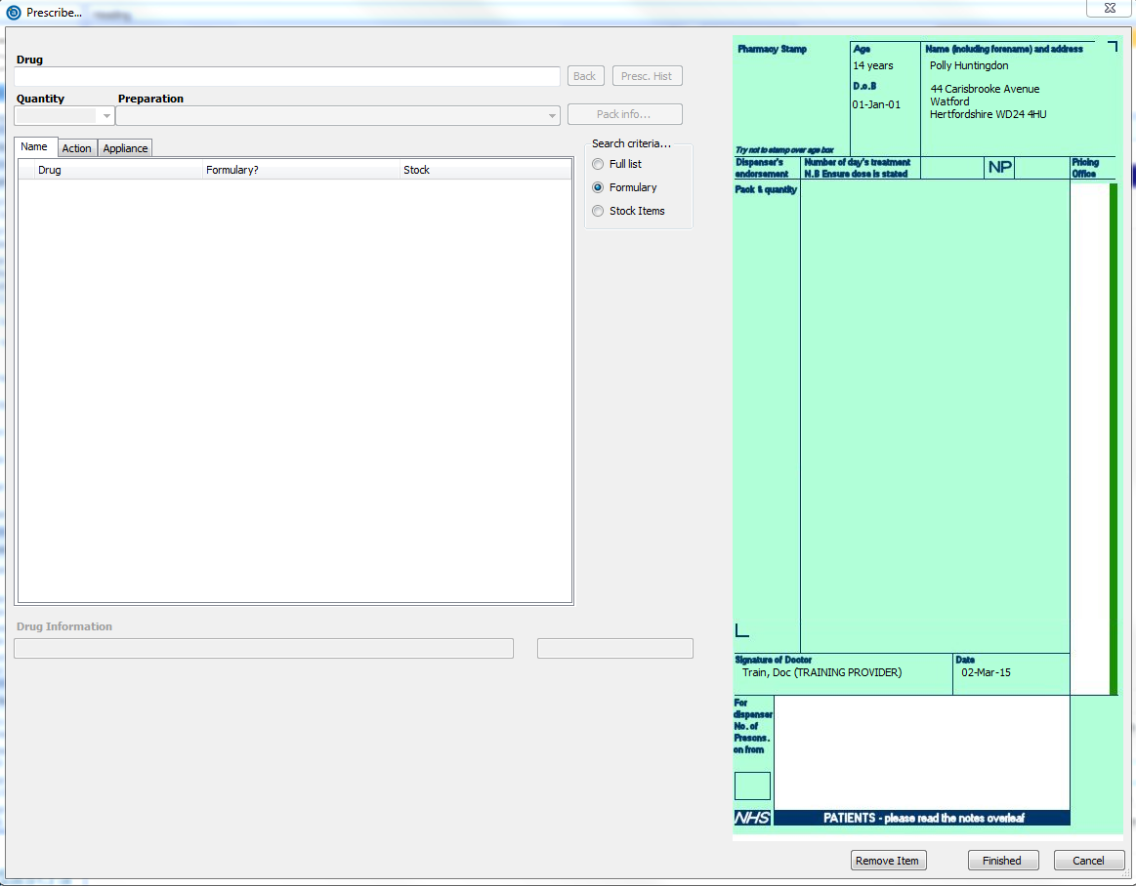
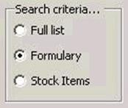
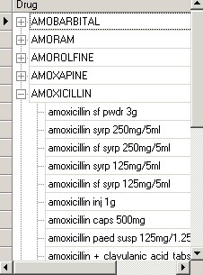
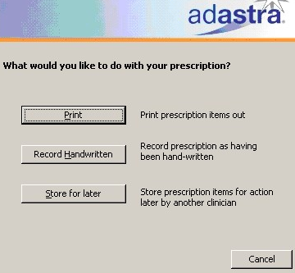
Finish
Forward
Cen Forward
Lock
Prescribe
Appointments
Agency Refferral
Print
Sensitive
Treatment

Slide 47
Acute prescriptions
Complete courses to be prescribed
Analgesia – pay attention to analgesic ladder and be wary of opioids in opioid naïve patients
Maximum 7 day supply unless otherwise indicated (e.g. penicillin in scarlet fever)
No methadone or Subutex to be prescribed under any circumstances
Maximum 3 days supply low dose diazepam e.g. 2mg qds for 3 days

Slide 48
Personally administered drugs
Patients may occasionally need PA drugs
The drug name, dose, batch number, expiry date, route of admin, site of admin and time and date of admin must all be recorded
FP10REC must be completed

Slide 49
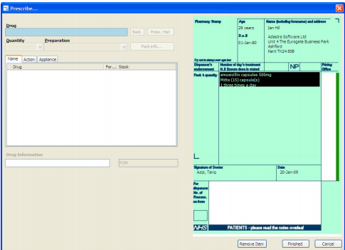

Slide 50
Repeat prescriptions
Frequent occurrence; many requests are genuine e.g. lost or forgotten meds or delayed scripts; others are for convenience or even fraudulent
Going forward most repeat prescribing will be handled by the Pharmacist in 111
In the first instance, clinicians are advised to suggest to patients that it may be possible to contact their usual pharmacy for an emergency supply
If patient unable / unwilling to comply:
Assess the immediate clinical need for a prescription to be issued
Establish the patient’s current medical condition, current medications, previous history, and allergies.
Check SCR
Ensure that you are happy that request is consistent with the history
Prescribe the minimum amount necessary for the patient, to cover until they can contact their own GP/original prescriber
Resist faxing prescriptions unless absolutely necessary –If a prescription is faxed, the prescriber must write the name and branch of the pharmacy in the top left of the prescription and FP10 must be posted and received by pharmacy within 72 hours CD prescriptions are not to be faxed
Faxed prescriptions should be preceded by a telephone call to the pharmacy to ascertain that they will be open when the patient arrives, that the fax is working and that they have the appropriate stock to deal with the request.

Slide 51
Telephone Prescribing and faxing scripts
Telephone Prescribing – Acute
This must be avoided
High risk – serious incidents have resulted
Only exception is a simple uncomplicated lower UTI
Rules regarding faxing still apply
Telephone Prescribing – Repeat
The prescribing clinician must be satisfied that the history given by the patient is consistent with the repeat prescription request (e.g. check previous encounters, look for previous prescriptions etc)
If satisfied then may be prescribed for collection
If not satisfied or not happy to prescribe on telephone (e.g. opioid analgesia, CD etc) then to book for F2F appointment in OOH and patient to bring repeat slip, empty box, other evidence
Maximum 7 days
Faxing of Prescriptions
Ideally patients or their friends / relatives should be encouraged to collect their prescriptions
A repeat medication slip, empty box or other evidence should be brought when collecting prescriptions
If clinician is satisfied about indication, is happy to prescribe and script cannot be collected then they may decide to fax – see next page

Slide 52
Faxing Prescriptions
Faxing is a last resort
Prescribing clinician is responsible
Indications for script to be clearly documented in notes
FP10 to be printed
FP10 is then faxed to one of the safe haven pharmacies only
Pre-programmed fax numbers ONLY to be used – no manual keying in of fax numbers
Nominated pharmacy is telephoned in order to confirm receipt of prescription
FP10 is put in envelope with pharmacy’s postal address – to be posted next day

Slide 53
Controlled drugs/Drugs liable to misuse
Methadone and Subutex are NOT to be prescribed
Exercise caution when assessing requests for controlled drugs, or those liable to misuse (such benzodiazepines, dihydrocodeine, methylphenidate, tramadol, mirtazapine and olanzapine).
Given the difficulty in confirming the prescription details out-of-hours, and the higher likelihood of deception, we advise that such prescriptions are not given.
Exceptions must be clearly documented, or where clear clinical need can be demonstrated through the patient notes e.g. palliative care patients.
Prescriptions for medicines that are liable to misuse SHOULD NOT be faxed unless there are documented exceptional circumstances.
Patients or carer should be asked to collect such prescriptions from their local base with some proof of their identity and address corresponding to the details taken by the call handler. Where it is necessary to fax a prescription the pharmacy should be advised to confirm the collector’s identity as well.
Lost/Stolen prescriptions must be replaced only in exceptional circumstances – max 3 days supply

Slide 54
Abnormal Lab results
Occasionally abnormal lab results will be called through to the Out of Hours via NHS 111 as per their protocol. Note that NHS 111 will not take the actual result but instead the call will be passed to the OOH for a GP to call back
When calling back the lab it is important to obtain:
Latest result
Any previous results
E.g. creatinine 320 now but 300 six months ago
Clinical details / past medical history
E.g. raised blood glucose called through but patient known Type 2 diabetic
Confirm patient contact details
Contact made with patient
Introduce yourself and explain why calling as patient usually not expecting the call
Complete a normal telephone consultation based on the result from the lab and decide upon closure with advice and follow-up, consultation at OOH base, home visit or hospital admission (e.g. little to be added by visiting a patient with a potassium of 7.5 – admit)
No contact made with patient
Follow failed contact guidance

Slide 55
Questions?
Thank you for listening

