Slide 1
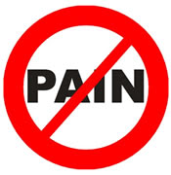
Managing chronic non-malignant pain in primary care
Dr Lorraine de Gray
Lead Consultant in Pain Medicine, QEH
Chair, UK Regional Advisors in Pain Medicine,
Faculty of Pain medicine, Royal College of Anaesthetists

Slide 2
What is pain?
‘An unpleasant sensory and emotional experience associated with actual or potential tissue damage and expressed in terms of such damage’ IASP 2001
‘Pain is inherently subjective……a patient’s self-report is the gold standard for assessment’ Portenoy 1999
Notes:
There have been many definitions of pain but probably the most commonly used is that of the International Association for the Study of Pain,¹ which emphasises both sensory (nociceptive) and emotional (suffering) factors and is sufficiently broad to encompass the diverse aspects of the pain experience.
1 Merskey H. Classification of chronic pain: description of chronic pain syndromes and definition of pain terms. Pain 1986; Suppl 3: S1–225.

Slide 3
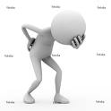
Put more simply:
“ Pain is what the person feeling it says it is”.

Slide 4
Influences on the pain experience
Age
Fears
Gender
Pain
Education and understanding
Culture
Previous pain experience (self/family)

Slide 5
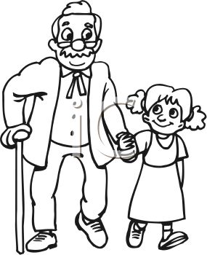
Incidence
Nearly one in seven people suffer from chronic pain and 20% have suffered for more than 20 years.
It is hardly surprising that people suffering from chronic pain consult their doctor up to five times more frequently than others. This results in nearly 5 million GP appointments a year.

Slide 6
Of all people consulting in primary care over a one year period approximately 30% of people attend for help with pain, half of these contacts are about chronic or recurring pain and two thirds are about musculoskeletal conditions.

Slide 15
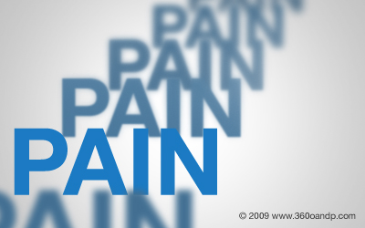
Objectives of Chronic Pain Management
Alleviate pain
Alleviate psychological and behavioural dysfunction
Reduce disability and restore function
Rationalize usage of medicines
Reduction of utilization of health care services
Attention to social, family and occupational issues

Slide 16
Invalidism
Sick leave
Chronic
Avoidance
The Pain Ladder
Depression
Weiser, 1997-1999), Main 2000
Helplessness
Failed treatment
Anger &blame
Catastrophising
Uncertainty & fear
Acute

Slide 17
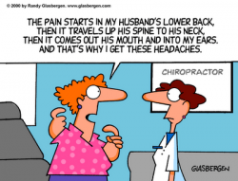

Slide 18
Treatment in the Primary Setting
Pain can be successfully managed in many patients by the use of simple assessment scales of the pain itself
Assessment of both physical and psychological functional impairment
Medication and non-medication treatments coupled with an idea of the patient’s goals for the end of treatment.

Slide 19
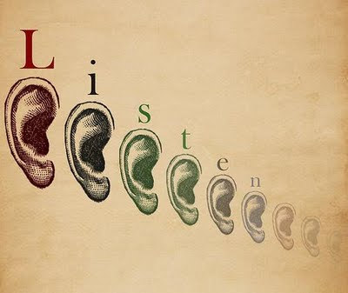
Best tool

Slide 20
Why Does
The Patient
Hurt?

Slide 22
RED FLAGS
Gross neurology
Sphincter disturbance
Saddle anaesthesia
Up going planters
Weight loss
History of malignancy
Recent significant trauma
Severe thoracic back pain
Severe bilateral leg pain
Spinal deformity
Severe constant night pain
Gait disturbance
Fever or night sweats

Slide 23
YELLOW FLAGS
Personal
Fear avoidance
Pessimism depression, expressed stress, anger and sometimes sleeplessness
Illness behaviour and adoption of the sick role
Passivity (external locus of control)
Helplessness
Tendency to see pain in a catastrophic light
Family: beliefs, expectations, reinforcement
Work: job satisfaction, difficulty working with pain, flexibility of employer, work options
Non-health problems (financial, marriage?)
Mobility and function
Hobbies and pleasures. Restrictions

Slide 24
Basic investigations
Full blood count, ESR, CRP, Bone profile, PSA
OA vs Autoimmune/inflammatory arthritis: Rheumatoid Factor, Uric acid, dsDNA, antiCCP antibodies, ESR, CRP
Neuropathy: Thyroid function test, Vitamin B12, Folic Acid, Liver function including gamma GT, FBC, Blood Glucose, consider nerve conduction studies
X-Rays ???

Slide 25
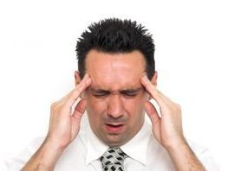
remember
“If you can’t explain why the patient has pain it does not mean the pain is not real”

Slide 26
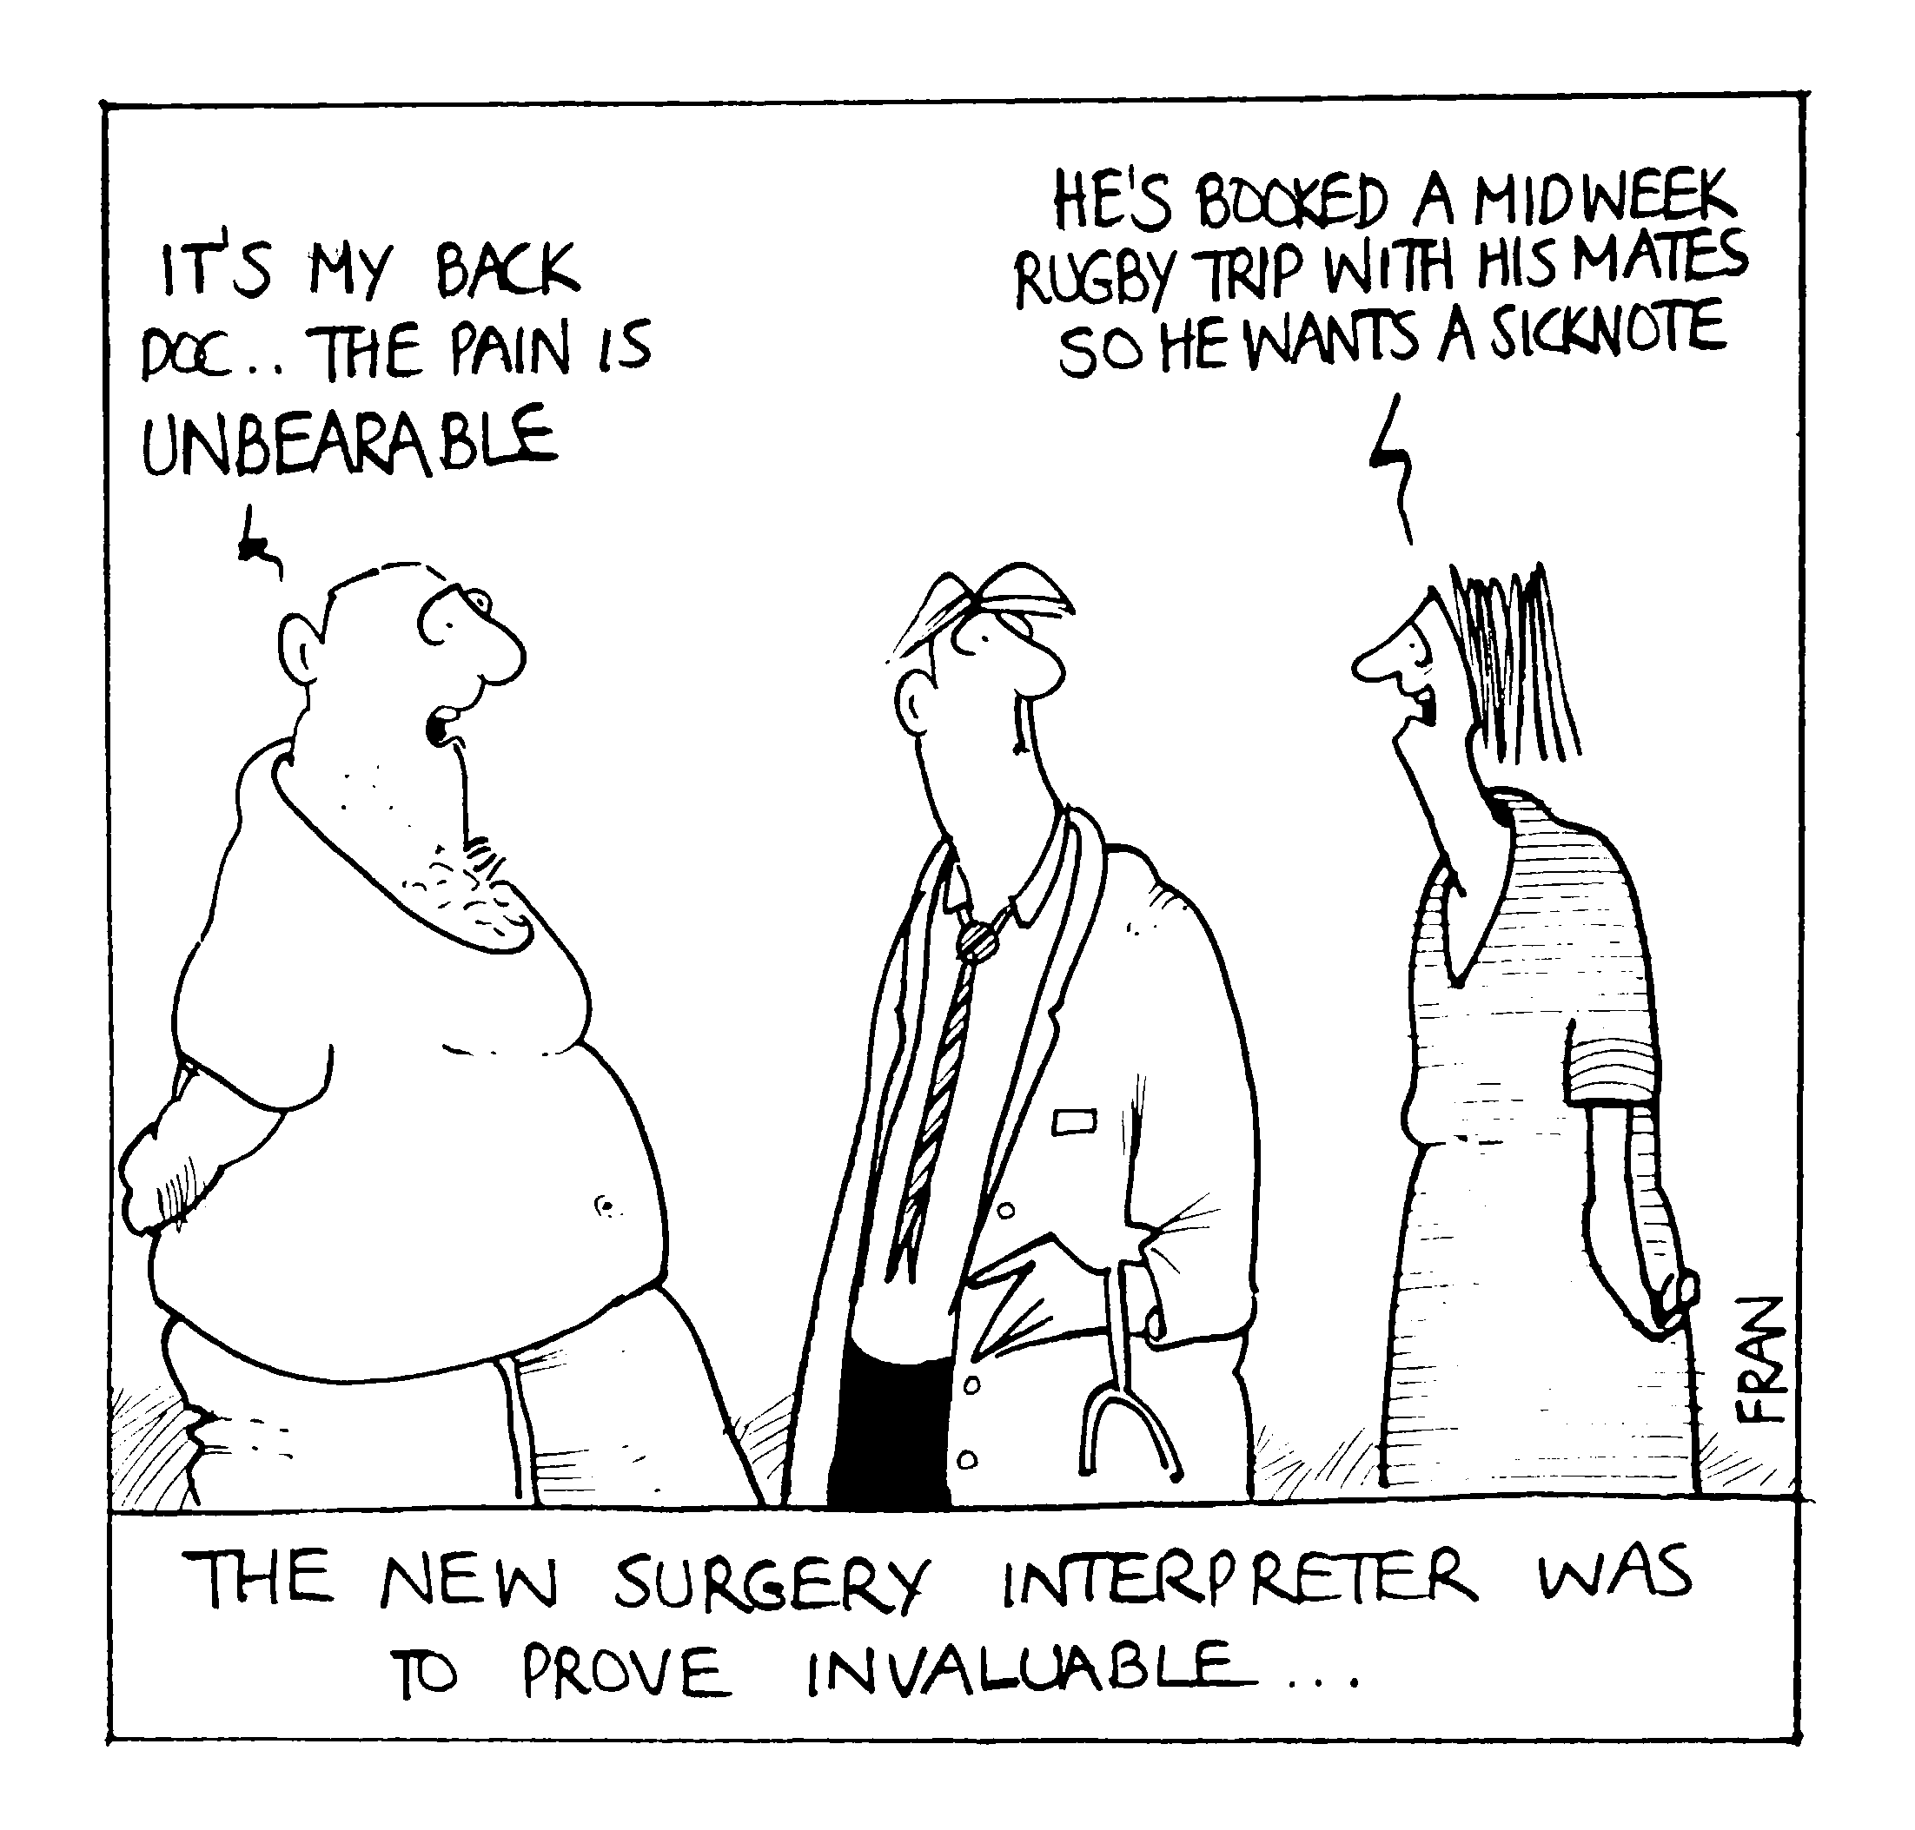
“How do you spot the malingerer?”

Slide 27
HOLISTIC APPROACH
Listen, explain, educate, motivate
Medication
Physiotherapy
Occupational Therapy
TENS
Acupuncture, osteopathy, and other alternative therapies
Supporting Services
Psychology
Mental Health Services
Intervention therapy

Slide 28
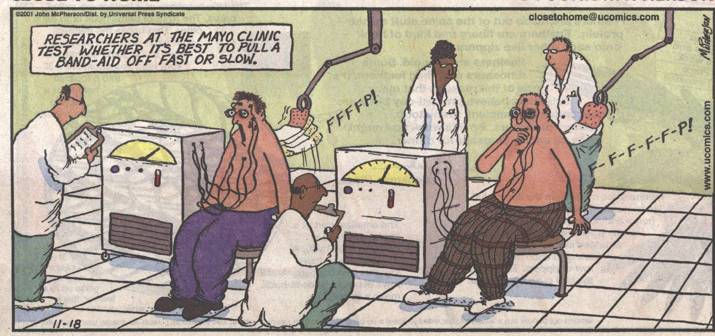
How do we measure pain?

Slide 29
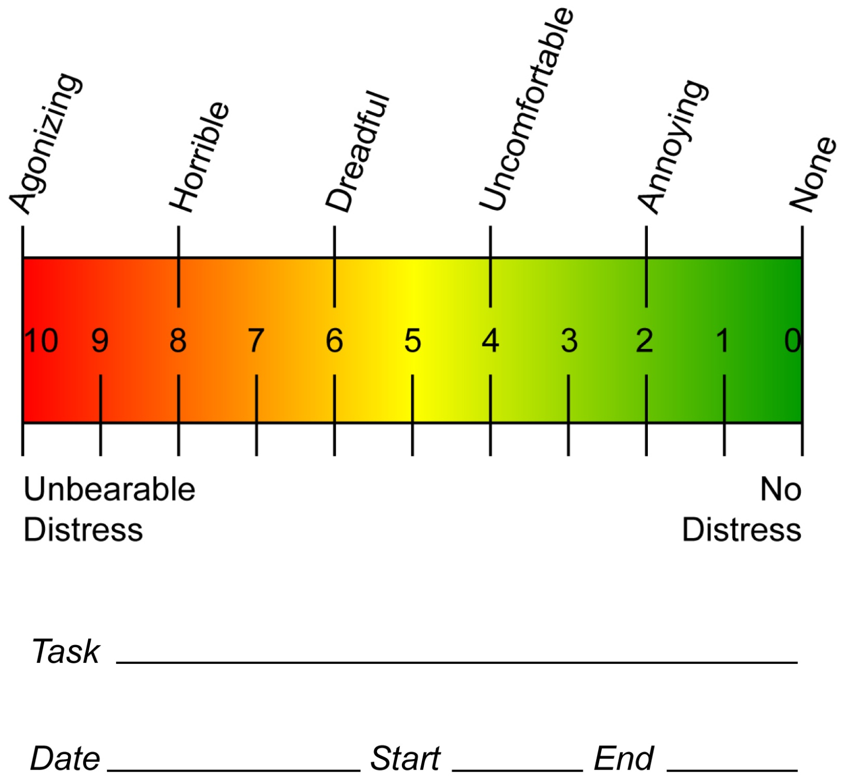

Slide 30
Useful measures
Hospital Anxiety and Depression Scale or PHQ 9
Brief Pain Inventory
SF 36

Slide 31
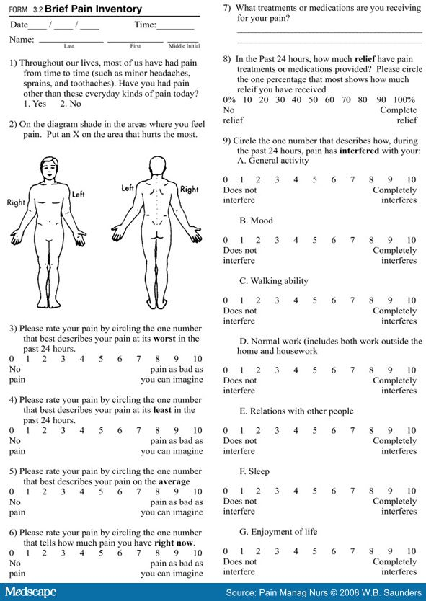

Slide 32
Nociceptive pain
Caused by an injury that stimulates pain receptors
Arises from continuing inflammatory damage
Is pain related to disease, surgery, trauma, arising from body tissue

Slide 33
What is neuropathic pain?
Neuropathic pain develops as a result of damage to, or dysfunction of, the system that normally signals pain.
It may arise from a heterogeneous group of disorders that affect the peripheral and central nervous systems.

Slide 34
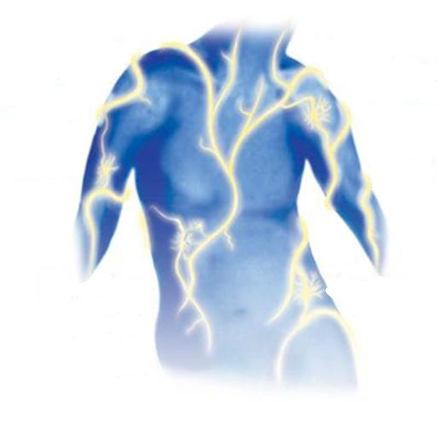
Symptoms of Neuropathic Pain
Stabbing
sensation
Stabbing
sensation
Electric
shock-like
sensation
Electric
shock-like
sensation
Pins and
needles
sensation
Pins and
needles
sensation
Numb
sensation
Numb
sensation
Throbbing
sensation
Shooting
sensation
Throbbing
sensation
Shooting
sensation
Burning
sensation
Burning
sensation
Notes:
PURPOSE OF THE SLIDE
To discuss that neuropathic pain can be clinically experienced in a variety of sensations and symptoms.
Figure: http://www.nepknowmore.ca/en/idpain_self_assess_tool
1/21/2014
34
Pathophysiology of Pain

Slide 36
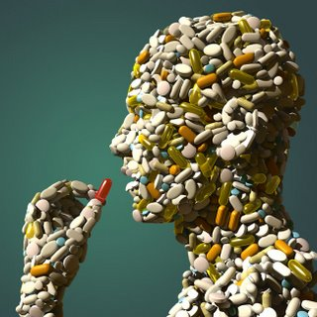
“Thou shall not fill me up with tablets”

Slide 37
When selecting pharmacological treatments, take into account:
• the person’s vulnerability to specific adverse effects because of co-morbidities or age (for example, vulnerability to falls)
• safety considerations and contraindications
• patient preference
• lifestyle factors (such as occupation)
• any mental health problems (such as depression and/or anxiety)
• any other medication the person is taking.

Slide 38
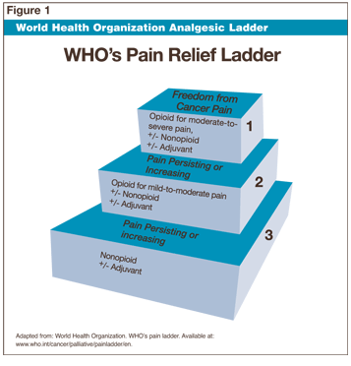
Medication for nociceptive pain

Slide 41
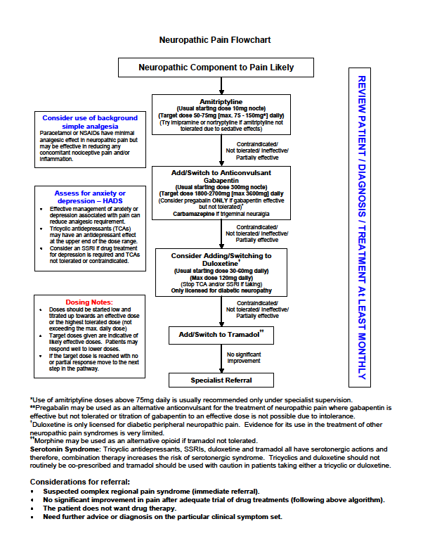

Slide 42
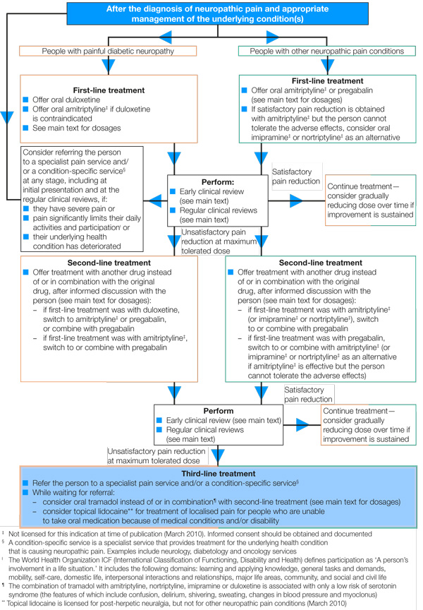

Slide 43
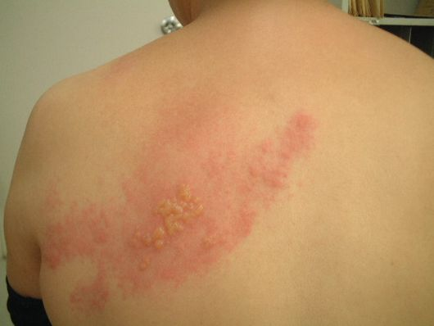
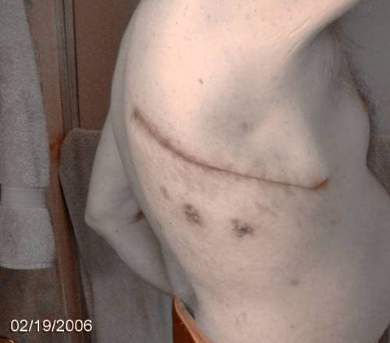
Topical treatments for localised neuropathic pain
Capsaicin 0.025% or 0.075% cream
Dimethylsulphoxide DMSO 50% cream
Lidocaine 5% plasters (Versatis)
Aspirin in Chloroform
Capsaicin 8% patch (Qutenza)

Slide 44
Tricyclic antidepressants
Unlicensed but recommended in NICE guidelines
Relieves neuropathic pain - this effect is independent of mood elevation.
Nortriptyline v Amitriptyline
More expensive but less side effects

Slide 46
NORTRIPTYLINE
Once daily at around 7pm:
Week 1 – 2: 10mg
Week 3 – 4: 20mg
Week 5 – 6: 30mg
If better continue
If not tail off over one week.

Slide 47
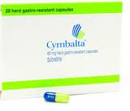
DULOXETINE
30mg once daily in the morning for two weeks
Increase to 60mg once daily
Reassess after 6 – 8 weeks for response. If none, or could improve further:
Increase to 60mg bd in two incremental steps

Slide 48
Anticonvulsant drugs
Gabapentin – structurally related to Gamma Amino butyric acid (GABA) – binds on the presynaptic neurone, reducing calcium flux
Pregabalin - higher potency and cost effectiveness than Gabapentin
Topiramate – potentiates GABA, modulates Sodium gated channels
Lamotrigine and Oxcarbazepine inconsistent effectiveness
Carbamazepine worth considering for trigeminal neuralgia

Slide 49
Gabapentin
 | MORNING | MID-DAY | EVENING
Day 1 - 6 | 0 | 0 | 300mg
Day 7 - 13 | 300mg | 0 | 300mg
Day 14 – 20 | 300mg | 300mg | 300mg
Day 21 – 27 | 300mg | 300mg | 600mg
Day 28 – 34 | 600mg | 300mg | 600mg
Day 35 onwards | 600mg | 600mg | 600mg
 | Stay on | this | dose

Slide 50
Pregabalin
.
 | MORNING | EVENING
DAY 1 TO 3 | NIL | 50MG
DAY 4 TO 6 | 50MG | 50MG
WEEK 2 | 50MG | 100MG
WEEK 3 | 100MG | 100MG
WEEK 4 | 100MG | 150MG
WEEK 5 | 150MG | 150MG
This table is simply a guide. If you find that you are very sensitive to the sedative side effects, that is the drugs makes you very sleepy by day, you may increase the dose at an even slower rate. Note that Pregabalin comes in different size tablets (including 25mg, 50mg, 75mg, 100mg and 150mg). Although 150mg twice a day is a commonly used dose, the drug can sometimes be prescribed in even larger doses. However do NOT increase the dose any further without seeking medical advice first.

Slide 51
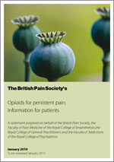
Problems with long term opiates

Slide 52
Which opiate to choose?
Transdermal Buprenorphine
Good tolerability profile – stepping stone to stronger opiates
Safe in the presence of renal impairment
Fentanyl
Useful in renal impairment
Widespread lack of appreciation of strength of Fentanyl
Morphine
Undoubtedly effective, level 1b evidence
Beware in renal impairment, active metabolite quickly accumulates
Less constipation
Less effect on testosterone
Lowest patch strength inappropriate for opiate naive patient
Familiar drug for most physicians enhances its safety

Slide 53
Which opiate to choose?
Oxycodone
Well tolerated
Targinact (oxycodone/naloxone)
Methadone
Narrow therapeutic window
Difficult to titrate
Tapentadol
Mu opiate uptake inhibitor
Norepinephrine reuptake inhibitor
Effect on NMDA Receptor

Slide 54
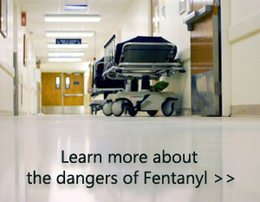
Fentanyl morphine equivalent
Fentanyl 12 = Morphine 45mg per day
Fentanyl 25 = Morphine 90mg per day
Fentanyl 50 = Morphine 180mg per day
Fentanyl 75 = Morphine 270mg per day
Fentanyl 100 = Morphine 360mg per day

Slide 55
When is it appropriate to prescribe opiates?
What should we be telling patients before we prescribe them?
“Informed consent”
Patient contract
Is it a one way road?
Alarm bells

Slide 56
When is it appropriate to prescribe opiates?
Patient has pain that is uncontrolled by alternative treatments
Malignant pain
Pain associated with life limiting disorders
Acute non-malignant pain
Chronic non-malignant pain

Slide 57
What should we be telling patients before we prescribe opiates?
http://www.britishpainsociety.org/pub_patient.htm

Slide 58
Alarm bells
Past history of alcohol or drug misuse
History of depression and anxiety
Challenging psychosocial background
Prescriptions run out before they should
Lost tablets, dropped my bottle, threw it by mistake in the recycling bin

Slide 59
Common side effects
Nausea, vomiting, constipation
Sedation, cognitive impairment
Sweating, anti-cholinergic side effects
Dependence, tolerance
Muscle rigidity and hyper- locomotion

Slide 60
Less well known (but still common) side effects
Opioid induced hyperalgesia
Effect on the immune system
Hormonal side effects

Slide 61
Effect on the immune system
Morphine can decrease the effectiveness of several functions of both natural and adaptive immunity, and significantly reduces cellular immunity.
Morphine is consistently associated with increased morbidity and mortality due to infection and worsening of cancer.
Not all opiates have the same effect. Buprenorphine is the most devoid of immunosuppressant activity.

Slide 62
Palliative Medicine 2006; 20: s9/s15 Opioids and the immune system, Paolo Sacerdoti
Opioids can be divided into
those that are immunosuppressive, such as codeine, methadone, morphine and remifentanil, fentanyl and
those that are less immunosuppressive, including buprenorphine, hydromorphone, oxycodone and tramadol.

Slide 63
Effect on the HPA
Morphine increases Serum Prolactin and Growth Hormone
It significantly decreases LH and TSH
This leads to low Testosterone levels in men associated with erectile dysfunction, loss of libido and osteoporosis
In women this can lead to abnormal menstruation, low fertility

Slide 64
Opioid induced hyperalgesia
Patients receiving opioids to control their pain somewhat paradoxically may become more sensitive to pain as a
direct result of opioid therapy.
Upregulation of compensatory pronociceptive pathways
Anesthesiology 2006; 104:570–87
Opioid-induced Hyperalgesia
A Qualitative Systematic Review
Martin S. Angst, M.D., J. David Clark

Slide 65
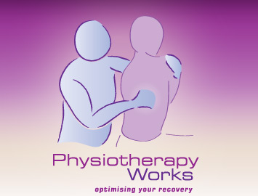
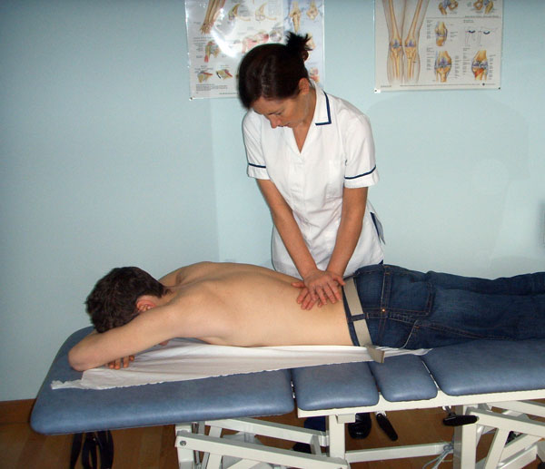
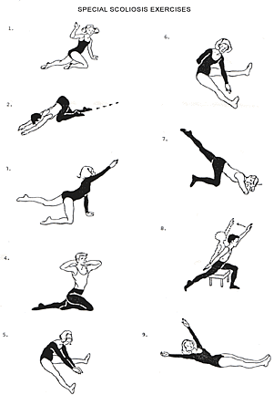
PHYSIOTHERAPY

Slide 67
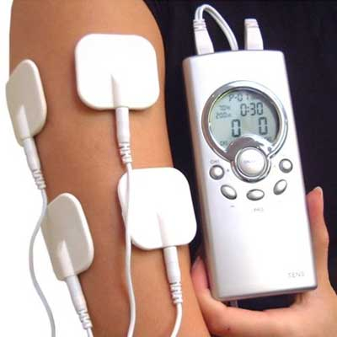
TENS – transcutaneous electric nerve stimulation

Slide 69
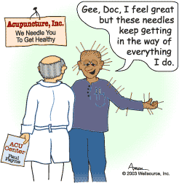

Slide 70
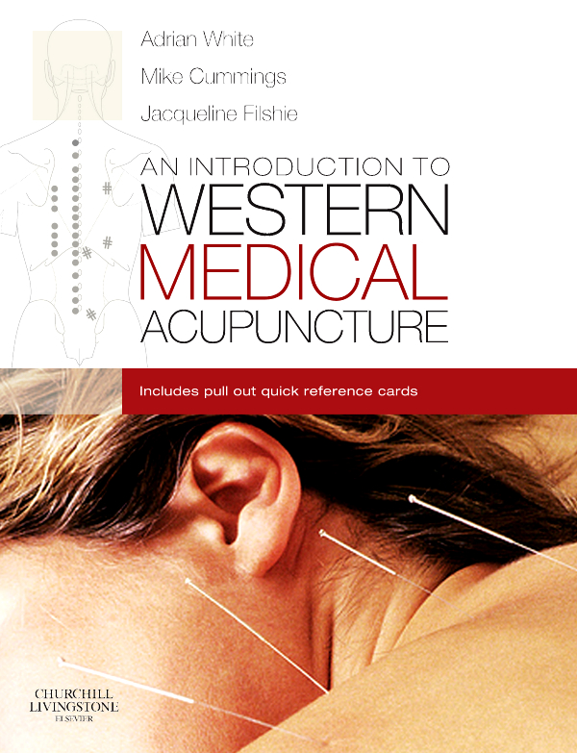

Slide 71
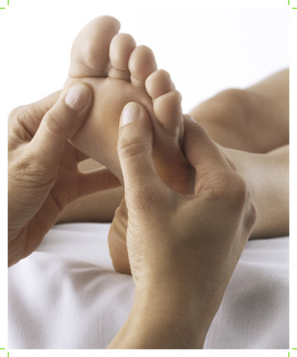
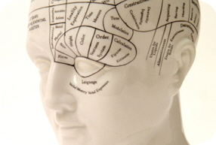
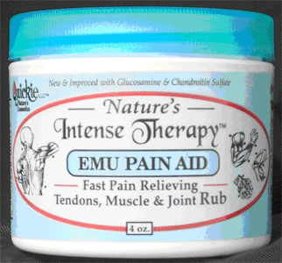
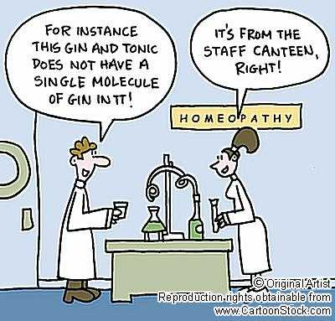
COMPLEMENTARY THERAPY

Slide 72
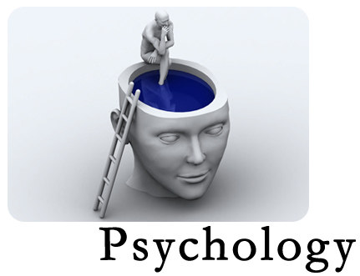

Slide 73
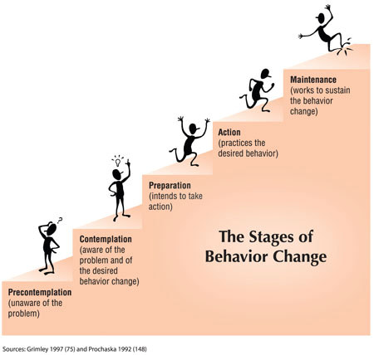
THEORETICAL MODEL OF CHANGE

Slide 74
CATASTROPHIZERS
HUGE PAIN BEHAVIOUR

Slide 75
Aims of the psychological assessment
History – social and of pain
Beliefs – about pain, self, others, etc
Outlook – levels of motivation, realism, etc
Previous coping styles
Patterns of behaviour
Social support
Values/culture
Goals, aims and expectations

Slide 76
Motivational interviewing
Simply giving patients advice to change is often unrewarding and ineffective
Motivational interviewing uses a guiding style to engage with patients, clarify their strengths and aspirations, evoke their own motivations for change, and promote autonomy of decision making
You can learn motivational interviewing in three steps: practise a guiding rather than directing style; develop strategies to elicit the patient’s own motivation to change; and refine your listening skills and respond by encouraging change talk from the patient
Motivational interviewing has been shown to promote behaviour change in various healthcare settings and can improve the doctor-patient relationship and the efficiency of the consultation

Slide 77
Motivational interviewing
Rollnick S, Miller WR, Butler C.
Motivational interviewing in health care: helping patients change behavior. 2008
Motivational interviewing in health care: preparing people for change. 2002
BMJ 2010, 340, c1900,
Motivational Interviewing,
Rollnick et al

Slide 78
The Pain Cycle
Notes:
Mood, beliefs about pain and coping style affect adjustment to chronic pain.
The initial cause of the pain is physical, but psychological factors play a role in progression to disability and distress.
When pain continues over time a person may avoid regular activities due to fear of further injury or increased pain. This includes stopping work, social activities and hobbies.
As the person withdraws and becomes less active, their physical condition declines and their weight may be affected. This contributes to the development of the belief that they are disabled.
As this continues they may develop negative beliefs about their pain e.g. “I can’t do anything”, “This will never get any better” and negative thoughts about themselves “I’m no use to my family because I can’t work”, “My friends won’t want to see me because I am too miserable”.
These thoughts, along with withdrawal from fulfilling and rewarding activities can cause a person to feel withdrawn and depressed. The distress side of the diagram and the cycle continues.

Slide 79
PSYCHOLOGICAL THERAPY
CBT will involve teaching and encouraging practice of adaptive pain coping skills such as relaxation skills, activity pacing, and positive self-statements, among others.
Acceptance and Commitment Therapy
Mindfulness
Hypnotherapy

Slide 81
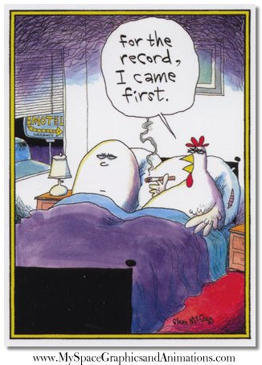

Slide 82
Referral to mental health services
IAPT - Lincolnshire
Well Being Service - Norfolk
Agenoria House - Cambridgeshire

Slide 83
Consider referral to
Social Services for practical help such as perching stools, re-housing, home assessments/aids (occupational therapy involvement)
Asking patients to use services such as Citizens Advice Bureau for financial, welfare support etc
Blue badge application
Care line application
Local gyms
Weight reduction support groups

Slide 84
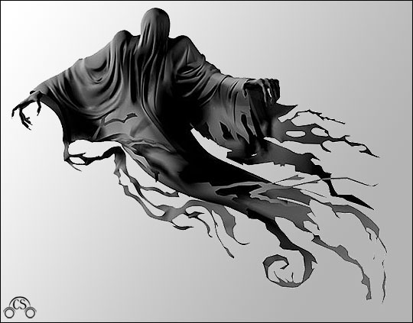
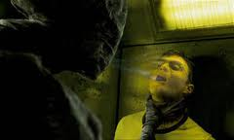

Slide 85
Treatment at secondary level
Some patients with complex pain and psychosocial problems may require much more in-depth assessment and treatment and will need to be referred to secondary care.

Slide 86
Consider referring the person to a specialist pain service if
• they have severe pain and/or
• their pain significantly limits their daily activities and participation
.

Slide 87
Referral Criteria
We are in general happy to see any patient who has pain, although an attempt to start managing pain in primary care should be considered before referral.
While we try to ensure that an important diagnosis has not been missed, we are not primarily a diagnostic centre, except in the sense of diagnosing pain syndromes such as complex regional pain syndromes (CRPS). If a diagnosis has not yet been made, it may be more suitable for the patient to be seen by a relevant specialist first.

Slide 88
Referral Criteria
Severe or difficult to treat neuropathic pain, such as trigeminal neuralgia, post-stroke pain and phantom limb pain.
When a delay in treatment may be detrimental, such as CRPS.
Where pain is causing significant disability, distress or loss of work.
Where interventional treatments may be appropriate such as acute disc prolapse
Where attempts in primary care to manage pain have not been successful

Slide 89
TAKE HOME MESSAGE
“The most effective measure against long term incapacity appears to be a strong focus on early intervention”

Slide 90
REMEMBER
Patients are human and individual
Engage with them – make them feel believed.
Acknowledge the emotional impact, and loss of confidence and esteem
If you‘re not....become more patient centred

Slide 91
Useful reading material
Health for England Survey on Chronic Pain/HSE 2011: VOL 1 | CHAPTER 9: CHRONIC PAIN https://catalogue.ic.nhs.uk/publications/public-health/surveys/heal-surv-eng-2011/HSE2011-Ch9-Chronic-Pain.pdf
British Pain Society Website – patient information leaflets
National Pain Audit www.nationalpainaudit.org/media/files/NationalPainAudit-2012.pdf

Slide 92
Thank you for listening

