Slide 1
‘From the Baby to The Boardroom’
9th December 2013
Julia Whiting
Health Visitor Programme Lead
Health Education East of England

Slide 2

House Keeping
There are no planned fire alarms, so if you hear one it is for real! the muster point is in the main car-park.
Exits are clearly marked around the room
There are ample toilets - access from the main foyer.
Wifi is available free – just search to access, no code needed

Slide 3


Welcome

Slide 4
Background
Tender in 2012 – ‘Proposals are sought from experts in the field of Strength Based Leadership Development to become a partner with NHS East of England, to provide a programme to support and develop leadership skills within the Health Visitor workforce across the East of England’
  Aligned to the overall ambitions of The Health Visitor Implementation plan: a call to action AND The Healthy Child Programme
  Knowledge of current NHS/health visiting issues
  Ability to offer a range of tools to enhance leadership skills, e.g. appreciative enquiry, coaching skills, influencing skills plus others.
  Consideration of networking and buddying opportunities to further enhance the development of leadership and delivery of evidence based health visiting services across the East of England.

Slide 5

What has been delivered?
3 day programme for Band 7 team leaders and Practice Teachers (216 participants)
3 day programme for Band 8 leaders responsible for ensuring delivery of the healthy child programme across a locality followed by action learning sets (26 participants)
2 day residential programme for operational leads from each organisation, HV locality leads, and HV Programme Lead followed by individual and team coaching. (18 participants)
AND TODAY – the end of this phase and the beginning of the next.

Slide 6

Introduction to the day
‘From the Baby to the Boardroom’
Kate Billingham
Ben Fuchs

Slide 7

‘From the Baby to the Boardroom’
09:00 – 10:00 | Registration | Tea & Coffee
10:00 – 10:05 | Welcome | Julia Whiting, Health Visiting Programme Lead, Health Education East of England
10:05 – 10:15 | Introduction to the day | Kate Billingham and Ben Fuchs
10:15 – 11:00 | Keynote: Leading community services: a personal perspective. Discussion / Q&A | Tracy Cannell, Chief Executive East Coast Community Health Care CIC
11:00 – 11:30 | BREAK | Tea and coffee
11:30 – 12:30 | Reflections on the strength-based leadership programme. Achieving our desired culture for the Healthy Child Programme and Health Visiting | Ben Fuchs and Kate Billingham with local leaders and participants
12:30 – 13:30 | BREAK | Lunch
13:30 – 14:30 | The role of supervision in changing culture | Ann Rowe, Clinical Director Family Nurse Partnership, England
14:30 – 15:00 | BREAK | Tea and coffee
15:00 – 15:45 | The changes that social media brings for practice and leadership | Anne Cooper, Clinical Informatics Advisor (Nursing) NHS England
15:45 – 16:00 | Reflections on the day
16:00 | Close

Slide 8
Leading Community Services – a Personal Perspective
Tracey Cannell
Chief Executive
East Coast Community Healthcare CIC

Slide 9
Tea and coffee break
11:00 to 11:30
Foyer of Main Events Centre

Slide 10
Reflections on the strength-based leadership programme.
Achieving our desired culture for the Healthy Child Programme and Health Visiting
Kate Billingham
Ben Fuchs

Slide 11
Summary of evaluation findings
Band 7s
Band 8s
Our personal reflections

Slide 12
Schein’s model for understanding culture

Slide 13
Different levels of culture
Artefacts Outward manifestations: buildings, furnishings, objects on display, symbols of power and authority, dress codes, mission statements. Stated values, policies, procedures and systems
Behaviour Spontaneous actions and routine responses. Norms. Enacted (rather than espoused) values and realities. Inferentially absorbed often via role models. Include how people engage, how conflict is handled, how mistakes are dealt with, what is rewarded or given attention to
Mindset Basic assumptions and world view that underpin habitual ways of thinking and behaviour, mostly unconscious
Emotional ground The emotional reservoir including unprocessed responses to organisational changes, anxiety and emotions imported from key stakeholders or customers
Motivational roots The passions, aspirations and aversions that represent the motivational energy within a culture, often well camouflaged, muted or expressed in distorted forms
Notes:
13

Slide 14
Discuss at tables
What is your desired culture for HCP/HV?
How can you help achieve this?

Slide 15
Lunch break
12:30 to 13:30
The Trinity Rooms

Slide 16

The potential for supervision to change the culture of practice and management
  Ann Rowe
  Clinical Director
  FNP National Unit

Slide 17
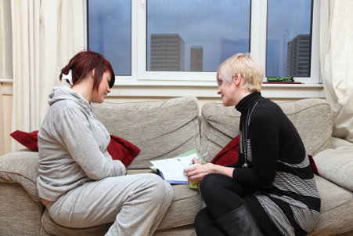
Compassionate Care
Engages hearts and minds/ emotions and intellect
Is relational
Comes alongside and provides containment of distress
Requires emotional resilience
Requires maintenance of therapeutic boundaries
Is often offered in the context of complexity, uncertainty, ambiguity and risk
Clinicians require an appropriate context to maintain this stance
Managers play an important role in facilitating this

Slide 18
Parallel process
The clinician’s relationship with her supervisor/manager and her interactions with others in the organisation affects her interactions with clients/ families.
Supervisor/ manager
Clinician
Client/ family
Notes:
In relationship based organizations an interesting phenomenon occurs which we call “Parallel Process”.
The supervisor role models healthy behaviors that promote therapeutic relationships.
Read definition.
So how you ‘are’ with the nurse can have a significant impact on how the nurse is with the client….
Any thoughts?

Slide 19

Parallel process
The family’s relationship and interactions with the clinician can affect their interactions with their child.
Clinician
Client/ family
Child
Notes:
In relationship based organizations an interesting phenomenon occurs which we call “Parallel Process”.
The supervisor role models healthy behaviors that promote therapeutic relationships.
Read definition.
So how you ‘are’ with the nurse can have a significant impact on how the nurse is with the client….
Any thoughts?

Slide 20

Supervisory components
Educative (formative)
  Developing the skills, understanding and capacities of supervisees
  Supporting reflective capacity and analytical / critical thinking
Supportive (restorative)
  Attending to the emotional impact of the work on supervisees
Managerial (normative)
  Supporting decision making regarding planned clinical work
  Supporting quality assurance and improvement of service delivery
Notes:
Ok so now lets look at the functions of supervision in more detail.
Supervision can be educative, supportive and managerial (Kadushin, 1976)
Educative – this includes action learning, emphasize the role of facilitator of team learning and introduce workbooks, importance of planning days with the team etc
Supportive – example; A family nurse comes to supervision and begins a conversation about her feelings of anxiety about being able to manage her workload
This is attending to the emotional impact of the work
Managerial- interesting aspect to the role, think about being a supervisor and manager and the possible areas you may wish to consider, being part of the team and yet separate from the team.

Slide 21
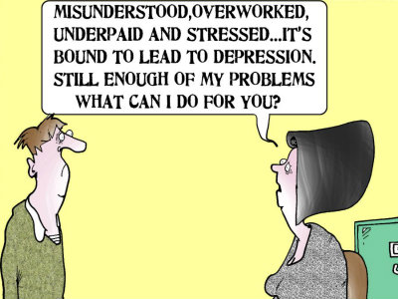
Reflective supervision is not…
Therapy
A moaning fest
Telling people what to do
Transactional
Just for novices
Irrelevant to the care received by families
Something put aside in times of high workloads/ crisis
Casual or unstructured
Just for clinicians

Slide 22

Kolb’s Experiential Learning Cycle
Concrete Experience
“Experiencing”
Reflection
“Examining”
Actions “Applying”
Analysis
“Explaining/ hypothesis building”
Notes:
Thinking and analysing

Slide 23
The benefits of reflection
Think of a time when reflection made a practical difference to the way you acted within a work context (clinical or managerial).
Tell a colleague about this experience.

Slide 24
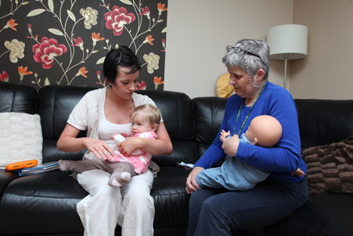
Resilience/ burnout
Some evidence that developing reflective capacity builds and maintains resilience and accurate empathy
Protects against empathic distress and consequent burnout
Hearts and Minds: Aspects of Empathy
and Wellbeing in Social Work Students
Louise Grant

Slide 25
Managers/leaders/supervisors
Often at the interface between;
  demands of performance driven agenda and ambiguous, emotionally laden work of practice
  use of technical, transactional processes and relational ways of working
  regulation, predictability and conformity and autonomy, professional judgement and creativity
  projections of anxiety from organisation and practitioners
  A choice (either/or) or a held, creative tension?

Slide 26
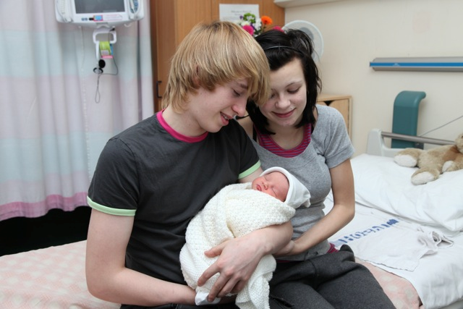
Reflective management and leadership
Keeping families and the primary purpose at the centre
Respecting and acknowledging the complexities of practice
Holding the technical and reflective strands of the management role in a creative tension
Requires an organisation with structures and cultures that enable a reflective stance (parallel process)

Slide 27
Activity
Reflect in pairs;
How is this creative tension impacting on you?
What step could you take to play a part in creating a more reflective culture in your organisation?

Slide 28
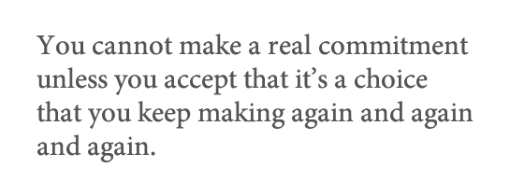
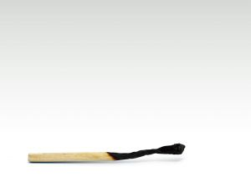

Slide 29
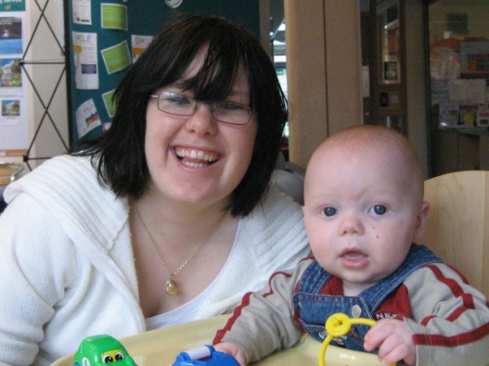
Photographs used with kind permission of families and nurses in FNP sites

Slide 30
Tea and coffee break
14:30 to 15:00
Foyer of Main Events Centre

Slide 31
The changes that social media brings for clinical leaders
Anne Cooper,
Clinical Informatics Advisor (Nursing) NHS England

Slide 32
Reflections on the day
Kate Billingham
Ben Fuchs

