Slide 1
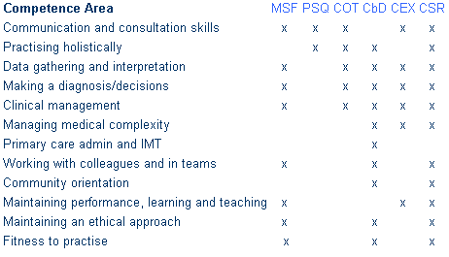
How the competences are linked

Slide 2
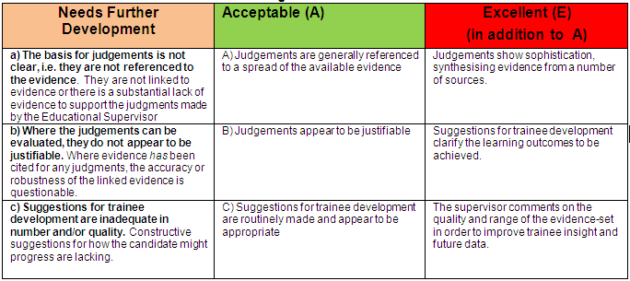
Rating the quality
The college recommend narrative, specific and dated evidence, and formative feedback.

Slide 3
CSR quality

Slide 4
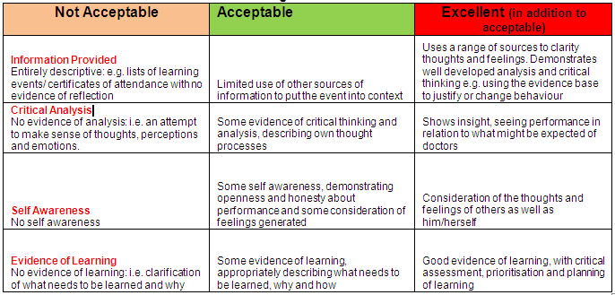
Learning Log - rating

