Slide 1
Prevention Concordat for Better Mental Health
Acknowledgements:
PHE Teams: Public Mental Health; Mental Health Intelligence Network; Health Economics
Expert Steering Groups - Prevention Concordat for Better Mental Health Programme; Joint Strategic Needs Assessment; Health Economics

Slide 2
Five Year Forward View for Mental Health Prevention Overview
Rec 2: National Prevention Concordat to support all Health and Wellbeing Boards (+ CCGs) to put in place updated JSNAs and joint prevention plans that include mh & co-morbid alcohol and drug misuse, parenting programmes, and housing, by no later than 2017
Rec 3: All local areas to have multi-agency suicide prevention plans in place by 2017, reviewed annually thereafter and supported by new investment.
Lead PHE
Lead
PHE
Lead DH
NHSE
Support
Align NHS I (Learning from death by suicide)
Rec 20: Ensure that people with mental health problems at greater risk of poor physical health get access to prevention and screening programmes. All mh inpatient units and facilities to be smoke-free by 2018.
Rec 43: Clear plan to develop and support the Mental Health Intelligence Network over 5yrs, so that it supports data linkage across public agencies, effective commissioning & implementation of new clinical pathways and standards as they come online.
Lead PHE
Lead NHSE
NHSE
Support
Lead PHE
Align NHSE –led Recommendation 22 (improved physical health for people with SMI 280,000 more people with SMI will have access to evidence based physical health checks and interventions
)
3. Prevention Concordat for Better Mental Health programme
Notes:
Five year forward view for mental health in 2016 marked step change in approach.
Important emphasis on approaching mental health problems in the population – and securing the place for prevention in services and the wider health and social care sectors.
PHE and public health approaches highlighted as having a particular role in helping deliver whole system change and the shift toward prevention.

Slide 3
Prevention Concordat for better Mental Health
The Prevention Concordat is intended to provide a focus for cross-sector action to deliver a tangible increase in the adoption of public mental health approaches across the whole system.
This includes local authorities, the NHS, public, private and VCSE sector organisations and employers.
The development phase was guided by an expert steering of key national partners, listed below, and wider support through members of the national prevention alliance for better mental health
6. Prevention Concordat for Better Mental Health programme
Notes:
Those logos represent the steering group representatives.

Slide 4
Prevention Concordat Consensus Statement
7. Prevention Concordat for Better Mental Health programme
7. Prevention Concordat for Better Mental Health programme
Notes:
We developed this statement alongside the steering group, who have all agreed to be the first signatories. Purdah delayed us sharing it more widely initally, but it has now gone to the National Mental Health Prevention Alliance members, and relevant arm length bodies. After the launch we have a second phase of gathering signatories and support planned focused on local areas.
Some of those already committed:
Faculty of Public Health
NHS Mental health Commissioners Network
Association of mental health providers
Centre for Mental Health
Mental Health Foundation
Department of Health
NSUN
Children and Young Peoples Mental Health Coalition
Student Minds
Samaritans
NHS Digital
CQC

Slide 5
Prevention Concordat for Better Mental Health Signatories
The Prevention Concordat launched on 30th August 2017 with 30 signatories
Key national cross-sector partners declared commitment to support action across the whole system. Initial signatories were:
Age UK
Association of Directors of Public Health UK
Association of Mental Health Providers
Care Quality Commission
Centre for Mental Health
Children and Young People’s Mental Health Coalition
Department of Health
Faculty of Public Health
Health Education England
Homeless Link
Housing Associations’ Charitable Trust
Local Government Association
Mental Health Foundation
Mind
NHS Clinical Commissioners
National Institute for Health Care and Excellence
The National LGBT Partnership
National Suicide Prevention Alliance
National Survivor User Network
National Voices
NHS Digital
NHS England
NHS Improvement
Public Health England
Rethink
Royal College of Nurses
Royal College of Psychiatrists
Samaritans
Student Minds
Youth Access
List available at: https://www.gov.uk/government/publications/prevention-concordat-for-better-mental-health-consensus-statement/prevention-concordat-for-better-mental-health
5. Prevention Concordat for Better Mental Health

Slide 6
A Suite of Prevention Concordat Resources
2016
2017
2018
Summer
December
February
March
August Launch
Autumn/Winter
Mental Health Joint Strategic Needs Assessment (JSNA) Online Tool
Prevention Concordat for Better Mental Health Consensus Statement
Multi-part programme to support adoption:
Enhanced Mental Health Champions leadership initiative
Masterclasses covering every PHE Centre geography (11 events)
Engagement and activation of signatories
Prevention planning resources: guide for local areas; summary; infographic and stocktake findings
What does a good mental health JSNA look like?
Pilot training for Elected Member Mental Health Champions to support prevention focused leadership
Mental health return on investment ROI tool and commissioning guides
Mental health JSNA knowledge guide
Two rapid evidence reviews of what works
Psychosocial pathways report
9. Prevention Concordat for Better Mental Health programme
Notes:
2016 resources highlighted above are:
June: Better Mental Health for All: A Public Health Approach to Mental Health Improvement (2016) London: Faculty of Public Health and Mental Health Foundation. This was a rapid evidence review using PHE funds.
July: Mental health and prevention: taking local action for better mental health Mental Health Foundation. This was a rapid evidence review commissioned by PHE.
December: Meeting the need: What makes a ‘good’ JSNA for mental health? (Centre for Mental Health, 2016) funded by Public Health England and produced in support of the National Mental Health, Dementia and Neurology Intelligence Network, analyses how these councils carried out their Joint Strategic Needs Assessments (JSNAs) to achieve real changes in their communities
2017 resources highlighted above are:
February: Mental Health Joint Strategic Needs Assessment Online Profile
March: 2 pilot training for Mental Health Champions to support them as prevention focused leaders (Elected Members)
July (forthcoming): 5 resources and a consensus statement all discussed in the next few slides
1. Together for better mental health: Preventing mental health problems and promoting good mental health. A practice resource for local areas (PHE, 2017)
2. Stocktake of local strategic planning arrangements for the prevention of mental health problems Summary (PHE and Kings Fund 2017)
3.Commissioning Cost-Effective Services for Promotion of Mental Health and Wellbeing and Prevention of Mental Ill Health (PHE/London School of Economics 2017)
4. Mental Health and Wellbeing Joint Strategic Needs Assessment Toolkit: Knowledge Guide (PHE, 2017)
5. Psychosocial Pathways and Health Outcomes: Informing action on health inequalities (PHE/UCL Institute of Health Equity, 2017)

Slide 7
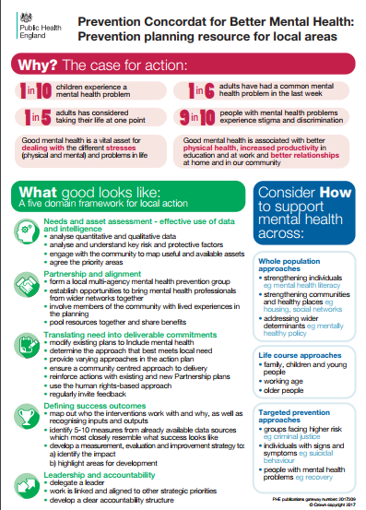
1. Prevention Concordat for Better Mental Health – A prevention planning resource for local areas
The planning resource:
has been developed to support local areas across England to put in place effective arrangements to promote good mental health and prevent mental health problems;
builds on published evidence and draws on the findings of a stocktake of prevention planning arrangements, which was led by The King’s Fund; and
supported by stakeholder engagement events across England with a range of representatives to understand needs of local areas.
The resource is accompanied by an infographic and a topline summary document
10. Prevention Concordat for Better Mental Health programme

Slide 8
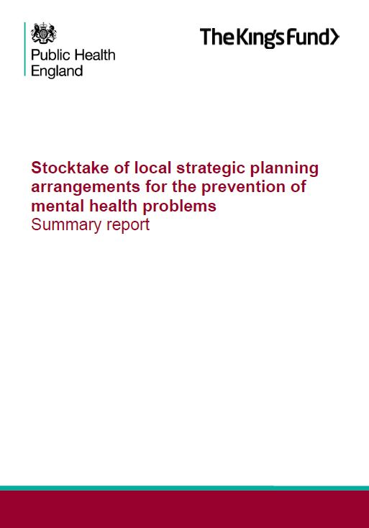
2. Stocktake of local planning arrangements for the prevention of mental health problems Summary Report
The summary document :
Has been produced in partnership with Kings Fund
Provides a high-level summary what local areas are doing currently
Identifies 4 common challenges to effective inclusion:
A. aligning different local planning processes/documents around a shared set of priorities;
B. translating strategy into deliverable commitments;
C. developing effective partnership arrangements;
D. measuring outcomes in relation to public mental health.
13. Prevention Concordat for Better Mental Health programme

Slide 9
3. Commissioning Cost-Effective Services for Promotion of Mental Health and Wellbeing and Prevention of Mental Ill Health
The Return on investment resources
Has been developed by PHE and London School of Economics;
Comprises commissioning guides and an interactive tool which will enable local areas to understand the ROI for specific cash-releasing interventions.
The intention is that local areas will use this additional information alongside interventions highlighted in the 2011 Mental health promotion and mental illness prevention: The economic case report
15. Prevention Concordat for Better Mental Health programme

Slide 10
4. Psychosocial Pathways and Health Outcomes: Informing action on health inequalities
This report:
has been developed by PHE and the Institute of Health Equity, UCL;
aims to describe and provide evidence about the relationships between social determinants, psychosocial factors and health outcomes; and
provides a conceptual framework that focuses on the psychosocial pathways between factors associated with social, economic and environmental conditions, psychological and psychobiological processes, health behaviours and mental and physical health outcomes
16. Prevention Concordat for Better Mental Health programme

Slide 11
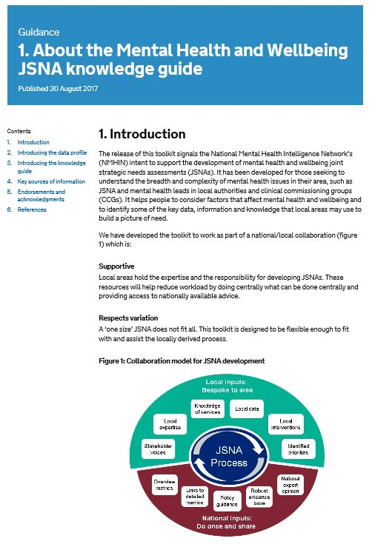
5. Mental Health and Wellbeing Joint Strategic Needs Assessment Toolkit: Knowledge Guide
This knowledge guide:
Complements the Mental Health Joint Strategic Needs Assessment Online Profile which is designed to support local Health & Wellbeing Boards in developing Mental Health JSNA;
It brings together nationally available data on mental health prevalence, risk and protective factors and healthcare services; and
covers the whole of the pathway from prevention through to treatment and includes wider determinants and assets.
The tool can be accessed at: http://fingertips.phe.org.uk/profile-group/mental-health/profile/MH-JSNA
14. Prevention Concordat for Better Mental Health programme

Slide 12
A focus on the Mental Health and Wellbeing JSNA Toolkit

Slide 13
Approach
Local inputs:
Bespoke to area
Knowledge of services
Local data
Local expertise
Local interventions
JSNA Process
Stakeholder voices
Identified priorities
Overview metrics
National expert opinion
Links to detailed metrics
Robust evidence base
Policy guidance
National inputs:
Do once and share

Slide 14
Components
Mental health and wellbeing JSNA toolkit 2017/18
Data profile
Knowledge guide
Prevalence & incidence
Risk factors
Understanding place
Children & young people
Protective factors
Services
Understanding people
Working age adults
Quality & outcomes
Finance
Perinatal
Older years
Content:
100+ overview metrics
GP & ward level metrics
Each domain follows life course
Gateway to a range of NMHIN topic based profiles
PDF output report
Content:
HTML based with bite sized sections
Focus on prevention, wellbeing, risk profiling and community assets
Intelligence on policy, case for change, data and interventions
Guide follows life course
Supporting components
Meeting the need – what makes a ‘good’ JSNA for mental health?
(Centre for Mental Health 2016)
Mental health JSNA stocktake
(Kaleidoscope)
Mental health primary prevention return on investment tool & report
(London School of Economics)

Slide 15
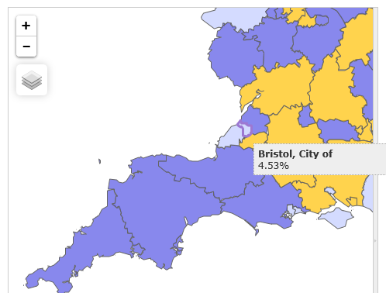
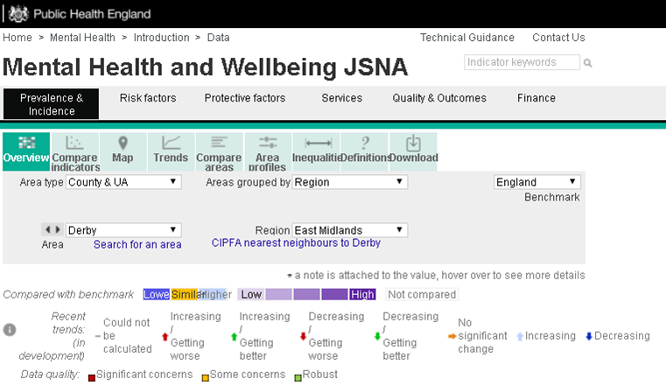
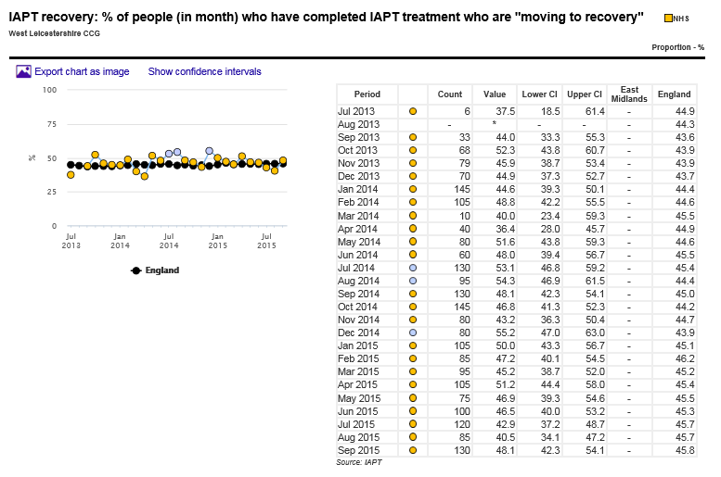
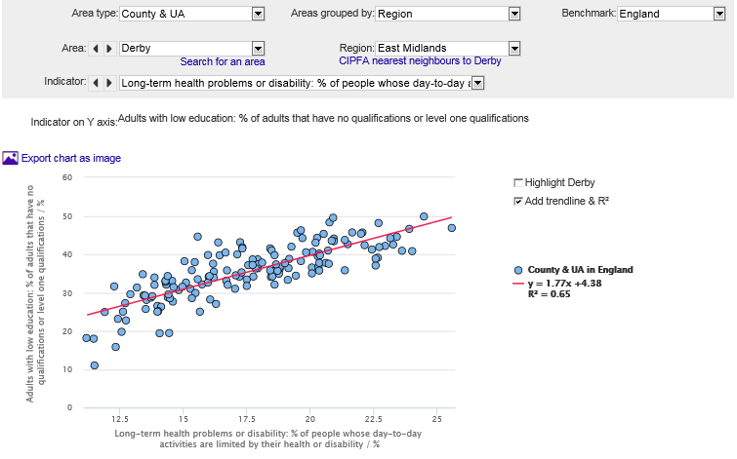
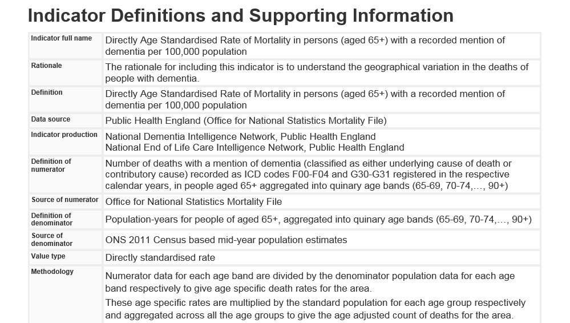
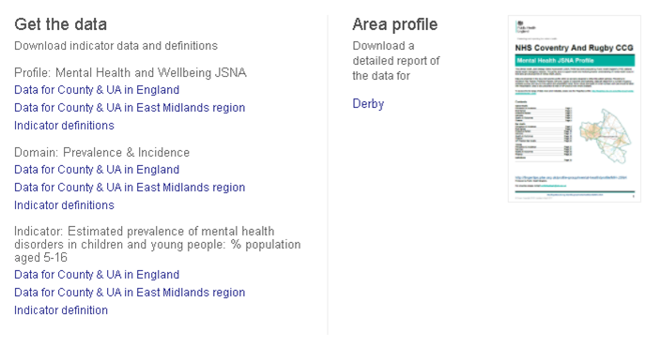
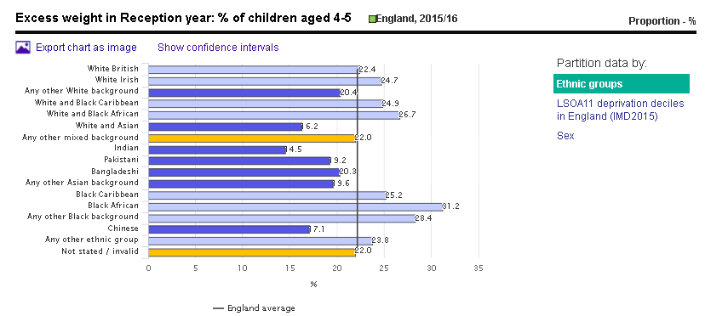
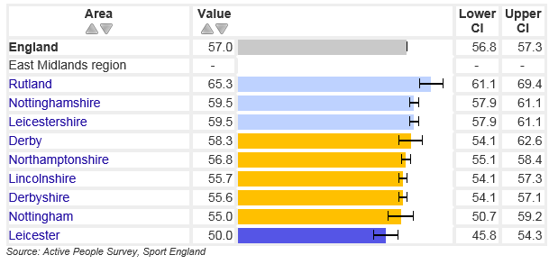
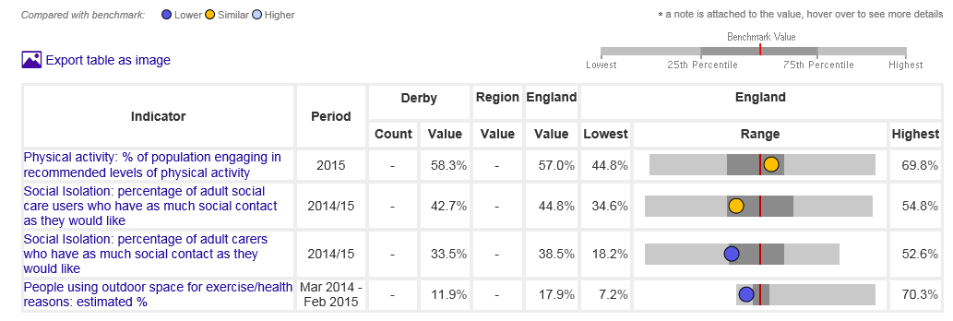
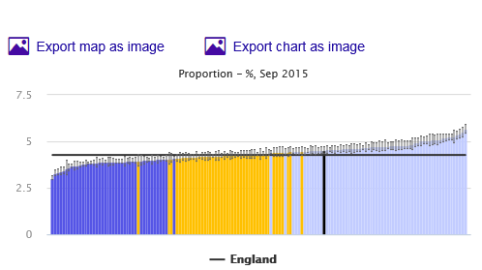
Data Profile: Overview
Structured into 6 domains
Notes:
The mental health and wellbeing JSNA data profile fits with and works alongside the ‘Knowledge Guide’. It presents selected nationally available metrics that provide an overview of mental health in a way that is easily navigated. Data are drawn from many sources and vary by time period, population and presentation of values.
The profile aims to provide enough whole-pathway metrics to enable local areas to assess current mental health need, services and outcomes.
Metrics can be presented in a number of ways as shown here.
Data are presented in 6 domains:
prevalence and incidence
risk factors
protective factors
services
quality and outcomes
Finance
The majority of metrics in this (and other Fingertips profiles) are presented by CCG or local authority. However, for the first time in a NMHIN profile, a small number of metrics are included by electoral ward and General Practice to provide an assessment of variation within the patch; where possible metrics are also presented by STP footprint.
the slide you are looking at is now running through the various views of data available to you in profile, also highlighting that each metric comes with detailed metadata, and that it is possible to download all the data from Fingertips’

Slide 16
Variation between areas
CCG view - QOF SMI (against most similar CCG’s (CIPFA))

Slide 17
Variation within West Norfolk (GP practice)
QOF Depression: % of adults on register
QOF SMI: % of register

Slide 18
Output reporting

Slide 19
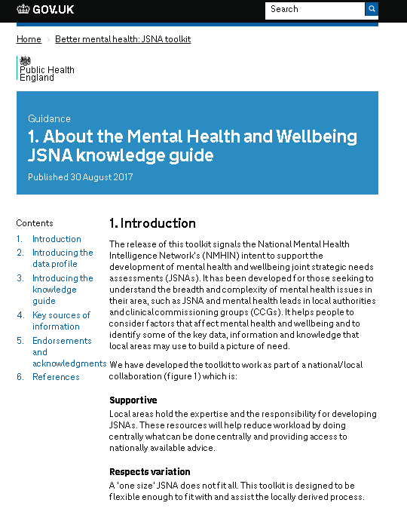
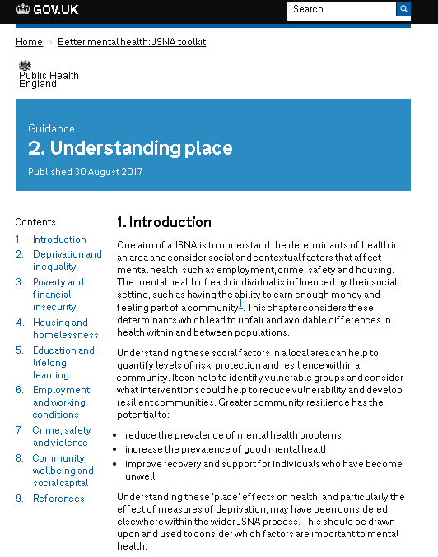
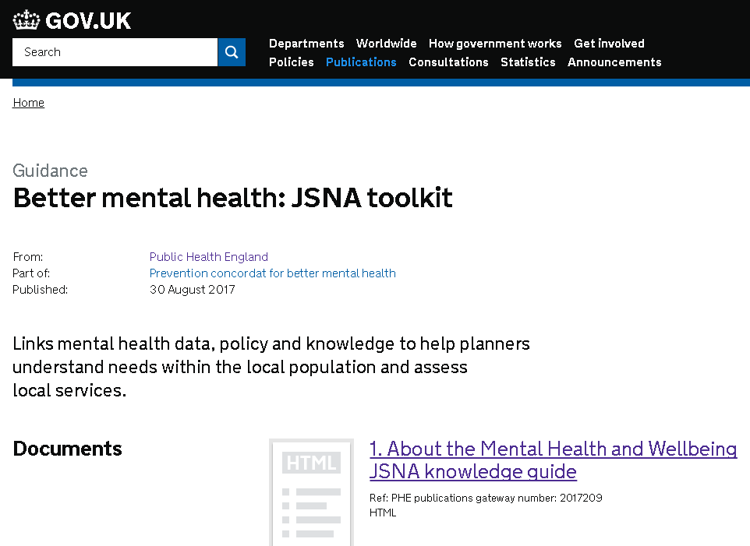
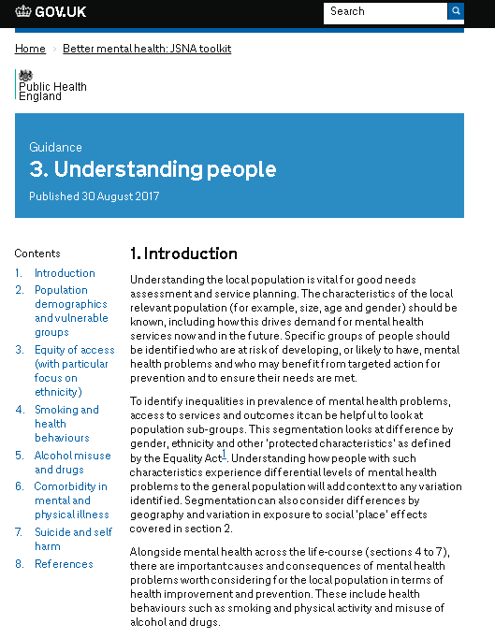
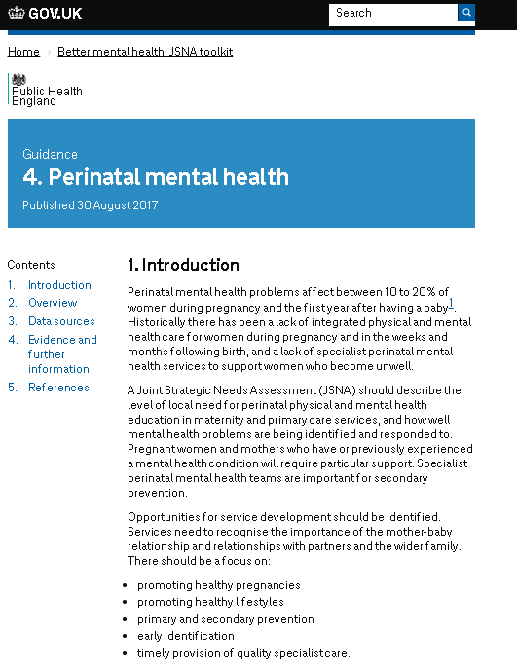
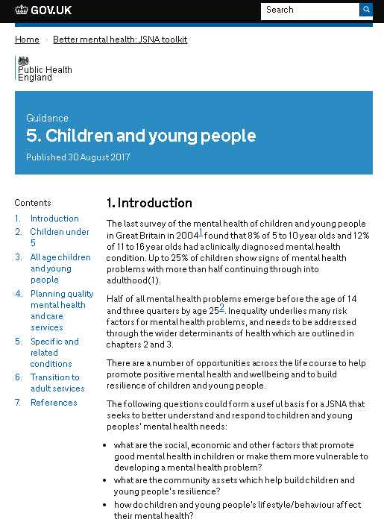
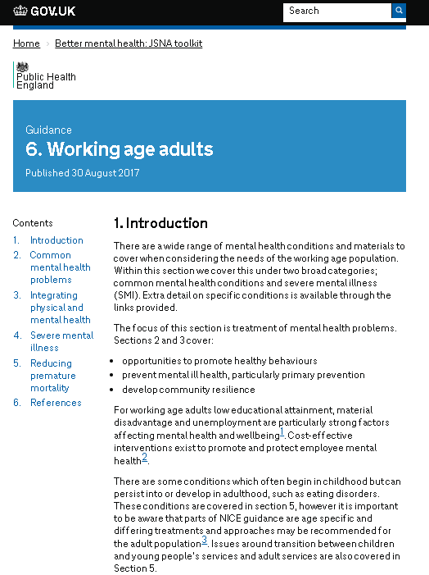
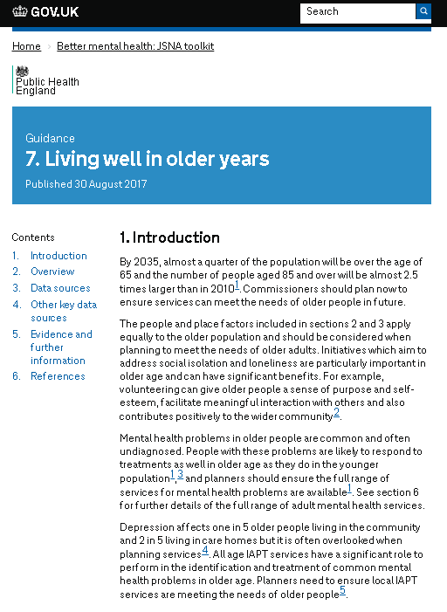
Knowledge Guide: Overview

Slide 20
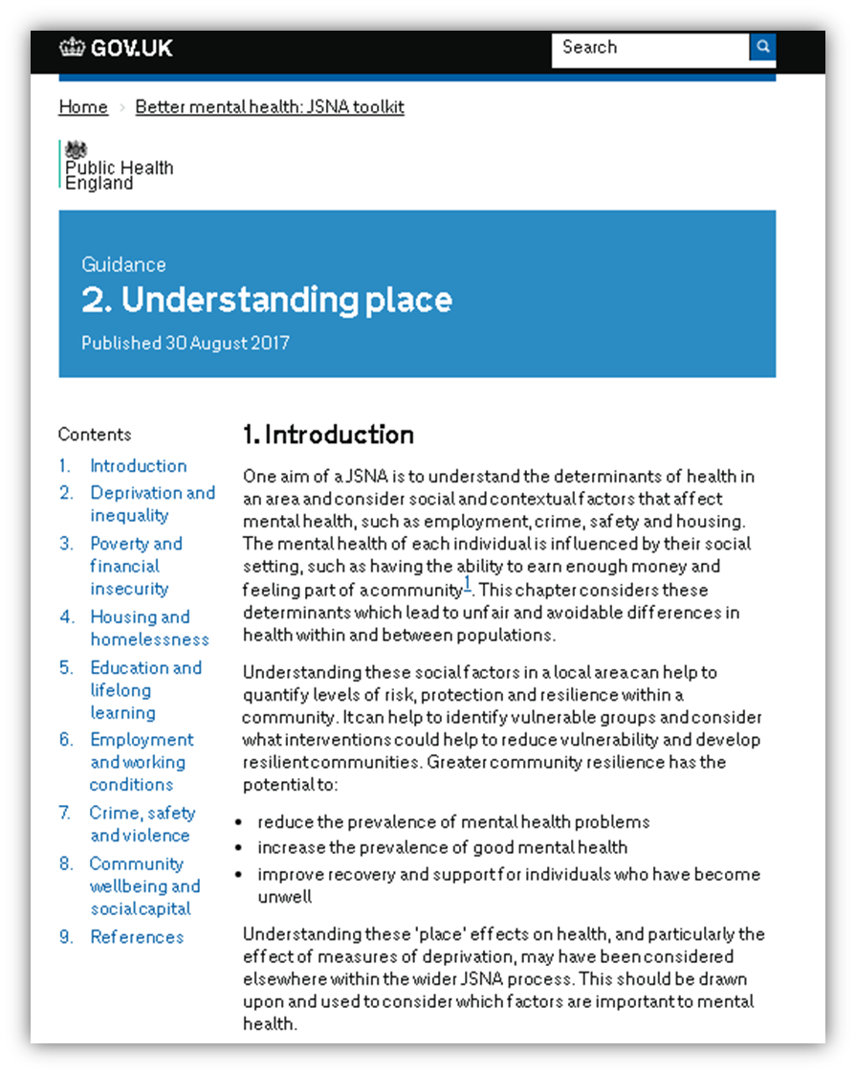
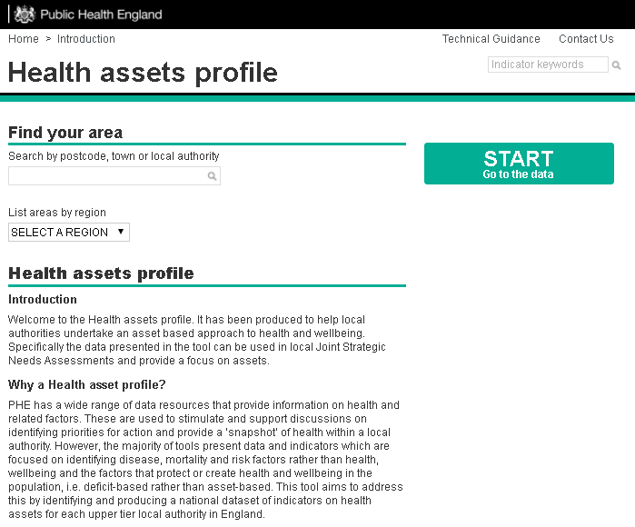
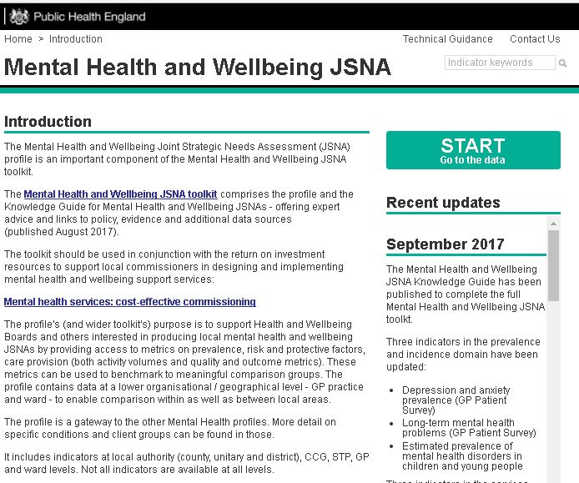
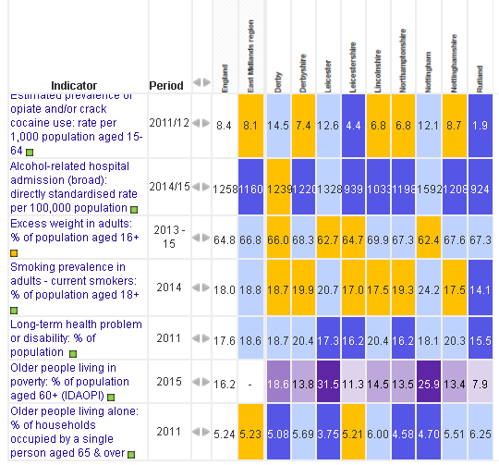
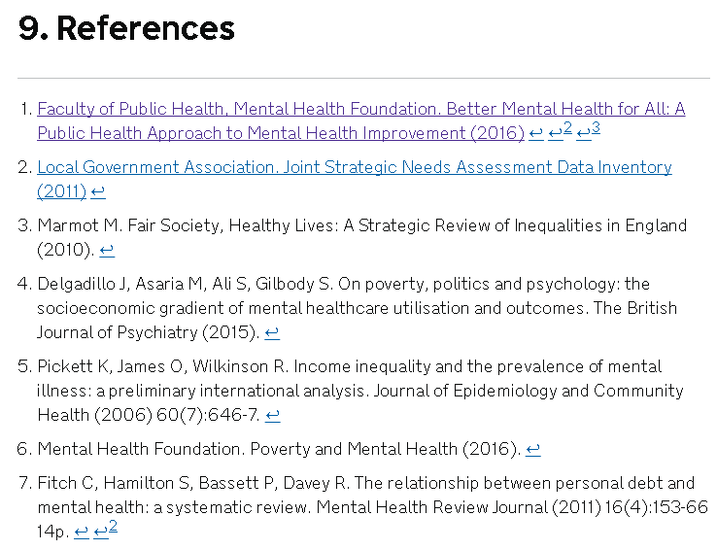
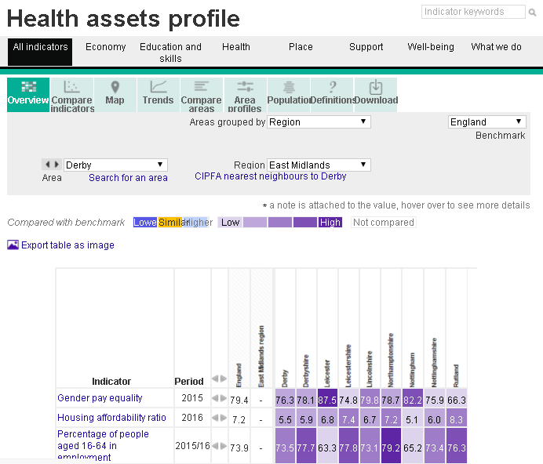
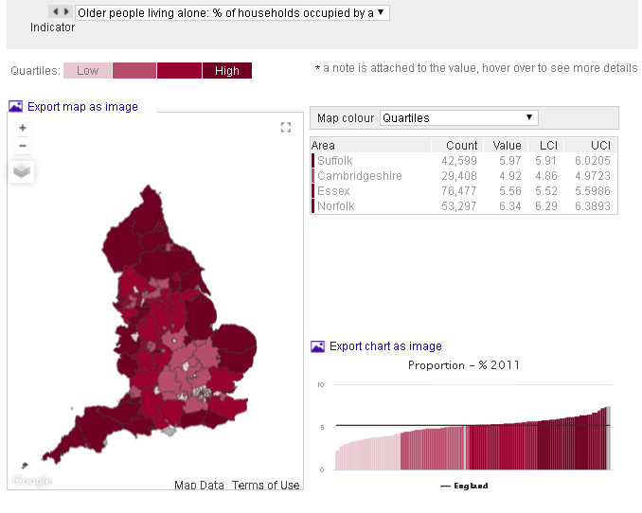
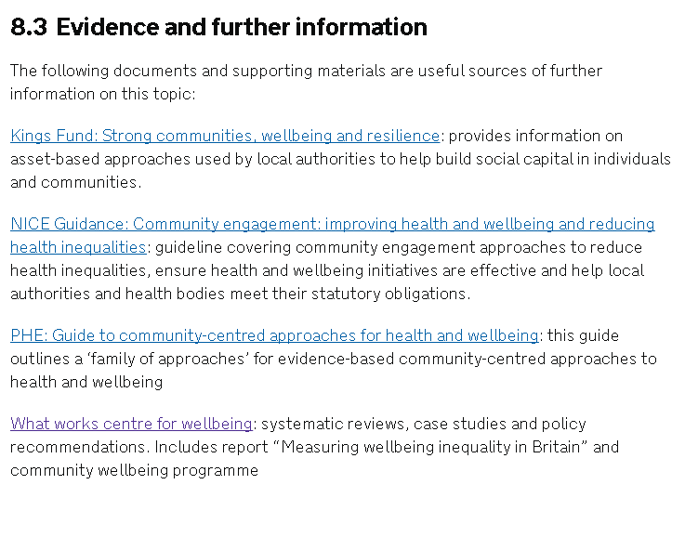
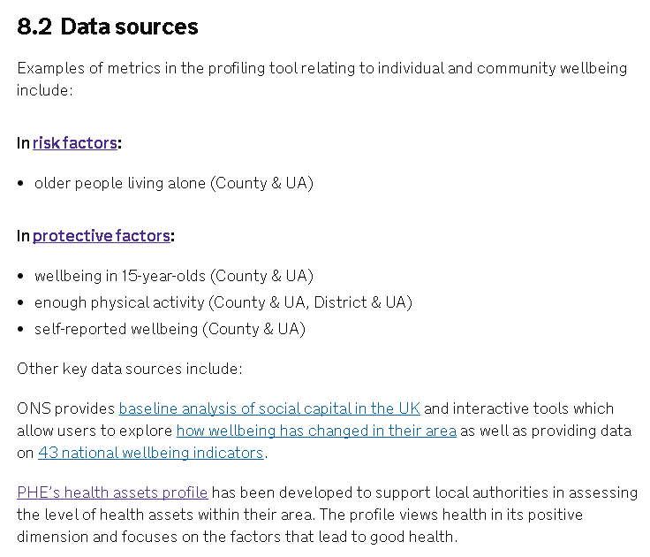
Using the toolkit
Notes:
The guide and the profile are available as interactive web products. The guide has been published on gov.uk in a HTML format which allows for:
easy navigation across sections
quick access to linked materials, data and resources
It also allows the national mental health intelligence network to easily easy update and review content and links to enable ongoing development
This is the understanding place topic, and within that the community wellbeing section.
The overview provides a summary of the section, including a range of references, and can easily be cut and pasted.
The data sources section includes links to the relevant metrics in the profile and other key sources of data.
Within the evidence and further information section you will find links to further key resources and publications

Slide 21
Dissemination
For further information please contact;
Cam Lugton (NMHDNIN Programme Lead)
cam.lugton@phe.gov.uk / 07825 115277
Sam Lane (NMHDNIN Programme Manager)
sam.lane@phe.gov.uk / 07917 241832

