Slide 1
East of England Public Health Professional Development Day, Wednesday 8th November 2017 ‘Tackling a significant inequality’
Neil Wood
Health and Wellbeing Programme Manager
Public Health England – East of England
E-mail: Neil.wood@phe.gov.uk

Slide 2
‘Tackling a significant inequality’
How can we encourage work to be
seen and embedded as a health
outcome within the health and care system?’

Slide 3
‘Tackling a significant inequality’
What I’ll cover…
Background and context…
What the scale of the ‘significant inequality' looks like…
What we’ve been doing…
What you can do to help…

Slide 4
‘Tackling a significant inequality’
Firstly, a few things about me…
Part of PHE – East of England’s Health and Wellbeing Team
Policy areas include:
Tobacco and smoking
Worklessness, health and work
Mental health
And…

Slide 5
“We know that not having a job or enough money to live on, or somewhere decent to live are barriers to people’s good health and wellbeing.”
Duncan Selbie 2014
Unemployment contributes to poor health, with causal links to decreased lifespan and higher levels of mental health problems. “Getting people into work is therefore of critical importance in reducing health inequalities.”
Sir Michael Marmot 2011
I spent years watching people’s health and mental health deteriorate, and did nothing about it, because it wasn’t my job…
Neil Wood
DWP / Jobcentre Plus to 2009 and DH / PHE to date…

Slide 6
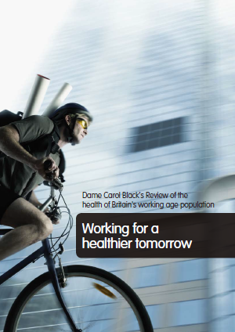
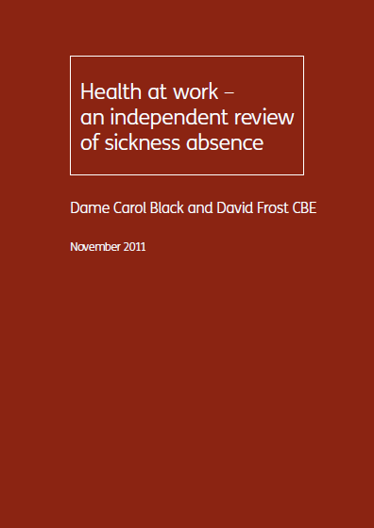
The links between health and work, a few reference points…
Is work good for your health and wellbeing? Waddell & Burton 2006
Working for a healthier tomorrow, Dame Carol Black’s Review of the health of Britain’s working age population 2008
Improving health and work – Govt response to Black Review 2009
Fair Society, Healthy Lives – The Marmot Review 2010
Health at work – an independent review of sickness absence 2011

Slide 7
And you’ll be familiar with this…
But, are our partners in DWP or Housing or Citizens Advice Bureau?
…DWP and Housing and Citizens Advice Bureau are regularly in contact (very often at point of crisis) with those we often describe as ‘vulnerable’ or ‘hard to reach’, those that experience the greatest health inequalities…

Slide 8
Dame Carol Black’s ‘Review of the health of Britain’s working age population’, the key challenges included…
Many employers were unaware of the business case for investing in health and well-being.
Poor understanding of health and well-being initiatives that employers can implement, a lack of initiatives, information and advice.
Accessible and affordable sources of support and advice are rarely available for small and medium sized enterprises (SMEs).
The current sickness certification process focuses on what people cannot do, furthermore, the flow of recipients of other benefits onto incapacity benefits suggests a failure in other employment and skills programmes to identify developing health conditions at a sufficiently early stage…

Slide 9
‘Review of the health of Britain’s working age population’ included these recommendations …
6, The paper-based sick note should be replaced with an electronic fit note, switching the focus to what people can do…
7, A new Fit for Work service based on case-managed, multidisciplinary support for patients in the early stages of sickness absence…
8, When models for the Fit for Work service are established, access to the service should be open to those on incapacity benefits and other out-of-work benefits…
And…Government should fully integrate health support with employment and skills programmes, including mental health support where appropriate…

Slide 10
Early intervention - essential
Old system: paper ‘Sick Note’
New system: ‘Fit Note’
Uninterrupted flow of the untreated unwell…
System, cultural and behavioural change required to get here…

Slide 11
So what about the flow of people moving out of work or from other benefits onto incapacity benefits?
(now DWP’s Employment and Support Allowance…)

Slide 12
East of England Labour Market Profile
Out-of-work benefit claimants by statistical group (August 2017)
Jobseekers Allowance 30,000 0.8%
Lone Parents 33,200 0.9%
Others on Income- 5,200 0.1%
Related Benefits
Employment Support Allowance 181,050 4.8%
and Incapacity Benefits
Total 249,450 6.6%
There are also…
Carers 55,220 1.5%
Disabled 26,380 0.8%

Slide 13
Employment and Support Allowance (Feb 17)
Local Authority | Total | Mental and behavioural disorders | Diseases of the musculoskeletal system and connective tissue
Bedford | 4,980 | 2,440 | 640
Cambridgeshire | 16,410 | 7,870 | 2,090
Central Bedfordshire | 5,990 | 2,720 | 780
Essex | 40,320 | 19,130 | 5,200
Hertfordshire | 27,430 | 13,320 | 3,280
Luton | 7,330 | 3,410 | 960
Norfolk | 31,080 | 16,260 | 3,760
Peterborough | 8,380 | 3,950 | 1,090
Southend-on-Sea | 7,200 | 3,760 | 790
Suffolk | 21,520 | 10,790 | 2,680
Thurrock | 4,830 | 2,150 | 740
Milton Keynes | 7,620 | 3,550 | 1,050
Total | 183,100 | 89,350 (48.8%) | 23,070 (12.6%)
…an increase of 2,450 from February 2016 to February 2017. An increase of 2,000 (and by 0.5%) due to mental health, but a reduction of 730 (and by 0.6%) relating to MSK...

Slide 14
Employment and Support Allowance

Slide 15
‘Government should fully integrate health support with employment and skills programmes, including mental health support where appropriate…’

Slide 16
Work and Health Joint Unit
Two main outcomes:
Improve health outcomes for working age people with health conditions and disabilities, to improve productivity and labour market participation
Improve employment outcomes for people with health conditions and disabilities, to contribute to halving the disability employment gap
Supported by six objectives which will drive our work programme:-
to create a more integrated and supportive individual journey through the work and health systems;
to encourage work to be seen and embedded as a health outcome within the health and care system;
to create cultural change so that individuals, employers and wider society recognise the importance of work and health;
to influence employers so that they support health in the workplace thus improving productivity, and also recruit and retain people with health conditions and disabilities;
to use the resources currently expended by the employment and health and care systems where they make most difference; and
to develop delivery models that support and incentivise the outcomes we want.

Slide 17
Work and Health Joint Unit
Two main outcomes:
Improve health outcomes for working age people with health conditions and disabilities, to improve productivity and labour market participation
Improve employment outcomes for people with health conditions and disabilities, to contribute to halving the disability employment gap
Supported by six objectives which will drive our work programme:-
to create a more integrated and supportive individual journey through the work and health systems;
to encourage work to be seen and embedded as a health outcome within the health and care system;
to create cultural change so that individuals, employers and wider society recognise the importance of work and health;
to influence employers so that they support health in the workplace thus improving productivity, and also recruit and retain people with health conditions and disabilities;
to use the resources currently expended by the employment and health and care systems where they make most difference; and
to develop delivery models that support and incentivise the outcomes we want.

Slide 18
Work and Health Joint Unit
Two main outcomes:
Improve health outcomes for working age people with health conditions and disabilities, to improve productivity and labour market participation
Improve employment outcomes for people with health conditions and disabilities, to contribute to halving the disability employment gap
Supported by six objectives which will drive our work programme:-
to create a more integrated and supportive individual journey through the work and health systems;
to encourage work to be seen and embedded as a health outcome within the health and care system;
to create cultural change so that individuals, employers and wider society recognise the importance of work and health;
to influence employers so that they support health in the workplace thus improving productivity, and also recruit and retain people with health conditions and disabilities;
to use the resources currently expended by the employment and health and care systems where they make most difference; and
to develop delivery models that support and incentivise the outcomes we want.

Slide 19
Work and Health Joint Unit
Two main outcomes:
Improve health outcomes for working age people with health conditions and disabilities, to improve productivity and labour market participation
Improve employment outcomes for people with health conditions and disabilities, to contribute to halving the disability employment gap
Supported by six objectives which will drive our work programme:-
to create a more integrated and supportive individual journey through the work and health systems;
to encourage work to be seen and embedded as a health outcome within the health and care system;
to create cultural change so that individuals, employers and wider society recognise the importance of work and health;
to influence employers so that they support health in the workplace thus improving productivity, and also recruit and retain people with health conditions and disabilities;
to use the resources currently expended by the employment and health and care systems where they make most difference; and
to develop delivery models that support and incentivise the outcomes we want.

Slide 20
Work and Health Joint Unit
Two main outcomes:
Improve health outcomes for working age people with health conditions and disabilities, to improve productivity and labour market participation
Improve employment outcomes for people with health conditions and disabilities, to contribute to halving the disability employment gap
Supported by six objectives which will drive our work programme:-
to create a more integrated and supportive individual journey through the work and health systems;
to encourage work to be seen and embedded as a health outcome within the health and care system;
to create cultural change so that individuals, employers and wider society recognise the importance of work and health;
to influence employers so that they support health in the workplace thus improving productivity, and also recruit and retain people with health conditions and disabilities;
to use the resources currently expended by the employment and health and care systems where they make most difference; and
to develop delivery models that support and incentivise the outcomes we want.

Slide 21
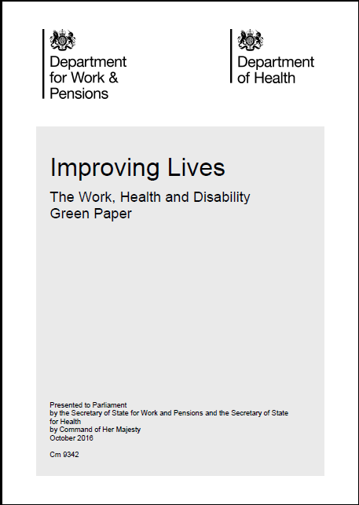
Finally, in October 2016…
Improving Lives: The Health, Work and Disability Green Paper asks:
What will it take to transform the employment prospects of disabled people and people with long-term health conditions?

Slide 22
So what have we been doing?

Slide 23
Worklessness, Health and Work
Activity in Essex from 2014, East Anglia Devolution Deal provided focus through 2016
Worklessness, Health and Work Network established September 2016
Facilitated introductions between LAs and DWP Districts – range of activity linking lifestyle services with DWP taking place i.e. MECC, NHS health checks etc…
Consultation on the Green Paper in January 2017
Supporting / co-ordinating training of DWP staff and roll-out of ‘health and work conversation’, working with DWP’s Work Psychologists and Community Partners
Audit of LA workplace health ‘offers’, LA and DWP employer and business engagement to identify areas of mutual interest / closer working, and challenges…
Mapping range of LA and DWP interventions from full employment ⬄ long term unemployment
…and currently facilitating introductions between DWP and IAPT / Wellbeing Services regarding expansion of employment adviser support and Individual Placement Support (IPS)…

Slide 24
‘Tackling a significant inequality’
In summary…
Employment - 32% gap between wider working age population and those with health conditions / disabilities…
183,000 individuals with health conditions and disabilities on ESA, 89,000 due to mental health…
Previously unsupported with regard to their health / mental health, but things beginning to change in DWP…
Work and Health Joint Unit aims / objectives - we’re joining up the work and health / mental health systems…
But, work to do around links with growth and economic development…

Slide 25
Work and Health Joint Unit
Two main outcomes:
Improve health outcomes for working age people with health conditions and disabilities, to improve productivity and labour market participation
Improve employment outcomes for people with health conditions and disabilities, to contribute to halving the disability employment gap
Supported by six objectives which will drive our work programme:-
to create a more integrated and supportive individual journey through the work and health systems;
to encourage work to be seen and embedded as a health outcome within the health and care system;
to create cultural change so that individuals, employers and wider society recognise the importance of work and health;
to influence employers so that they support health in the workplace thus improving productivity, and also recruit and retain people with health conditions and disabilities;
to use the resources currently expended by the employment and health and care systems where they make most difference; and
to develop delivery models that support and incentivise the outcomes we want.
✓
✓

Slide 26
‘Tackling a significant inequality’
Two questions for you…
What can you do to encourage work to be seen and
embedded as a health outcome within the health and
care system?
What can you do to influence your own organisation
to recruit and retain people with health conditions
and disabilities?

Slide 27
Thank you for listening,
any questions?
Neil Wood
Health and Wellbeing Programme Manager
Public Health England – East of England
E-mail: Neil.wood@phe.gov.uk
Tel: 01223 722493 / 07917 263632

