Slide 1
Quality in Training
Dr Mashbileg Maidrag
Consultant in Public Health| Training Programme Director for Faculty Development & QA|

Slide 2
Development
Notes:
Will explain the reasons why this exercise came about and which guidance informed it

Slide 3
The Training Pathway Review 2016/17
An exercise to ensure training locations can deliver against the 2015 Public Health Curriculum
Consultation involving
Registrars
Clinical Supervisors
Educational Supervisors
Training Programme Directors
Notes:
The arrival of the 2015 PH Curriculum means a rethink about how training locations can deliver registrar training needs
A consultation exercise took place last year to identify areas stakeholders felt were important, and those which they felt it was hard for some training locations to deliver

Slide 4
Key expectations derived from stakeholder feedback
Notes:
The training pathway review generate one set of standards

Slide 5
Health Education East of England
Risk and Quality Governance Handbook 2017
outlines the framework to be used by providers and HEE staff to measure, identify and improve quality in education and training environments and for all learners in health and care.
Based on the national HEE Quality Strategy 2016-2020, which was launched in April 2016 and the HEE Quality Framework Handbook 2017-2018.
The framework is built around:
A Learning Environment Continuous Improvement Cycle
Six quality domains and 27 associated standards
Notes:
At the same time, new standards came from HEE regarding all training locations. These are written with mostly clinical locations in mind but contain important universal quality standards which we must demonstrate we can fulfill

Slide 6
Notes:
This includes 6 quality domains and 27 standards

Slide 7
Merging
Notes:
We are bringing these two together to create one self-assessment document that locations can use

Slide 8
Aligning Public Health quality to HEE domains
Training pathway review priorities
NHS Athens journal access
Core reference books, either in your department or in a local library
Library services - access to articles which are not available online
HEE Quality domain
1.5 The learning environment provides suitable educational facilities for both learners and educators, including space, IT facilities and access to quality assured library and knowledge
Notes:
For example these elements which came from the training pathway review map to this HEE domain. We have created QUALITY MEASURES for each HEE quality domain (where relevant to public health – we have removed some which are totally clinical in focus)

Slide 9
Example
Specific
HEE Quality Domain | Quality Measure (to assess and evidence)
1.3. There are opportunities for learners to engage in reflective practice with service users, applying learning from both positive and negative experiences and outcomes. | 1.3.1 Clinical supervisors promote the registrars' reflection, making time to reflect face to face with a registrar on a task in the course of signing off an activity summary sheet
 | 1.3.2 Clinical supervisors offer feedback in a variety of tools such as Direct Observation of Practice and Case Based Discussions
 | 1.3.3 There are opportunities for the registrar to meet with the public, service users and lay representatives.
Generic

Slide 10
Intended use

Slide 11
Methods of assessment for training locations against standard
Annual meeting of all supervisors & registrars at the location to self-assess the location against the standard
Annual survey sent to all registrars to assess their current location against standard
Reported triennially to preserve confidentiality
Survey sent as ‘exit survey’ to registrars when leaving a location
Notes:
We suggest 3 basic methods of assessment
Locations where problems are highlighted in returns will get support and assistance to develop

Slide 12
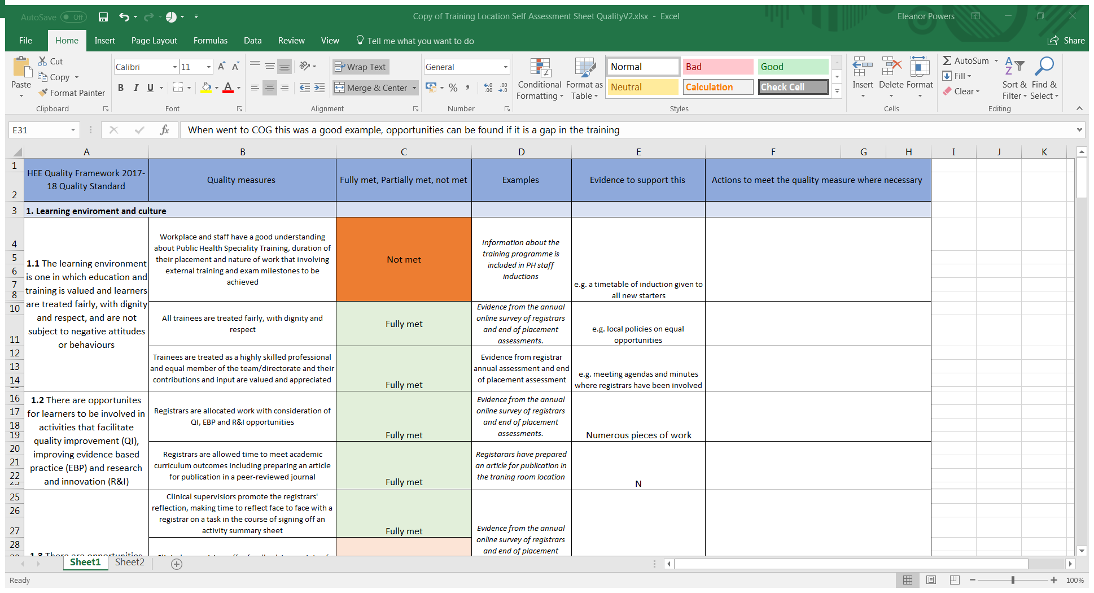
Self assessment is completed on an Excel tool which has been created to allow grading of each quality measure as ‘full’, ‘partial’ or ‘not met’
Suffolk undertook this process at a registar/supervisor meeting & it was a useful process

Slide 13
Group exercise

Slide 14
In your tables
Assess the quality standards on your table (1-6)
Are they clear and relevant for public health?
More information, less information?
Provide examples of types of evidence that could be used to demonstrate that the quality standard was being met
Should learning outcomes that match these measures be included?
Should Work Place Based Assessment templates be included ie Case based Discussion, Direct Observation Form etc

