Slide 1





Slide 2


Slide 3
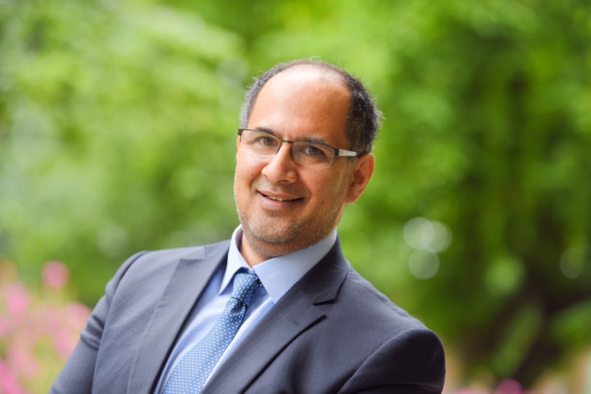



A very good afternoon & warm Greetings

Slide 4
All you want to know about Faculty CPD & audit including reflection
Dr.P.Badrinath PhD (Cantab) FFPH
Consultant in PH Medicine &
Associate Clinical Lecturer
EOE Regional CPD advisor

Slide 5

Before we start

Slide 6
In 2016-17 round what proportion of CPD submissions were deemed as unsatisfactory after the audit?

Slide 7
Unsatisfactory returns
0%
4.2%
9.8%
11.4%
14.5%

Slide 8
Unsatisfactory returns
0%
4.2%
9.8%
11.4%
14.5%

Slide 9
This day in History
- Quiz

Slide 10

What landmark event took place today 8th November 1965 that made Great Britain humane country?

Slide 11
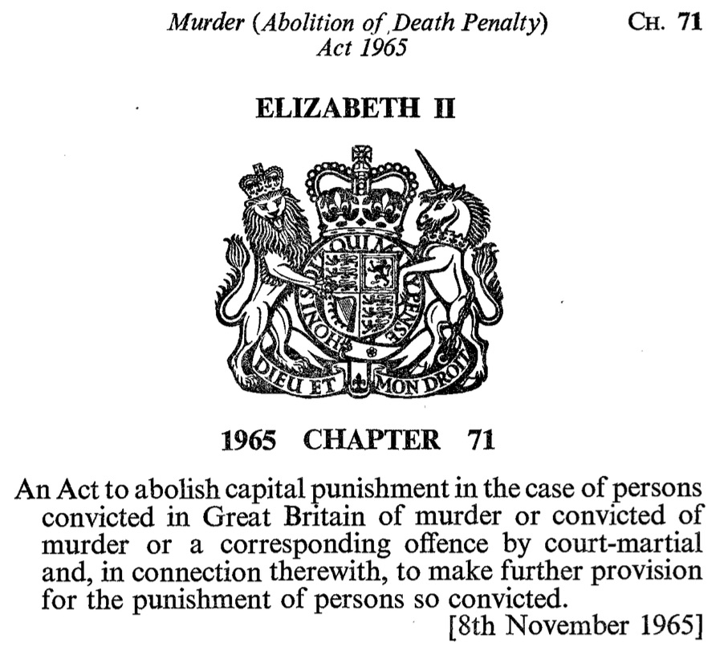

Slide 12

What has this got to do with 8th of November 2016?

Slide 13


The Twitter President

Slide 14
Show us the Evidence

Slide 15
My attempt at evidence
Member of Faculty CPD Committee
Involved in national CPD audits
Been audited twice before
Completed PGC Med Ed (key assignment on reflection)

Slide 16
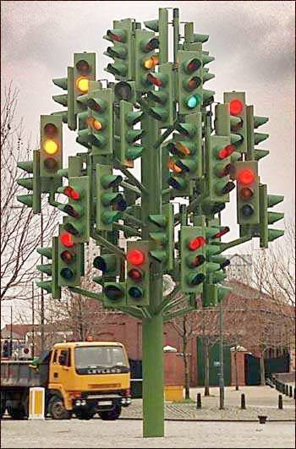
CPD submission & audit – moving forward

Slide 17
CPD – Definition
“The Academy of Medical Royal Colleges (AoMRC) and the Faculty of Public Health (FPH) defines Continuing Professional Development (CPD) as a continuing process, outside formal undergraduate and postgraduate training, that enables individual doctors (and other public health specialists) to maintain and improve standards of medical (and public health) practice through the development of knowledge, skills, attitudes and behaviour”

Slide 18
Hope to “Provide clarity on what is expected of Faculty members regarding CPD”

Slide 19
What we will discuss
2016-17 audit results
How to submit a good CPD return
A brief note on reflection
Q & A

Slide 20
Why audit CPD?
Requirement of Academy of Royal Medical Colleges
So Faculty can assure itself that participants are meeting CPD policy requirements
Participants will use audit results for appraisal documentation
Opportunity to feed back on quality of reflective notes

Slide 21
Who gets audited?
All members and fellows except for those claiming exemption from CPD are eligible for audit
  One in five eligible members (non-random sample)
  Additional 2 per cent random sample
  Anyone with unsatisfactory audit (including not submitting) previous year
  Anyone not returning CPD submission for that year

Slide 22
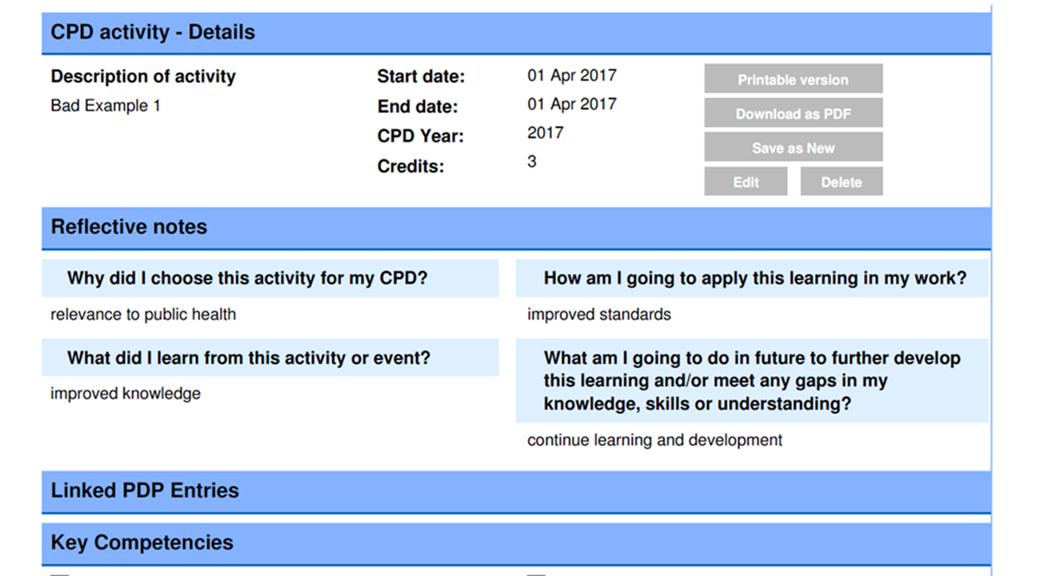
Example 1

Slide 23
Audit thresholds
Submission must be personally identifiable
There must be a PDP(s) covering the relevant CPD year
Must be at least 50 credits (up to 100 assessed)
All credits supported by a reflective note
No more than 5 credits per reflective note
A minimum of 25 credits directly related to PDP
Balance type of activities – One type of activity not more than half of claimed credits

Slide 24
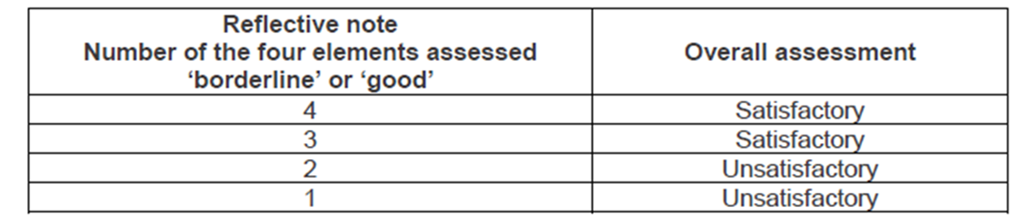
Audit thresholds
To be submitted online (Exception - given prior approval)
At least 40 credits supported by a reflective note assessed as ‘satisfactory’
Now qualitative assessment of reflective notes.

Slide 25
Outcomes of audit
If submission deemed satisfactory
  Participant sent letter advising satisfactory audit
If submission deemed unsatisfactory
  Documentation sent to a second Regional CPD Co-ordinator for repeat audit
If deemed satisfactory by second auditor
  Participant sent letter advising satisfactory audit
If deemed unsatisfactory by second auditor
  Reviewed by Director of CPD who will make ultimate decision whether to send letter advising unsatisfactory audit

Slide 26
Review of CPD audit results
 | 2016 | 2017
Selected for audit | 364 | 436
Submitted audit papers | 319 | 356
Failed by at least one auditor | 59 | 81
Failed audit | 22 (6.9%) | 35 (9.8%)
Less than 40 points supported by a satisfactory reflective note
No Personal Development Plan
Less than 25 points explicitly cross-referenced to the PDP
Errors resulted in <50 CPD points

Slide 27
A selection of comments
Your reflective notes were of a satisfactory quality
  But, the PDP provided is not for the year being audited
  After requesting correct PDP - the same one was submitted
<50 points claimed
  12 points claimed for a single day
The reflective notes are not well developed
  all virtually the same wording, no evidence of reflective practice
Reflections are very brief and notes are mainly descriptive
  Comments such as ‘self-evident’, or ‘as day 1’ are not reflection
  Lists of subjects covered are not reflection
There was no linkage of any activities to the relevant PDP

Slide 28
Key part of CPD audit - Reflection
Hence next session how to write a better Reflective Note

Slide 29
The importance of reflection
Increasing professional emphasis on good quality reflective notes to augment professional learning and strive to be a better and more effective practitioner both in appraisals and revalidation:
You should use the framework for appraisal & revalidation to§
  reflect on your practice and your approach to medicine,
  reflect on the supporting information you have gathered and what that information demonstrates about your practice,
  identify areas of practice where you could make improvements or undertake further development,
  demonstrate that you are up to date and fit to practise.
§ Source: General Medical Council. The Good medical practice framework for appraisal and revalidation.

Slide 30
What is reflection?
‘consciously thinking about and analysing what you are doing and what you have done; thinking about what and how you have learnt’§
Reflection is a developmental thinking process that is contextualised into past experiences, thus it is unique to each individual and not merely a description of the events themselves
§ Source: Brodie, L. (2008). Reflective Writing Guide for Students

Slide 31
What is reflective writing?
Reflective writing provides evidence of reflective thinking
valuable tool for helping you to formulate and clarify your evolving thinking as it develops.
Usually involves:
  Looking back at something (often an event, i.e. something that happened, but it could also be an idea or object).
  Documenting your personal analysis of the event or idea (thinking in depth and from different perspectives,).
  Writing carefully about what the event or idea means for you and your ongoing progress as a learner and/or practising professional.

Slide 32
Reflective writing is not:
just conveying information, instruction or argument
pure description, though there may be descriptive elements
a straightforward decision or judgement (e.g. about whether something is right or wrong, good or bad)
simple problem-solving
a summary of course/conference notes
a standard essay

Slide 33
Why reflection
Reflection promotes critical thinking, deepens understanding, leads to improved
self-assessment and professionalism and delivers best results when shared – (Aronson & Sanders)

Slide 34
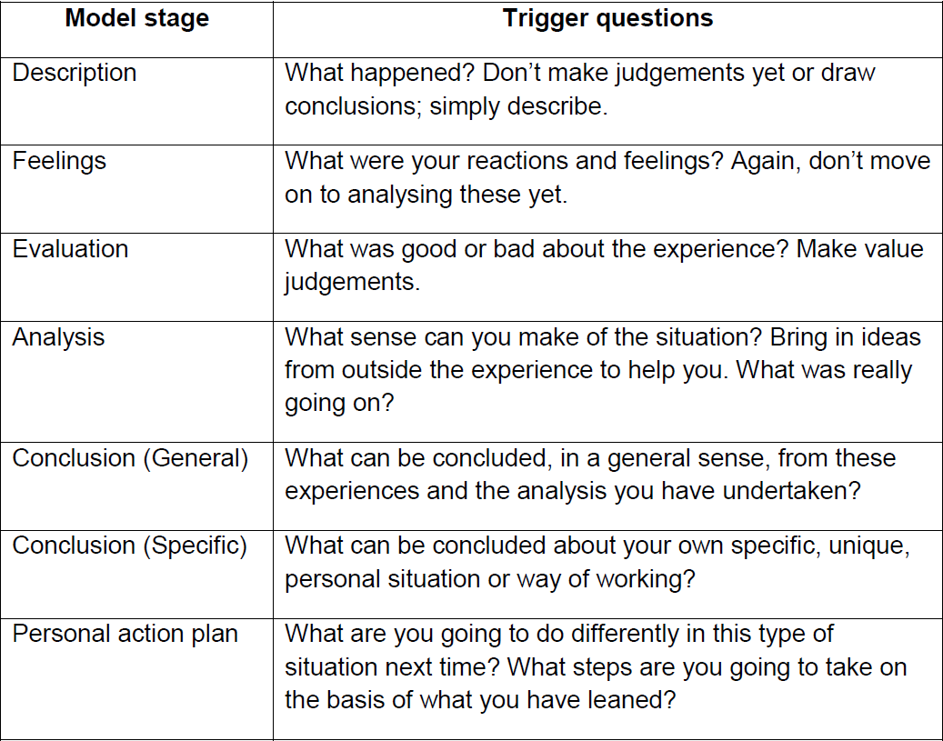
Stages of Gibbs model & trigger questions

Slide 35
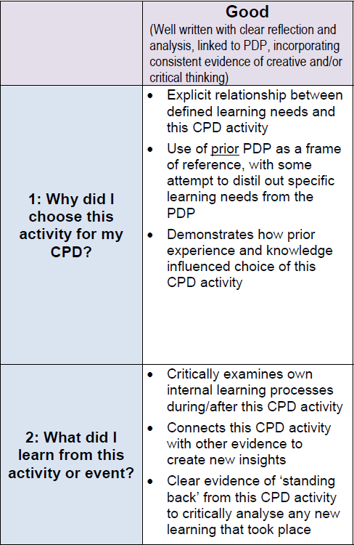

Slide 36
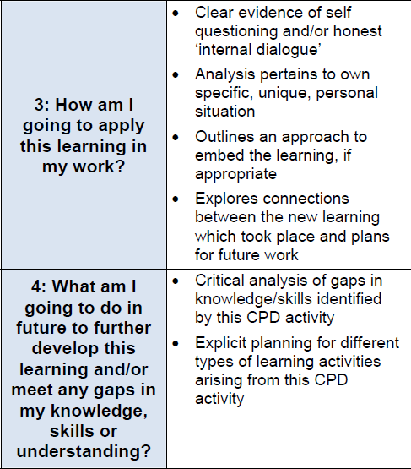

Slide 37
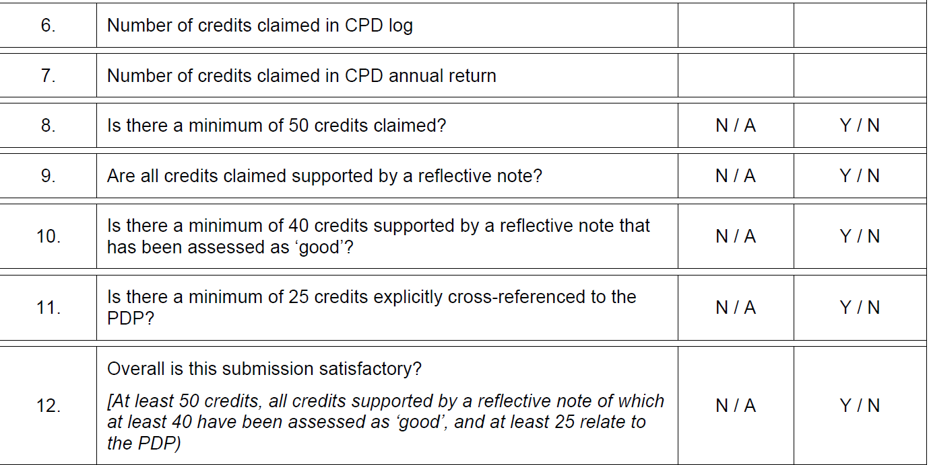
The Checklist

Slide 38
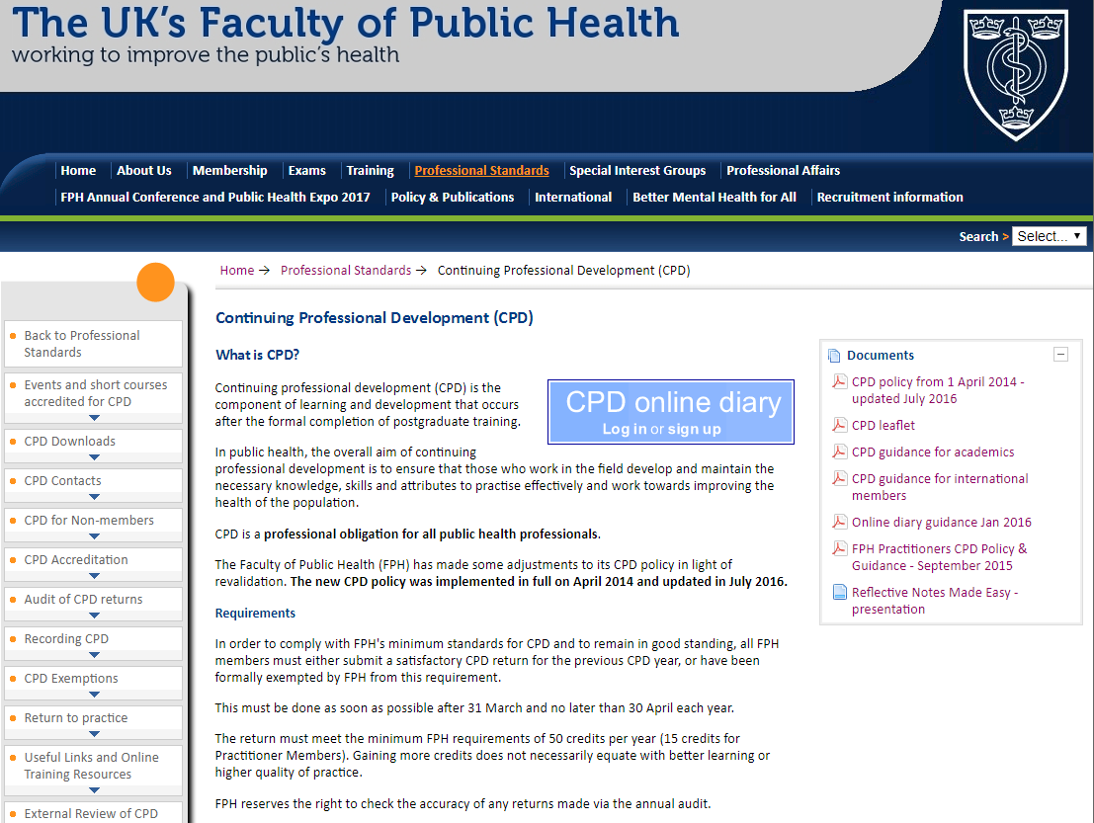

Slide 39
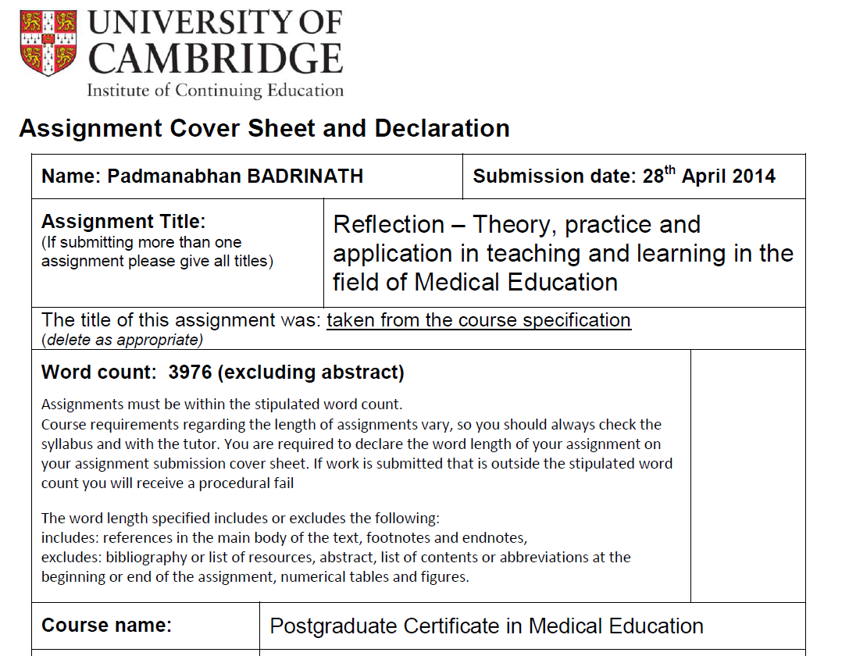

Slide 40
What we have discussed
2016-17 audit results
How to submit a good CPD return
A brief note on reflection

Slide 41

A final
Thought

Slide 42
Faculty CPD is not about catching people but to support and help colleagues so that we as a profession are assured that standards are maintained and we all continuously learn and develop

Slide 43
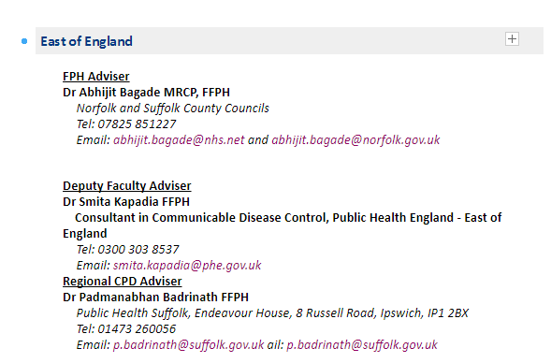
We are here if you need us

Slide 44


Slide 45


Slide 46

Thank you for your time & attention

