Slide 1
UKPHR Public Health Registration
Alix Sheppard
UKPHR Registered PR0332
East of England Scheme Coordinator (HEE)
Programme Lead (Faculty of Public Health)
Associate Lecturer (Anglia Ruskin)

Slide 2
Practitioner Registration
CfWI estimates 36k-41k core PH workers in England. Up to 10,000 may be unregulated
UKPHR has piloted practitioner registration since 2011 with good evaluation results
16 local practitioner registrations schemes, including East of England across the UK and NI
Currently 300+ practitioners registered
Supported by both PHE and HEE as a way of developing the PH workforce

Slide 3
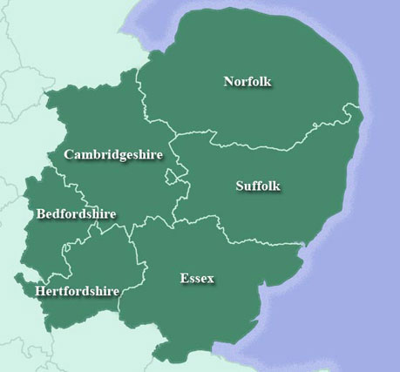
East of England Scheme- the story so far…
Hosted and funded by HEE with joint funding from PHE and DsPH network
Seven cohorts each with approx.10 practitioners are started developing portfolios 28 currently in process
18 practitioners have successfully achieved UKPHR registration with a further 7 due to complete by Feb 2018
A team of 21 Assessors (senior PH workforce members)
5 Verifiers, Consultants in Public Health

Slide 4
How does it work?

Slide 5
Each scheme has:
Scheme coordinator
Locally recruited cohorts of practitioners developing their portfolios
Locally trained assessors from the advanced practitioner/specialist workforce (voluntary)
Locally trained verifiers from the local consultant/specialist workforce (voluntary)
An assigned UKPHR moderator
Local engagement of the university sector to address skills/knowledge gaps and add capacity

Slide 6
Process for the practitioner
START
Develop portfolio
(up to 12 months)
Apply for assessor
Submit within
12 months
Apply to join the scheme with manager’s endorsement
Attend portfolio development groups and other master classes
Identify 3 or 4 areas of work that you will present in your portfolio (commentaries)
Map your work against the standards and start writing and collecting evidence
Apply for an assessor with 1 completed commentary
Respond to assessment and submit further commentaries until evidence for all standards accepted
Submit Portfolio to the local verification panel
Portfolio submitted to the national registration panel

Slide 7
Eligibility
At least three years public health experience working at level 5 (the level of autonomous practice) or above on the Skills for Health Career framework
Commitment to attend 4 portfolio development days and to carry out development and training as needed
Commitment from line managers
Signed commitment to submit a completed portfolio for verification within 12 months of joining the programme

Slide 8
Assessors and Verifiers
Assessors:
must have at least 2 years experience at senior level in PH
skilled in assessing evidence
thoroughly conversant with standards
supportive yet impartial, up to date CPD
Verifiers:
are registered public health specialists with at least 3 years at consultant level
Check the assessment has been carried out appropriately – independent scrutiny (QA role)
Verifiers meet as the local Verification Panel

Slide 9
Assessor role
A
Certainly a good thing to have in ones CV as being committed to developing the workforce and actually having evidence that they have done it. Would go down well in their first consultant interviews.
I think in general this is a good thing to do as assessing the work of others is what senior people do – and they are training to be senior people. Part of the metacompetency of a consultant / senior leader.
Dr Augustine Peirera PH Consultant, Dr Alistair Lipp, Head of School of PH and Regional Medical Training Director (Midlands and East)

Slide 10
Practitioners
Open Day
Introduction Day
Assessors
Yearly training for new assessors
Yearly refresh for existing team
Verifiers
4 x PDG
3 x Masterclass
Monthly Telecon
6 month Progress review
Learning Contract
Bi monthly telecon
Yearly training for new Verifiers
Bi monthly Panels
Stakeholders
Quarterly Newsletter
Advocacy with employers
Links to professional networks
Steering Group
Commentary writing Days

Slide 11
Routes
UKPHR
Specialist Register
PractitionerRegister
Training Programme
Dual Route
Portfolio Route
Defined (retrospective portfolio)

Slide 12
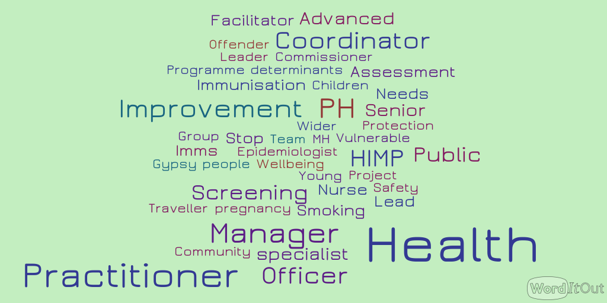

Slide 13
The benefits expressed by practitioners:
I am more aware of my own competence
It enhances my professional credibility with partners who have their own professional registration
I feel I have something nationally recognised to offer in job applications
It was a big confidence boost
Its made me more articulate about my skills and able to lead

Slide 14
From E of E Practitioners
In a nutshell, it evidences that we understand and are able to apply the ‘nuts and bolts’ of public health.
Many of us work for Local Authorities which are facing unprecedented cuts. This will undoubtedly impact on the Public Health workforce.
As Public Health teams are restructured or streamlined and potentially fewer PH roles are available (and therefore competition for jobs increases), having the PHP registration will be a huge boost and will set us aside from those who don’t have it.
“Why do you feel practitioner registration is important?”
It has given me the confidence that I do have the knowledge and skills for public health. This was particularly important to me because I came from another area of work entirely, so I have found it very affirming.

Slide 15
Current Updates
Review of Practitioner Registration
Standards
Processes
Profile (UKPHR)
Review of Specialist Portfolio Rouute

Slide 16
Faculty of Public Health Accredited Practitioner Programme
A series of 6 workshops covering technical competencies required for UKPHR registration.
Aligned with the new PHSKF and accredited by Skills for Justice at Level 6 (bachelor degree).

Slide 17
https://heeoe.hee.nhs.uk/node/1626
www.ukphr.org.uk
Alix Sheppard
Health Education England
2-4 Victoria House | Capital Park | Fulbourn | Cambridge | CB21 5XB
T. 07708 705150
E. alix@healthtalks.org.uk

