Slide 1


Professional Development Day
28th November 2018

Slide 2
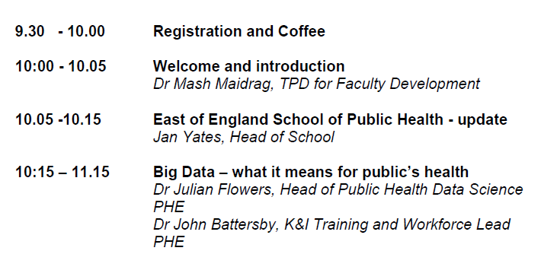
Agenda

Slide 3
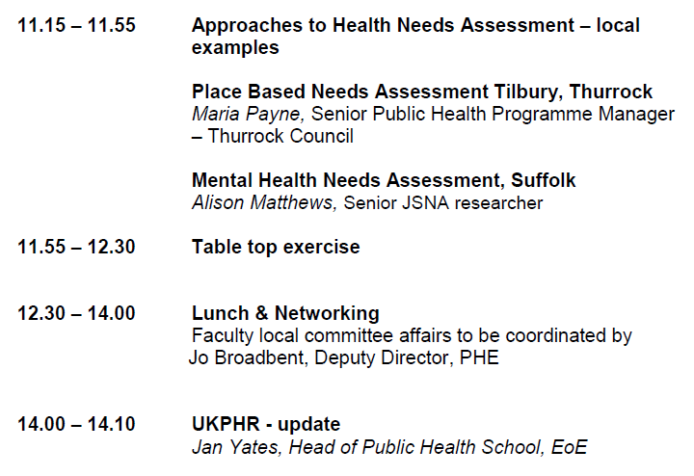
Agenda

Slide 4
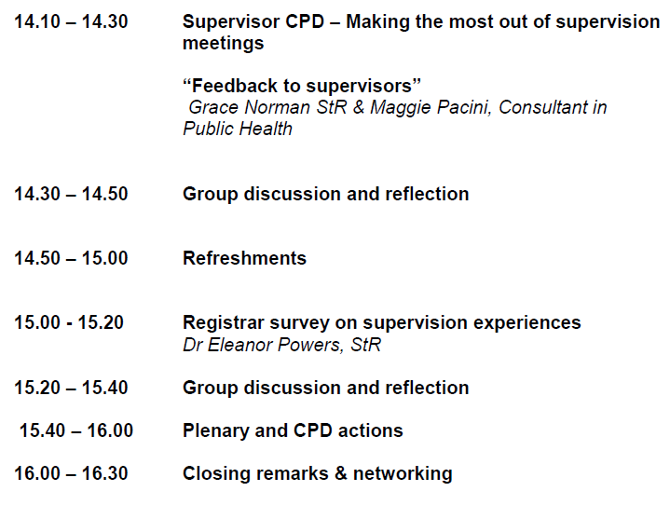
Agenda

Slide 5
House keeping
Fire Action – On hearing the fire alarm, please leave the building by the nearest exit and proceed to the assembly area on Laundress Green.
Please do not stop to collect personal belongings.
If first aid is needed please contact reception who will arrange for a First Aider to attend.
Toilets

Slide 6
School of Public Health - update

Slide 7
PH School Objectives - ADP
 | Objective | Plans/discussion points/next steps (lead)
ADP1 | Implement relevant recommendations from EoE PH workforce strategy Learning hub e-platform Increase placement diversity All organisations using practitioner registration All PH staff capable of brief intervention | Considering WMIds, learning from London (PHE) See ADP3 School Board function, presentations, events, STC discussion No current plan. Discuss at EoE HoS, STC discussion
ADP2 | Confirm governance arrangements including: School QA strategy Review of meetings and governance arrangements and establish PH School Board | Overview of current systems with HEE and quality lead. Discussion at School Board (SESQ) Draft School Board ToR out for comment. New HoS, TPD, ES and SES contracts required
ADP3 | Increase access to placements for registrars across a range of settings which meets the changing needs of the public health workforce | Summary of PH placement benefits to be sent to trusts and primary care School board discussion
ADP4 | Increase in EoE based UKPHR practitioner scheme assessors and verifiers | Ongoing presentation to relevant fora
East of England School of Public Health

Slide 8
PH School Objectives
Ongoing HEE reviews
    Budget restrictions – new fixed contractual price per PA
    Equivalent HoS/TPD resource across M&E
    M&E funding for practitioner scheme 18/19
    Move towards consistency across M&E
    Sustainable school structures and governance
East of England School of Public Health

Slide 9
Data Science Quiz
EoE CPD Day
Notes:
9

Slide 10
Question 1
How much of the data that is created ever gets analysed?
<0.5%
Around 4%
Between 9 and 12%
Between 15 and 20%
Notes:
https://www.technologyreview.com/s/514346/the-data-made-me-do-it/

Slide 11
Question 2
Which of these is usually regarded as the most important language for data science?
Ruby
SQL
R
Java

Slide 12
Question 3
Key Skills of data scientist
Data Visualisation
Statistics
Machine Learning
All of the above

Slide 13
Question 4
In this example are you looking at:
Long data
Tidy data
It doesn’t matter. It’s data
Wide data
State | 1960 | 1970 | 1980 | 1990 | 2000
New York | 2 | 5 | 2 | 5 | 4
New Jersey | 3 | 1 | 4 | 1 | 5
Arizona | 3 | 9 | 8 | 7 | 5

Slide 14
Question 5
Who coined the phrase “chartjunk”?
Julian Flowers
Hadley Wickham
Edward Tufte
David McCandless

Slide 15
Question 6
Fill in the missing word:
Data ______ is loosely the process of manually converting or mapping data from one “raw” form into another format that allows for more convenient consumption of the data with the help of semi-automated tools
Data cleaning
Data wrangling
Data analysis
Data scraping

Slide 16
Question 7
Which of the following is not one of the 4 (or 6) ‘V’s?
Variety
Visibility
Volume
Veracity

Slide 17
Question 8
Which of these is NOT a data science tool?
Giraffe
Python
Pig
Shark

Slide 18
Question 9
Which is the following is the correct sequence of increasing quantities of data?
Gigabyte, Terabyte, Zettabyte, Exabyte, Yottabyte
Gigabyte, Terabyte, Exabyte, Zettabyte, Yottabyte
Gigabyte, Terabyte, Exabyte, Zettabyte, Brontobyte
Gigabyte, Terabyte, Zettabyte, Exabyte, Brontobyte

Slide 19
Answer 9
Metric | Value | Bytes
Byte (B) | 1 | 1
Kilobyte (KB) | 1,024¹ | 1,024
Megabyte (MB) | 1,024² | 1,048,576
Gigabyte (GB) | 1,024³ | 1,073,741,824
Terabyte (TB) | 1,024⁴ | 1,099,511,627,776
Petabyte (PB) | 1,024⁵ | 1,125,899,906,842,624
Exabyte (EB) | 1,024⁶ | 1,152,921,504,606,846,976
Zettabyte (ZB) | 1,024⁷ | 1,180,591,620,717,411,303,424
Yottabyte (YB) Brontobyte (BB) Geopbyte (??) | 1,024⁸ 1,024⁹ 1,024¹⁰ | 1,208,925,819,614,629,174,706,176 1,237,940,039,285,380,274,899,124,224 1,267,650,600,228,229,401,496,703,205,376

Slide 20
Question 10
The Coxcomb chart is a type of data visualisation. It was developed by:
Edward Tufte
John Snow
David McCandless
Florence Nightingale

Slide 21
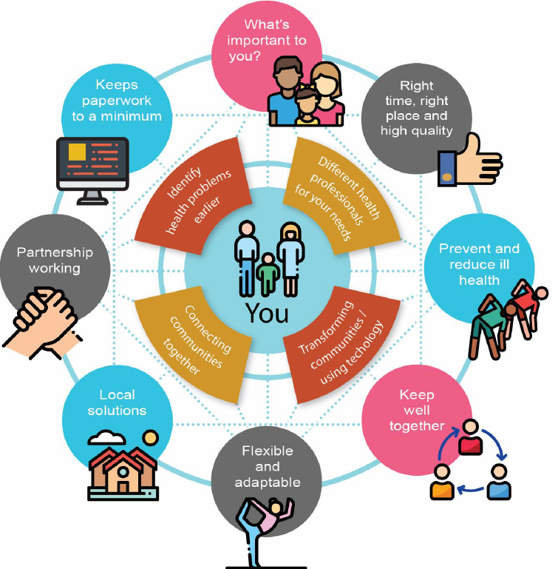
Our approach to Needs Assessment: Tilbury & Chadwell
Maria Payne
Senior Programme Manager – Health Intelligence
28th November 2018

Slide 22
Background
Background / Context

Slide 23
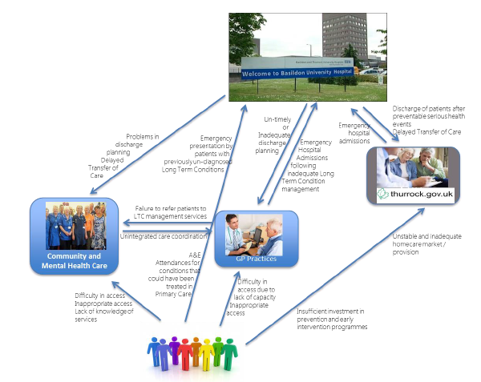
The current system is fragmented:
As outlined in the 2016 Annual Public Health Report

Slide 24
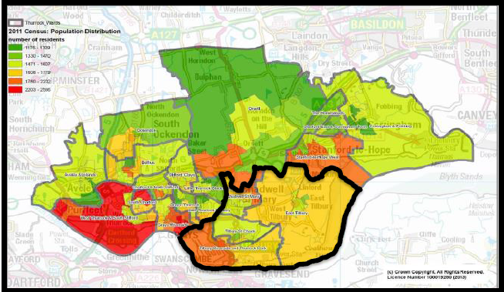
Locality focus
Locality of Tilbury and Chadwell – around 37,000 residents
Notes:
Request to focus on this area – deprivation, transport difficulties, known poorer health outcomes, active community ethos, failing primary care
And this was all known before the needs assessment work began…

Slide 25
Structure of Needs Assessment
The Ask….

Slide 26

Notes:
Our first JSNA in Thurrock back in 2012 was bulky, very descriptive but not helpful in terms of linking the data to existing service offer, not very visual, and certainly not strong enough in terms of recommendations for future actions.
So they did not want a repeat of this!
Note – JSNAs between 2012 and this Tilbury one have been vastly improved on this….

Slide 27
Structure of Needs Assessment
Needs Assessment Structure

Slide 28
Aims of Needs Assessment
To show demand on all parts of the system
To demonstrate how clinical practice in one part impacts on demand in another
To outline the most cost-effective system-wide solutions to reduce demand and improve the health of our local population.

Slide 29

Data sources
Local Health (PHE)
Quality Outcomes Framework
Primary Care Workforce Statistics
Adult Social Care data
Local provider and community datasets
Demographic data
Hospital Episode Statistics
Notes:
Range of data sources used – some easier to get than others!
Challenge that this was a ‘locality’ as defined by GPs catchments, didn’t quite match the wards, but had to use as proxy. Also, some data not available at lower geography at all… All involved lots of Excel time!!
Demographic data – ONS Mid Year Estimates, IMD. Publically available and easy to source. Population projections slightly more tricky – Thurrock undergoing a lot of growth. So chose to consult Planning colleagues and obtain data on planning applications received for the area.
Local Health – supplied a lot of ward-level data – e.g. mortality ratios, lifestyle behaviours. Easy to group wards together to form the locality geography.
QOF – again publically available. Looked at diagnoses and management (more details next slide)
Primary Care workforce data – from NHS Digital (more details later)
Adult Social Care data – directly from Council colleagues. Looked at package use by demographics and COST.
Provider data – e.g. mental health services (IAPT / secondary care), LTC community services, community & third sector info also – hard to obtain!
HES – including ACSC conditions

Slide 30
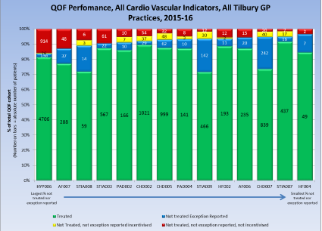
A couple of things we did a bit differently (1)
Notes:
Presentation of LTC management data (from QOF).
We built a tool which calculated, for each indicator:
The number who had received the intervention – i.e. who had been treated (green)
The number who did not receive the intervention but who were Exception Reported (blue)
Then we applied the QOF threshold for each indicator (around 80%), and calculated:
Those who did not receive the intervention but for whom the GP was incentivised (yellow) – i.e. the GP did not make their QOF maximum thresholds
Those who did not receive the intervention, were not Exception Reported and for whom the GP was not incentivised – therefore the GP would not receive payment even if they had treated them (red)

Slide 31
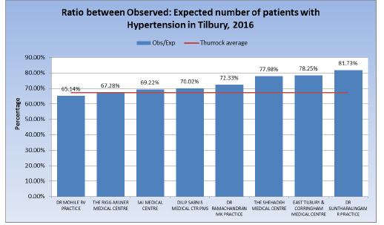
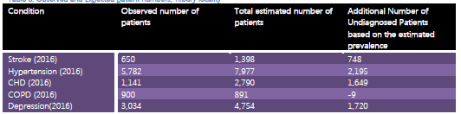
A couple of things we did a bit differently (2)
Notes:
We used practice level estimates developed by Imperial College (commissioned by PHE) to quantify the estimated total numbers of patients with certain long term conditions, and then compared these to patients diagnosed and on the QOF registers.
We also showed these as absolute numbers.
This highlighted the need to prioritise case-finding activities in this area..

Slide 32
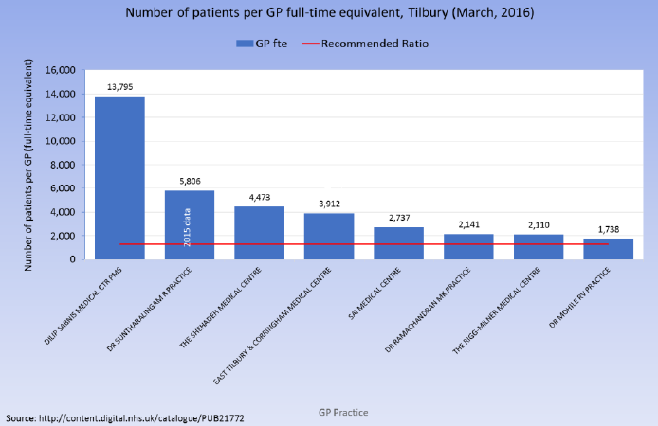
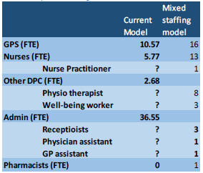
A couple of things we did a bit differently (3)
Notes:
We used current primary care workforce figures and research from ‘Making Time in General Practice’ to estimate the appointment split that could be delivered by non-GP professionals in primary care. We then devised a new ‘mixed staffing model’ which proposed different roles to be recruited to rather than GPs.

Slide 33
Conclusions
Conclusions of Needs Assessment

Slide 34
1) Too much money and too many patients are in the most expensive parts of the system:
There were 453 potentially avoidable emergency hospital admissions for ambulatory care-sensitive conditions in 2015/16 costing £19,000.
There were 1,844 delayed days for delayed transfers of care in 2015/16, with a net wastage of £2.31M, had adequate NHS community services been available (Thurrock wide figures).
77% of A&E attendances were for issues that needed “advice only and no treatment”, or the most minor investigation and treatment, and could potentially been treated in Primary Care. The net wastage to the system in treating this cohort of patients in 2015/16 was £0.5M
Notes:
Copied and pasted conclusions from needs assessment work. Each conclusion had relevant data points underneath it to back up as evidence…

Slide 35
2) Inadequate quality and capacity in Primary Care, Community Care and ASC keeps the money and the people in the wrong place:
Tilbury is one of the most “under-GP’d” and “under-practice nurse’d” localities in England
Thousands of patients with long term conditions have not been diagnosed, and so are not being treated, putting them at high risk of serious health events and emergency hospital admissions
For those patients who have received a diagnosis of a long term condition, many are receiving inadequate care within the community. In 2015/16, 4575, 2011 and 893 NICE recommended clinical interventions for patients diagnosed with diabetes; cardio-vascular disease; and COPD were not delivered.

Slide 36
3) Solve the capacity and quality issues and the money will follow in reduced hospital and ASC costs
ROI demonstrated through various preventative interventions – social prescribing, falls prevention etc….
The sheer amount of money involved….

Slide 37
4) Solving the capacity and quality issue requires integrating the system (and the money)
Current ‘organisational sovereignty’ of budgets creates perverse incentives not to address issues such as delayed discharges.
The interface between GP surgeries and Community Services needs to be improved. Too few patients on GP Long term condition registers are not being treated by Long Term Condition Management Services
Primary Prevention needs to be “ramped up” and integrated into the day job of all front line health and care staff, rather than being commissioned separately by the Public Health Team.
Mental and Physical Health Services operate largely in silos and need to be integrated
Self care and the third sector sit largely completely outside clinical care pathways

Slide 38
5) We require a period of “double running” (non-recurrent investment) to solve the problem.
We cannot simply decommission services provided by BTUH and ASC whilst we invest in prevention and early intervention programmes, and address the issue of capacity and capability within Primary Care

Slide 39

Take Home Messages:
Map out datasets you know of that could be useful – and involve others in this discussion
Be clear on potential data quality issues – and be confident in how to articulate any caveats
A good narrative is absolutely KEY and helps sell the important messages
The potential ‘power’ of Public Health Informatics in explaining a complex problem in a coherent yet numerical manner – one acorn….

Slide 40
Suffolk Mental Health Needs Assessment 2018
Getting the
used
EoE Professional Development Day for consultants in Public Health
Alison Matthews
28th November 2018

Slide 41
Evidence-based decision making?
Do
Review
Revise
Plan
Needs Assessment

Slide 42
What DOES happen?
Decide
(Find evidence that fits)
Carry on
Some organisations
They may ask Public Health to…
The others…
…regardless?

Slide 43
Barriers
Research
  Lack of relevant research
  Poor dissemination of research
  quality and authoritativeness of research
  Format of research output
Researchers
  Lack of managerial support
  Managerial will
  Staff turnover
  Different priorities from policymakers
  Professional bodies
Policymakers
  Policymakers &c lack skills to use evidence
  Poor long-term policy planning
  Unclear decision-making practices
  Inflexible and non-transparent policy processes
Economic
  Costs
  Resources - material and personnel
Other:
  Political
  Time
  competing priorities
  Media, vested interest, pressure/lobby groups

Slide 44
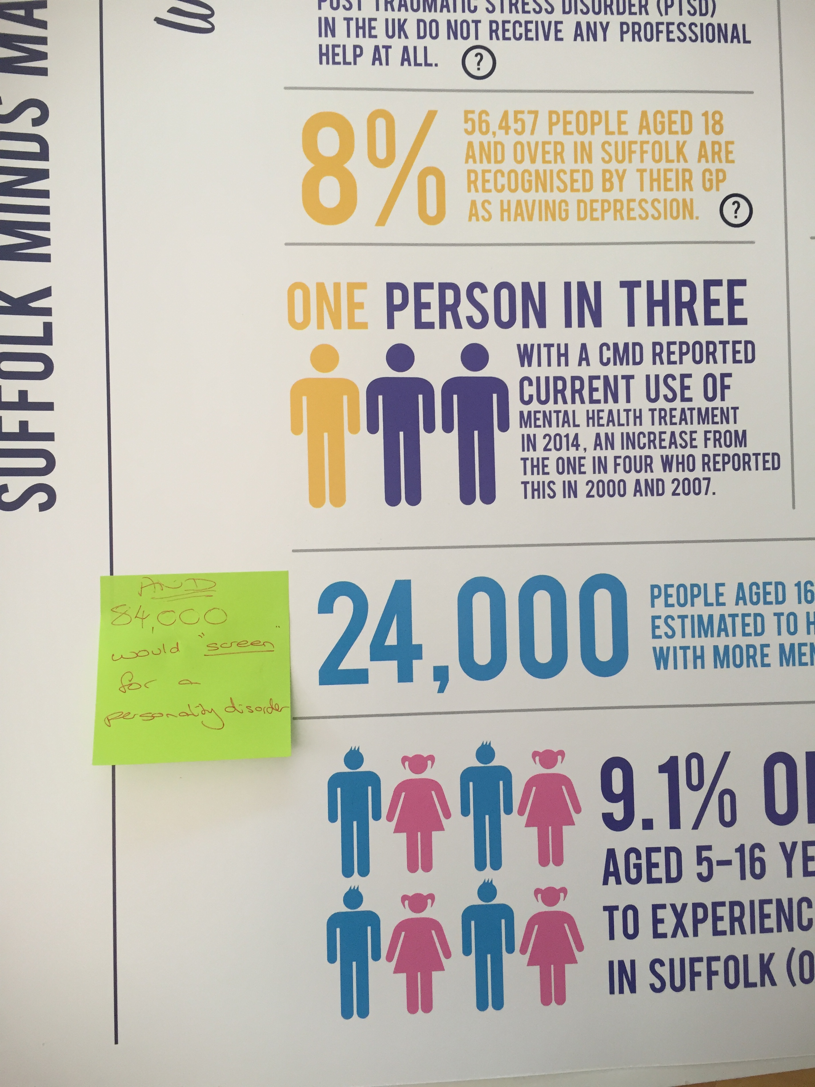
1: Share before it’s complete
Distribute early drafts and headlines
Adapt
Interact

Slide 45
What is Needs Assessment revealing about Mental Health in Suffolk in 2018? (May)
Share
Poor mental health and wellbeing is widespread
Physical and mental health are intertwined
There are inequalities linked to location and deprivation
Joint work is needed to prevent and support crisis and this impacts across all sectors
Self harm is increasing and is linked to deprivation
We need to continue suicide prevention work, especially among young people
Dual diagnosis, especially alcohol is important
Most (90%) mental health care takes place in primary care
Mental health is not just about mental health services

Slide 46
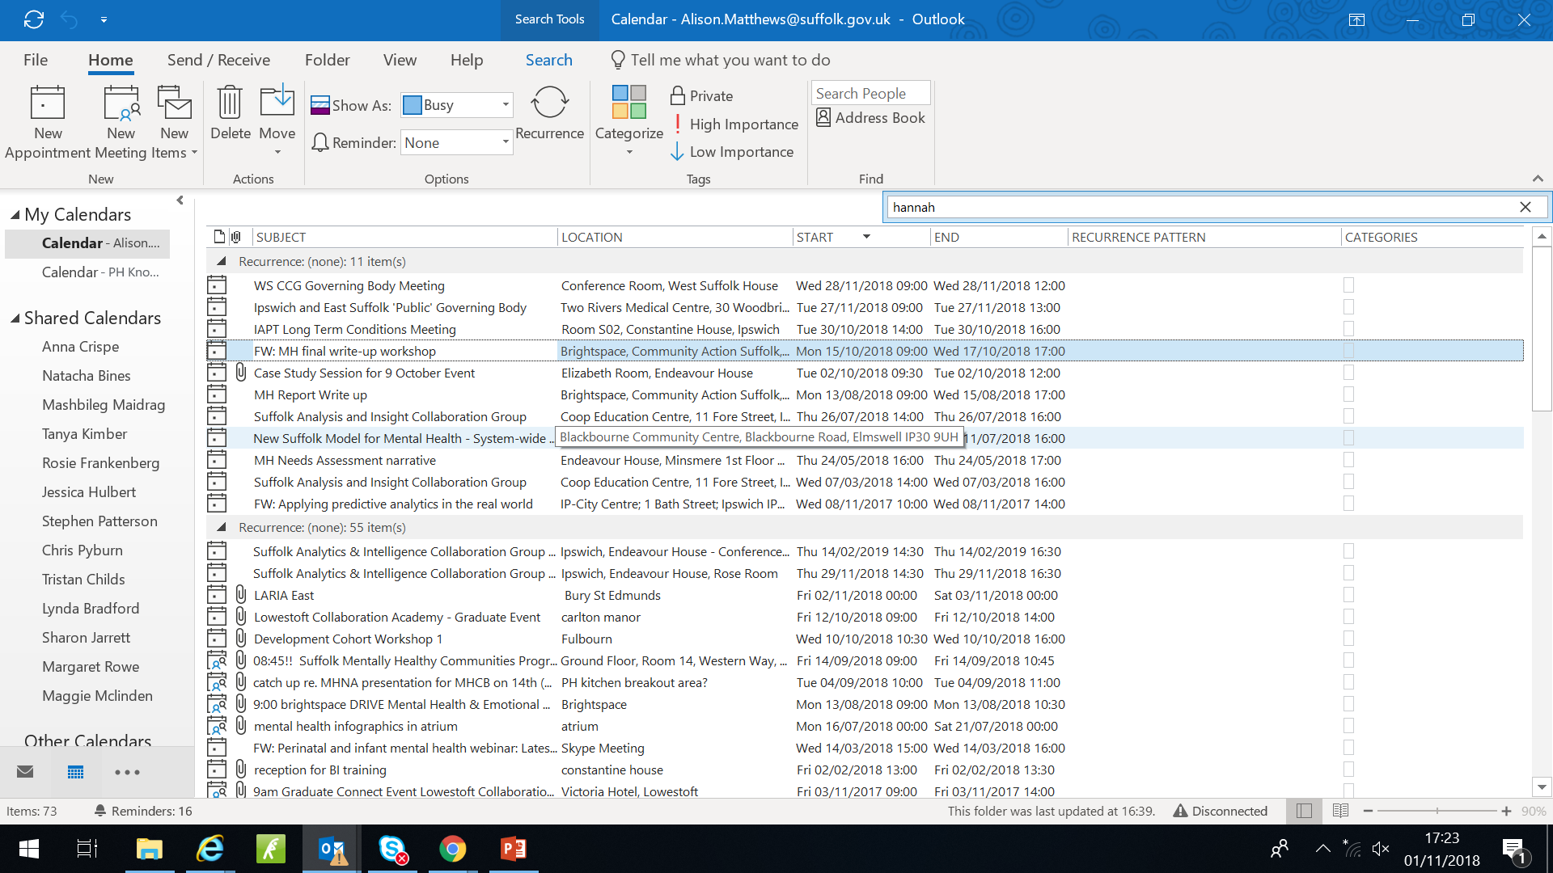
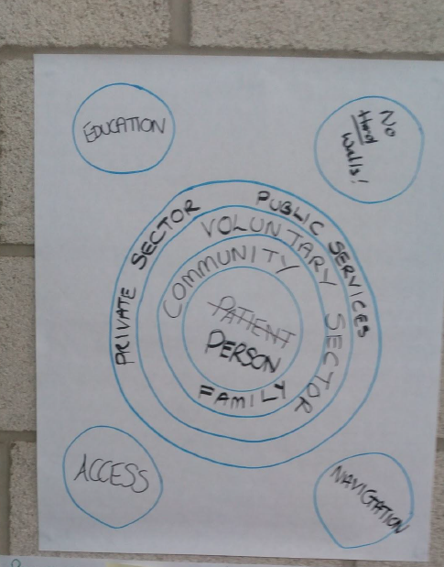
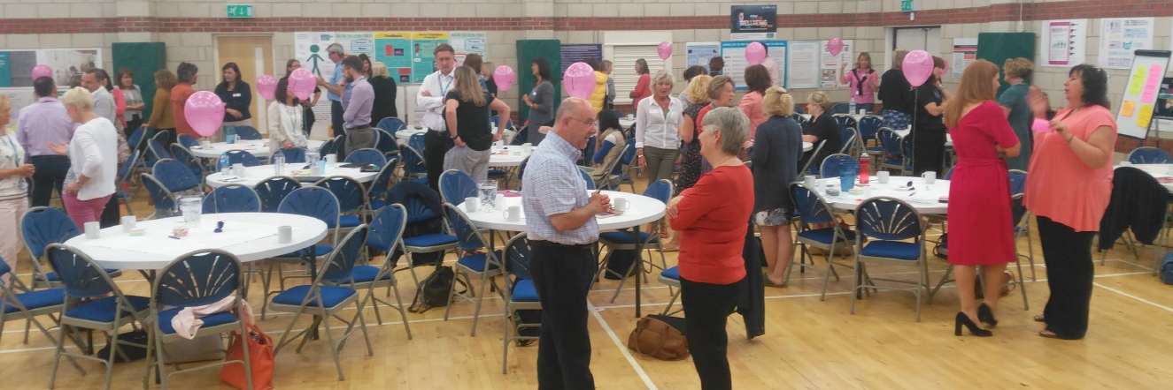
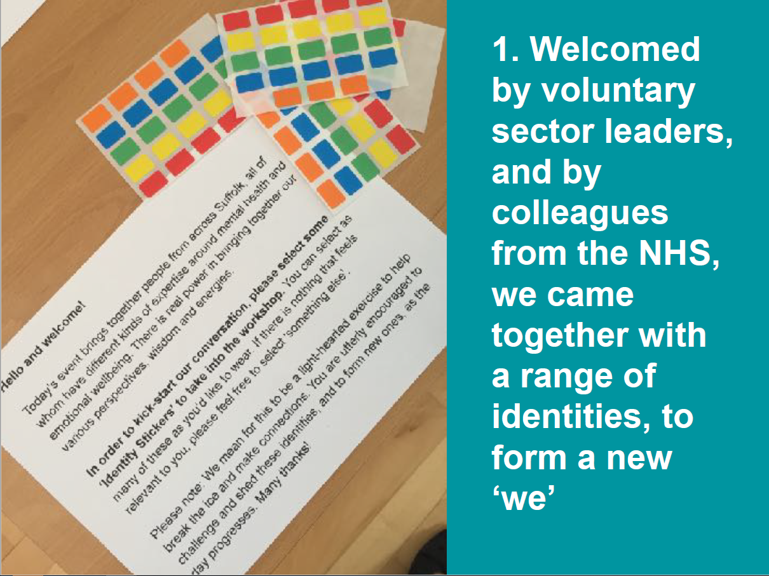
2: Remove gaps: Be part of clients’ discussions
Work with partners (CCGs, Foundation Trust, SUF, SPCN, Healthwatch)
Feed evidence into meetings (CCGs)
Influence strategy development
Adapt information to their needs

Slide 47
Remove gaps

Slide 48
3: Make it accessible
Maintain the website:
Break the needs assessment up:
  Easier to update
  Can add new topics – trending issues
  Use relevant geographies (ave. GP)
  More likely to be read:
  if you only read 4 things…
Link to existing assessments
People posters (web & pdf)
Presentations
Further reading
Think about delivery early on
Use infographics
Sieve your data
https://www.healthysuffolk.org.uk/jsna/reports/health-needs-assessments/MHNA-2018

Slide 49
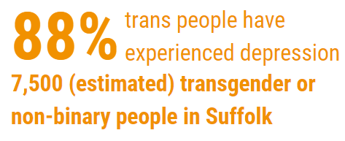
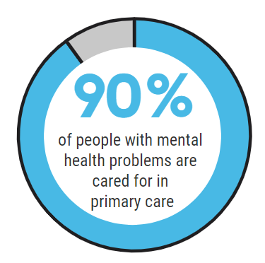

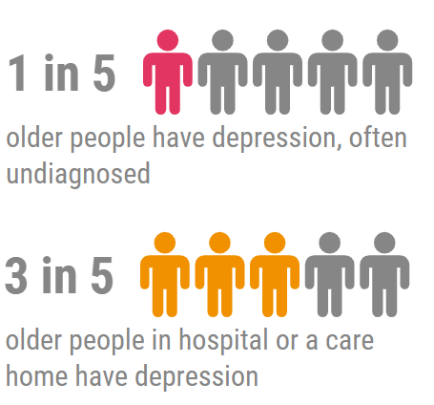


Infographics & bold colour scheme

Slide 50

Use
infographics

Slide 51
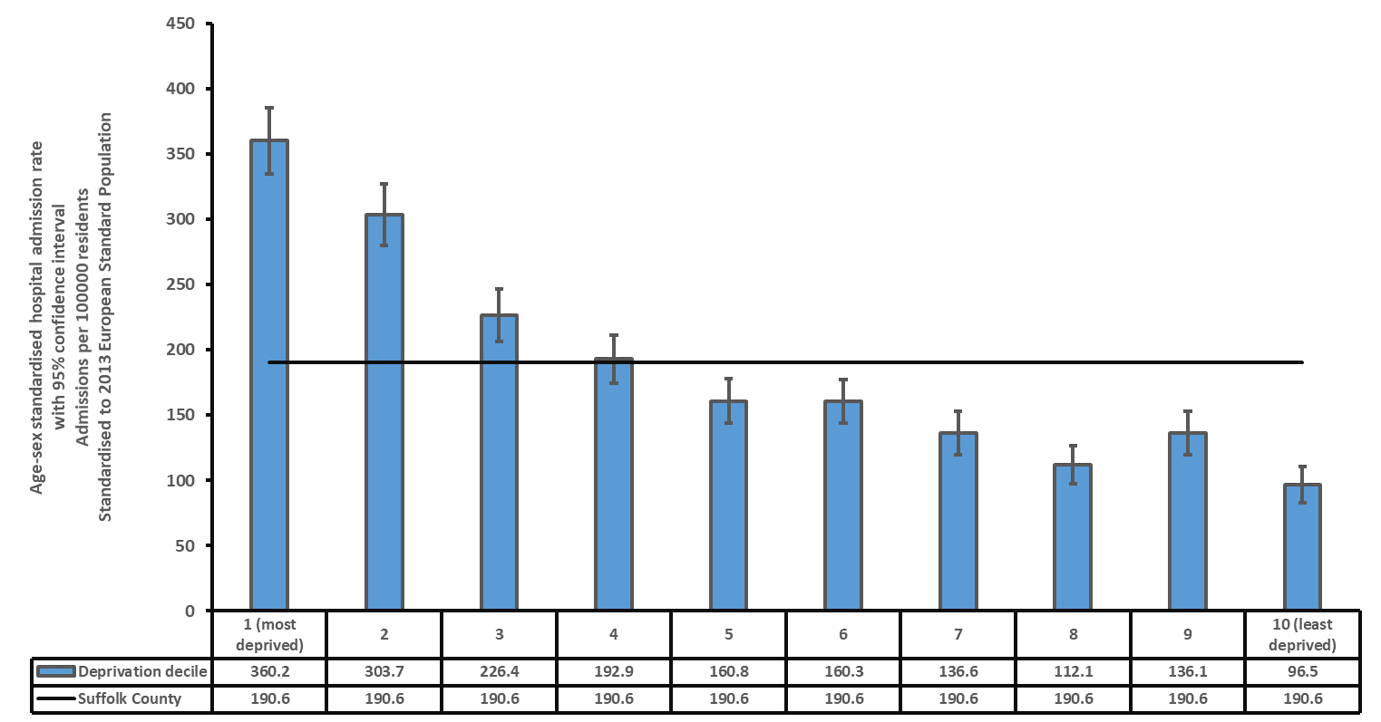
Young people 23% less likely to be referred to MH services if their GP practice is in a “most deprived” area
Self-harm: Suffolk
Charts can be powerful
Emergency admissions significantly higher than England
Young people: increasing levels of self-harm & suicide
85% variation in admissions due to deprivation
For each unit increase in deprivation, admissions increased by 45.6 per 100,000 (22.7 in 2009/10-10/11)

Slide 52
4: It helps when evidence matches experience
Crisis profile
Identified key issues which should be fed into planning new provision
Emergency department attendances increased in the summer and are usually between the early evening and midnight
GP Out of Hours services again show highest levels of contacts in the summer and between 6pm and midnight on weekends
Police Section 136 episodes increase in July and August
Ambulance service also has more calls from the East of the County and most in June to August
There are higher numbers of contacts in East Suffolk

Slide 53
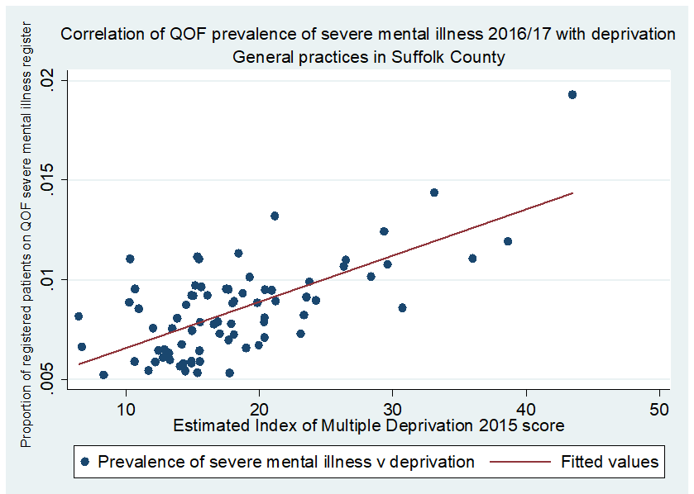
5: Don’t be afraid to be controversial
Mental health services for personality disorders do not meet user needs or NICE guidance:
  84,000 people in Suffolk would screen for PD
  People with PD have the highest use of A&E in this STP
45.6% of variation can be explained by deprivation
People with SMI die 15–20 years earlier than the rest of the population

Slide 54
Some unexpected differences*
12.6% women aged 16–24 screened positive for PTSD
4.4% adults screen positive for Post Traumatic Stress Disorder (men & women similar rates)
British forces: prevalence of PTSD:
  6% combat troops
  4% personnel who have been deployed
  Rates are lower for personnel on operations
  BUT YOUNG at greater risk (men <24)
*comparing screening with diagnosis
Be controversial
McManus S, et al. Mental Health and Wellbeing in England: Adult Psychiatric Morbidity Survey 2014. Leeds; 2016
Hunt, E. J. F., et al. The mental health of the UK Armed Forces: where facts meet fiction. Eur. J. Psychotraumatol. 5, 23617 (2014)

Slide 55
Summary
Share before it’s complete
  Distribute early drafts and headlines
Remove the gaps
  Link with other organisations
  Be in the clients’ discussions
Make it accessible
  Sieve your data
  Think about delivery early on
  Use bright colours and infographics
  Go local
It’s really nice when evidence matches experience
Don’t be afraid to be controversial
Maintain the website
https://www.healthysuffolk.org.uk/jsna/reports/health-needs-assessments/MHNA-2018

Slide 56
Mental Health Needs Assessment, created by:
Rosie Frankenberg, Public Health Consultant (& GP)
  rosie.frankenberg@suffolk.gov.uk
Alison Matthews, Senior JSNA Researcher (& “expert by experience”)
alison.matthews@suffolk.gov.uk
Colleagues across Public Health, PH Knowledge & intelligence team, the “Suffolk system”
https://www.healthysuffolk.org.uk/jsna/reports/health-needs-assessments/MHNA-2018

Slide 57
Table Top Exercise
What are the challenges do you have when undertake health needs assessments and how do you overcome
What other innovative approaches do you use?

Slide 58
UKPHR update - regulation
Revalidation from April 2019
1. Professional appraisal 2. Personal Development Planning 3. Health and Conduct Declaration 4. Professional Indemnity 5. Continuing Professional Development 6. Supporting Information of Quality Improvement Activity 7. Confirmation of Compliance

Slide 59


Slide 60
UKPHR Review
In 2016 UKPHR began a comprehensive review of practitioner registration, an extensive consultation was commissioned and the many points discussed by a range of stakeholders from the 4 nations.
22 recommendations ratified by the UKPHR Board in July 2018 including new standards.
Standards have not changed too much! More in-line with PHSKF, less duplication and the review of Standards was carried out by VIV Speller- also responsible for the Specialist Portfolio route review.
Implementation Group now responsible for making these changes happen- from April 2019.

Slide 61
East of England Scheme- the story so far…
23 in progress
26 practitioners have successfully achieved UKPHR registration
45 in Development Cohort
A team of 21 Assessors (senior PH workforce members)
5 Verifiers, Consultants in Public Health
FPH Masterclass programme for 2019 ALL PH workforce welcome!

Slide 62
Development Cohort
Many practitioners unused to reflective writing and gathering evidence for portfolios which means that they take longer to complete and do not make full use of the process
Four workshops to be delivered between Oct 18 and Oct 19 – 45 people engaged
1. Introduction to UKPHR Portfolio Development
2. Reflective writing and critical appraisal skills
3. Gathering evidence to support the portfolio
4. CPD workshop (content TBC from previous sessions)
Attrition and length of time it takes to complete is partly due to lack of preparation and understanding of what is required- this new initiative aims to address this need- the first pilot in the UK of this initiative.

Slide 63
East Mids and EofE
The East Midlands Scheme will relaunch on 29th November, also coordinated by Alix Sheppard. This will enable better sharing of resources across both regions and enable more development sessions for practitioners
45 people currently in the EofE Development Cohort- interested in registration but needing more learning sessions and skills to prepare.
Scheme needs more Assessors! This role contributes to your own CPD and is an interesting way to connect with the different domains of public health practice – across varying organisations and geographical areas.
Training will be held in April 2019.

Slide 64
For more information:
Alix Sheppard UKPHR reg PR0332
East Midlands and East of England Scheme Coordinator (HEE)
Accredited Practitioner Programme Lead (FPH)
T. 07708 705150
E. alix@healthtalks.org.uk

Slide 65
Practitioners
Open Day
Intro Day
Assessors
Yearly training for new assessors
Yearly refresh for existing team
Verifiers
4 x PDG
3 x Masterclass
Monthly Telecon
6 month Progress review
Learning Contract
Bi monthly telecon
Yearly training for new Verifiers
Bi monthly Panels
Stakeholders
Quarterly Newsletter
Advocacy with employers
Links to professional networks
Steering Group
Commentary Writing Days Monthly
Bi monthly telecon option

Slide 66
UKPHR – why help?
Good personal CPD related to education and teaching
Requires refresh of knowledge of a range of PH areas, also good CPD
Networking with peers across a region
Enables you to act as a champion in your own workplace
Useful opportunity for trainees to gain learning outcomes
Supports PH workforce development, the value of registration and career progression

Slide 67
UKPHR – how to help
In the workplace
Support applicants with mentoring, management support and time
Support applicants with appropriate work at the right level
Add requirements for registration to relevant JDs
Enable revalidation through regular appraisal which meet the criteria
Personal time and CPD….

Slide 68
UKPHR update – specialist
New (opened 1s Sept 2018) equivalence route including pre-application check and revised standards (more in line with specialty curriculum)
https://www.ukphr.org/specialist-registration-by-portfolio-assessment/

Slide 69
Practitioner Scheme Assessors:
must have at least 2 years experience at senior level in PH
skilled in assessing evidence
thoroughly conversant with standards
supportive yet impartial, up to date CPD
Practitioner Scheme Verifiers:
are registered public health specialists with at least 2 years at consultant level
Check the assessment has been carried out appropriately – independent scrutiny (QA role)
Verifiers meet as the local Verification Panel
Specialist assessors:
Be skilled in assessing evidence submitted to demonstrate competence in knowledge and its application in practice (‘shows’)
Be thoroughly conversant with the public health competences required for registration
Be able to maintain independence and impartiality in the role
Be willing and able to devote the necessary time (a minimum of two portfolios assessed each year, approximately 10 hours to assess a portfolio on average) and to give the task appropriate priority

Slide 70
Supervisor CPD – making the most out of supervision meetings
Feedback for supervisors

Slide 71
CPD Session

Slide 72
Feedback to Supervisors
Maggie Pacini & Grace Norman

Slide 73
Break

Slide 74
Registrar Survey
Ele Powers
To all registrars via email
Assured confidentiality

Slide 75
Results
17 responses (~48% of eligible participants)

Slide 76
Results

Slide 77
Educational Supervisors

Slide 78
Results: Educational Supervision
94% were in a different placement to their ES

Slide 79

Results: Educational Supervision

Slide 80
Results: Educational Supervisors
“How do you find the frequency of your meetings with your ES?”
“If you need them, do you feel able to contact your ES outside of your pre-arranged meetings?” – 100% Yes

Slide 81
Is there anything your ES doesn't do (or doesn't do enough) that you'd like them to?
“Difficult to contact to get forms signed and particularly expenses signed off”
“Pro active engagement with my development ... I know I'm the responsible person but I sometimes need someone to nudge me to get on with things”
“I'd like to discuss future placements, my career plans and professional development more. This hasn’t happened so far”

Slide 82
Clinical Supervisors

Slide 83
Results: Clinical Supervision
Supervision vs Line Management

Slide 84
Results: Clinical Supervision

Slide 85
Results: Clinical Supervisors
“How do you find the frequency of your meetings with your CS?”

Slide 86
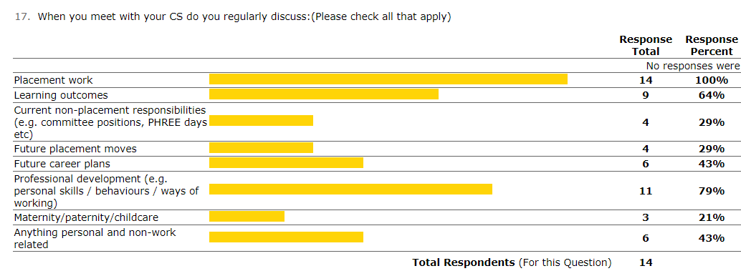
Results: Clinical Supervisors

Slide 87
Is there anything different you’d like your CS to do?
“I feel I'm always chasing them for time / a meeting. They are willing but I get the impression that if I didn't request meetings I wouldn't speak to them a great deal.”
“I think our meeting have been reactive - and we would have been better having a fixed regular slot”
“I’d like more structured meetings”
“I would like them to offer me shadowing opportunities or tell me about work they are doing / meetings they attend that would be helpful for my development / understanding of how the organisation works and what a PH consultant actually does - still feel I don't really know what the job involves”
“Doesn't always appreciate or take account of past experience/responsibilities”
“My CS has a lot of work pressure and I do understand why my meetings get cancelled but I think maybe my CS needs more support to be allowed to prioritise meeting me”

Slide 88
But context…
I have had really positive relationships with my ES and CS's. In particular my CS's have been really supportive with exam prep
There is only one of them and I value how they spend their time with me.
she has been great!
I am very happy with my ES
I'm very happy with my ES and our relationship.
they are available to talk to when I need
Very pleased with frequency of meetings and breadth of topics we cover.
I get helpful and constructive feedback on what I'm doing well and what I need to work on in the future.
It can be quite a thankless and time consuming task - thank you.

Slide 89
Discussion?

Slide 90
Discussion
How often do you meet your registrar (ES/CS) and is it regularly scheduled?
How will you know whether your supervision arrangement is working well?
What is the difference between CS and project managing consultant/professional role?

Slide 91
Discussions and reflection on your practice
How your registrars might feel about and how they might encourage feedback.

Slide 92
Asking Registrars for Feedback: Suggested Specifics
Supervisor availability
Frequency of contact?
Re-arranging?
Dedicated time – disruptions?
Face to face v phone?
Availability outside of pre-arranged meetings?
Context for our discussions
Safe space?
Do you feel heard?
Have we been clear about our expectations (both ways)?
Honest?
Content of our discussions
Sufficient breadth / depth of projects?
Didactic v socratic?
Holding to account?
Giving good feedback - positive & areas for development?
Pastoral?

Slide 93
Giving feedback – a framework
Describe the situation
Describe the observed behaviour (not assumptions)
Describe the impact – what reactions did you have
Alternative behaviour – what could have been done
Alternative impact – what would have been the impact of the alternative behaviour

Slide 94
CPD plenary
Crucial conversation
AoME framework
HEE resources
CPD log

Slide 95

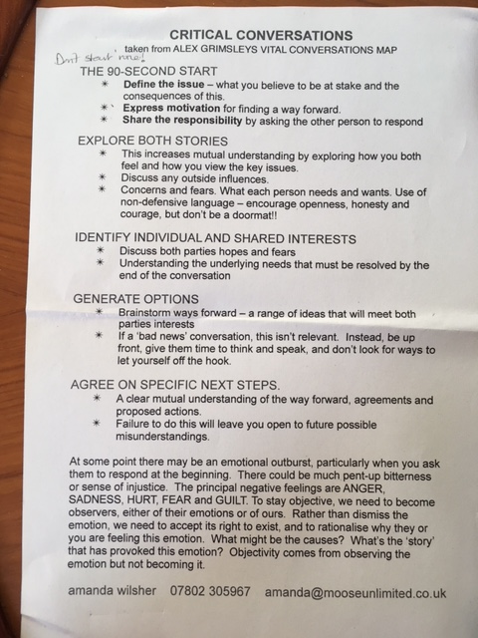

Slide 96
AoME area 2
Applies to CSs and Ess
Also useful for managers

Slide 97
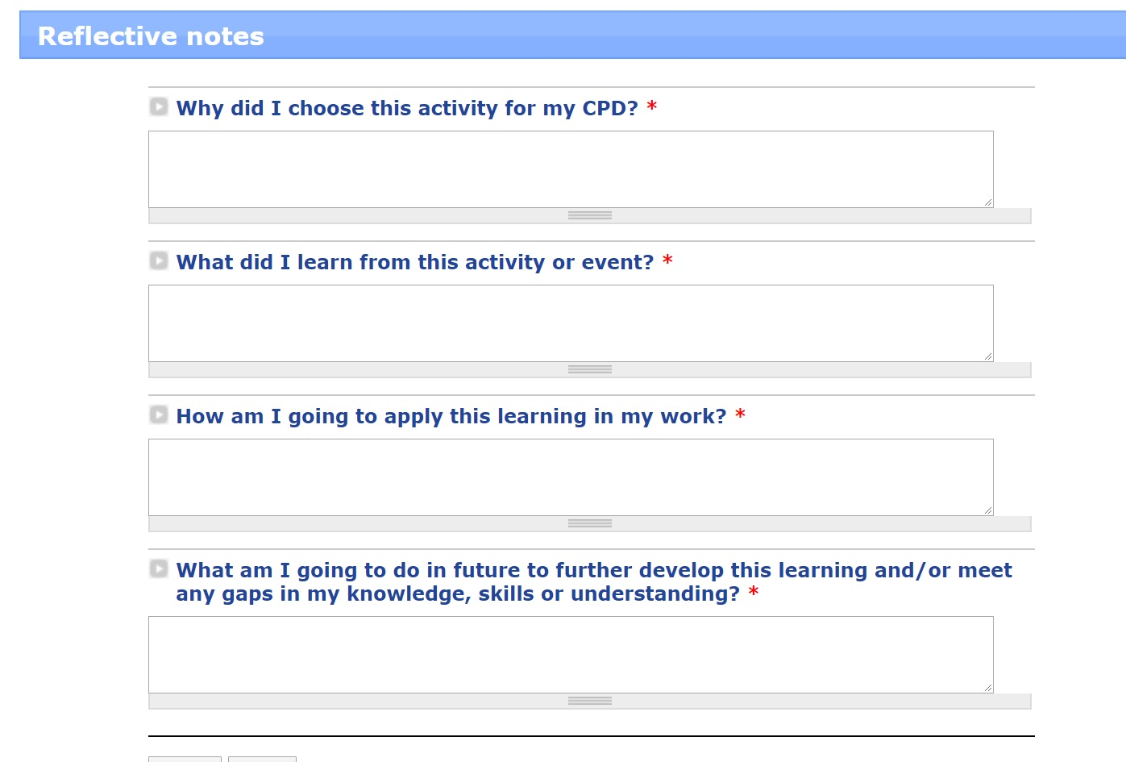
What next?

Slide 98
Reminders/Points
Small committee volunteers – to oversee PDDs & CPD sessions
Completion of self-assessment & return by 1st March to Mash
CS provide their comments to ES in support of ARCP using the template
Next dates: Wednesday, 12 June 2019 & Wednesday 6 November 2019
Evaluation

