Slide 1
OSPHE Familiarisation Course 2018
East of England
Dr Anne Swift, TPD North Zone & Exams
Health Education England, EoE

Slide 2
Time | Agenda Item | Presenter
10:00 | Introductions and Welcome | Anne Swift
10:15 | Part B – what is being assessed? | Anne Swift
10:35 | Practicalities and logistics | Anne Swift
10:50 | Registrar tips – Preparing for and surviving the exam | Connie Wou
11:15 | BREAK
11:45 | Scenarios and frameworks | James McGowan
12:15 | Q&A | All
12:30 | LUNCH
13:00 | Mini scenario practice | All
14:00 | Feedback – what worked? | All
15:00 | Practice stations for September candidates only
16:00 | Close

Slide 3
Purpose of the day

Slide 4
Aims
To familiarise candidates with OSPHE
Logistics and process
Preparation
To identify markers of good and poor performance
To provide some practice
scenario format, timing, preparation
To consider feedback
To have fun!

Slide 5
Not intended
Detailed individual feedback
Full length mock
Exact replica of exam set up
Expert examiners
THIS IS A FAMILIARISATION COURSE
Best taken as early preparation not as last minute cramming

Slide 6
Intended learning outcomes
To feel confident in planning exam preparation
To understand the logistics of the examination
To be able to identify further preparation needs

Slide 7
Session 1 – what is being assessed?
Anne Swift

Slide 8
Thoughts?
3 domains of PH practice
Application of theory to practice
5 specific competencies covered in every station

Slide 9
5 domains tested in every station
Presenting communication skills
Listening, comprehending, responding communication skills
Assimilating and using relevant information
Reasoning and judgement; giving a balanced view
Handling of uncertainty, the unexpected, challenge and conflict

Slide 10
How are these tested?
Skills and attitudes relating to every day public health issues in commonly experienced settings
Scenarios mostly based on the real experiences of question setting examiners in the workplace

Slide 11
To what standard?
A registrar with 2 years’ training left (not consultant level practice)
Demonstrate use of public health knowledge and skills appropriately in a variety of settings – “shows how”

Slide 12
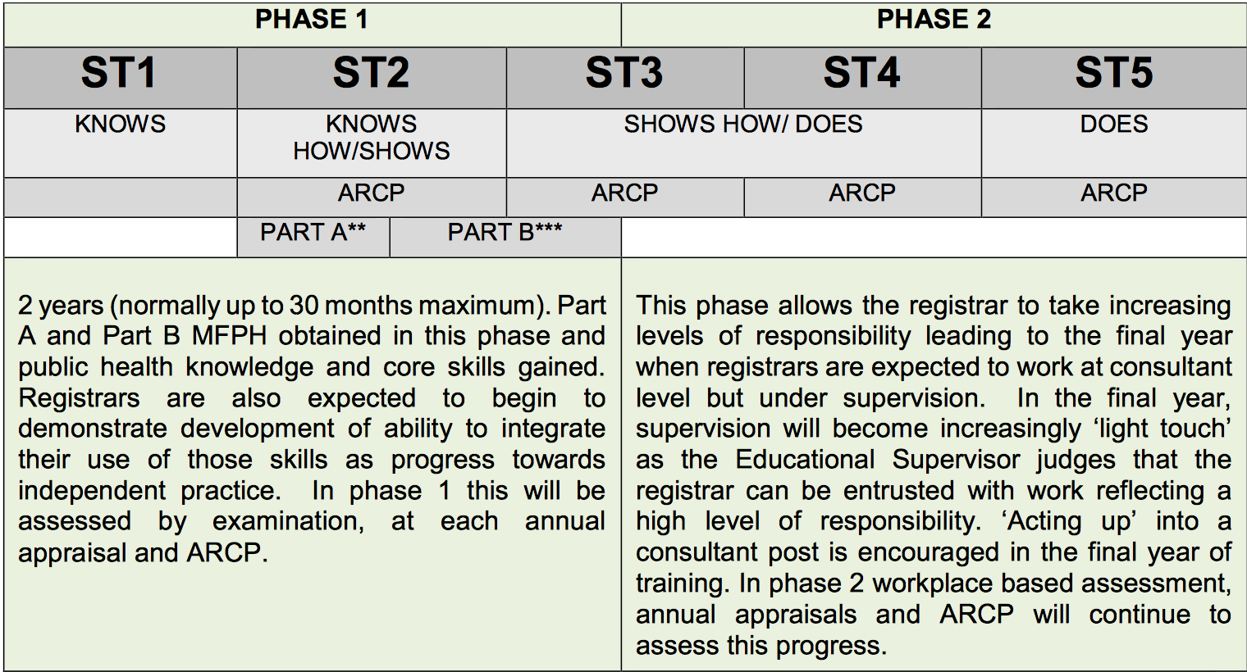

Slide 13
How are the domains marked?
Graded A (Excellent) to E (very weak)
Need a C (Adequate) in every domain, averaged across all stations
Must achieve average C or above AND must be C or better in half the stations (i.e. can’t get 2 As and 4 Ds)

Slide 14
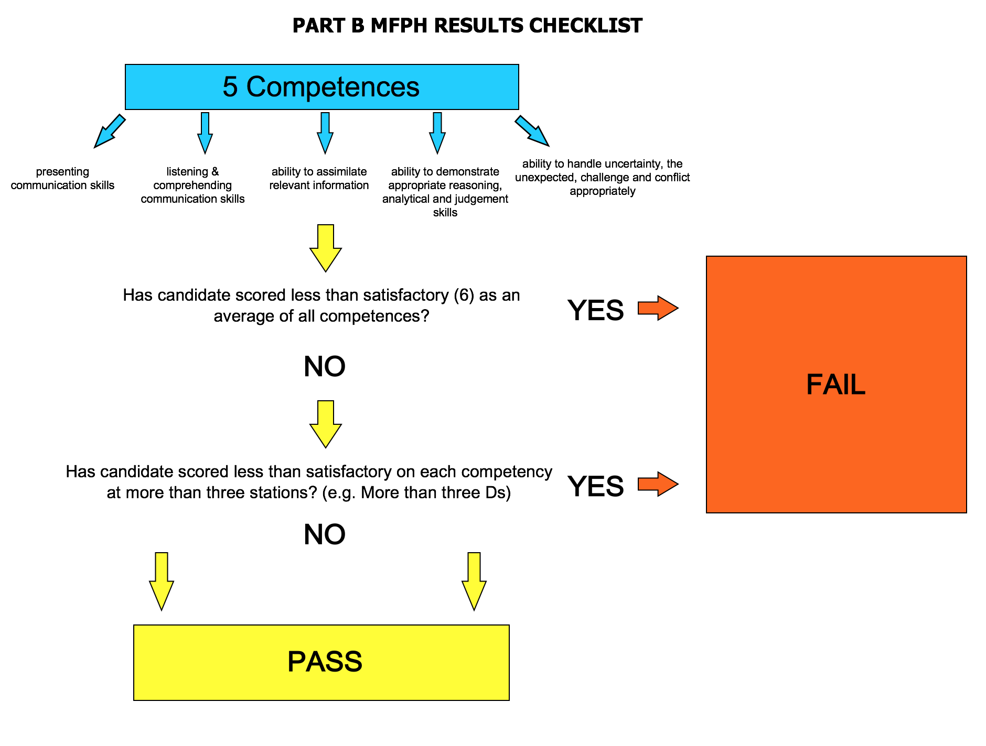

Slide 15
Is it a good test?
Running since 2006
Pass rate 70-80%
Exam has been evaluated by Birmingham University and reliability found to be extremely high

Slide 16
Types of scenario
Stakeholder meeting / briefing
Healthcare staff – clinical and management
Lay public
Media

Slide 17
Topic areas
Healthcare public health – implementation of interventions and working with stakeholders
Healthcare public health – technical aspects – use of public health expertise e.g. commissioning
Health improvement – including wider determinants
Health protection – including infection, imms, screening, environment

Slide 18
Domain matrix
 | Audience
Domain | Public/ lay | Journalist | GP/ professional | Manager | CX Chair
Health Improvement | Data skills Handling conflict Communication and assimilation
Health Protection
Health Service

Slide 19
Where do I start?!
Best practice is real life
Visit Faculty website
Other training events/simulations
Candidate observations
Check out other programme websites
Develop some yourselves and share
More tips to come from Connie…

Slide 20
Questions?

Slide 21
Session 2 - Practicalities and logistics

Slide 22
Applying
FPH website
12 spaces per sitting
£875 on application
No spaces available for Sept or Dec 2018
8 Feb 2019
Closing date 15 Dec 2018
28 June 2019
Closing date 3 May 2019

Slide 23
OSPHE logistics
Held at the Royal College of Emergency Medicine, EC4A 1DT
Near Borough tube station (5 min)
London Bridge (10 min)
Unexpected location!
Behind a petrol station in a residential street…
Thanks to Cath Fenton for the info

Slide 24
Arriving
Allow plenty of time – beware public transport and traffic (don’t get on the tube going the wrong way, for example…)
Ground floor – briefing for examiners and for candidates
Lockers (but they don’t lock…) – security staff on hand but consider whether to bring valuables. You can’t take anything in or bring anything out
First floor – toilets, tea and coffee
Second floor – exam rooms. FPH staff on hand to help

Slide 25
Don’t forget!
Exam allocation email
Original photographic ID (e.g. current passport)
IF YOU DO NOT BRING THESE YOU CANNOT SIT and you won’t get a refund!

Slide 26
Registration and briefing
With other candidates
Name badge with number (this is your first station)
Briefing pack includes the full set of 6 stations – carry it with you around the circuit
There will be hanging around… consider how you best manage stress
Water and (probably) tea and coffee… but no loo breaks during the exam

Slide 27
Exam format
Six 8 minute stations, exam takes 2 hours (you will be there longer)
Role play with actors
Professional actors for “lay” parts eg radio presenter
Role playing examiners for NHS parts eg CCG member
Marking examiner +/- observer/trainee examiner
8m preparation time, 1m transfer time
Confidentiality and cohort contamination
Electronic timing

Slide 28
The exam circuit
Prep room and exam room for each station
Speaker system and clock in each room, plus paper, pens, water
Spoken instructions for timings and moving between stations
Candidates shepherded around the circuit

Slide 29
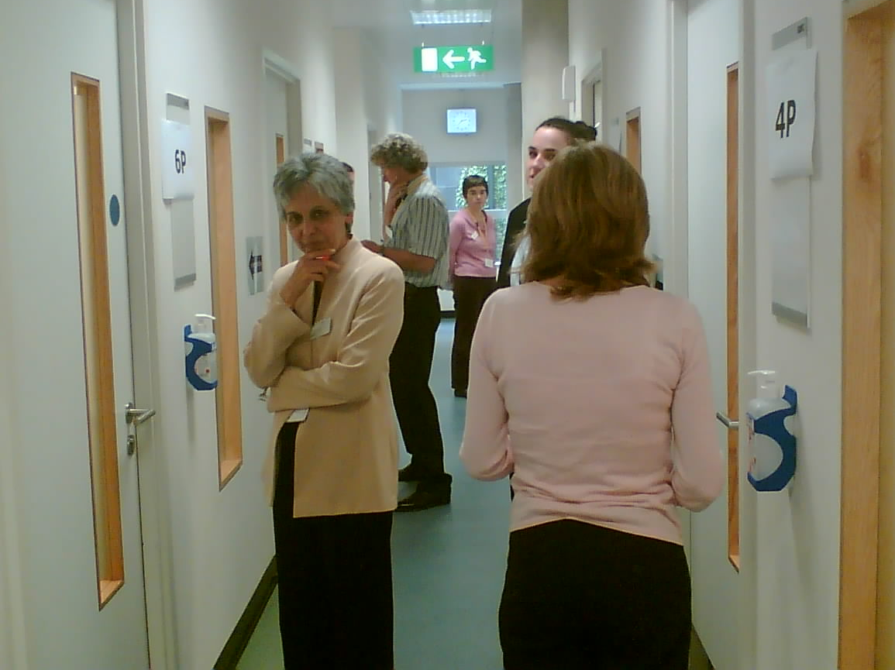
Exam Corridor

Slide 30
Step by step
Bell rings – enter the exam room
Ignore the examiner unless they speak to you
Bell at seven minutes = one minute left. Wrap up!
Bell at eight minutes = stop and leave immediately
If you finish early, wait in the station. Don’t try to chat

Slide 31
Marking
Name badge checked
Examiner watching and marking during exam
5 grades, scoring indicators
Excellent requires bringing in additional knowledge
All scenarios score all competencies
Each competency must be average or more at half stations

Slide 32
Results
Posted
Published on web
Copied to TPD
Feedback for fails

Slide 33
Tips from recent observation
“Shows how” exam, not knowledge test BUT you need to demonstrate public health skill (e.g. precision of language –rate vs number, registered vs resident population etc)
Make sure you use appropriate tone and language for the audience
Conflict and uncertainty seemed to come up at the one minute to go mark – be prepared
If you finish early you can start prepping the next scenario

Slide 34
More tips
Get into playing the role, be yourself but a bit larger than life… think about what you would do in real life if you were meeting this person or faced with this task
Be polite, empathise where appropriate, stay calm
"Aim to engage, enthuse and even entertain to a degree to get your message across" (OSPHE tips - Abhjit Bagade when he was a registrar)

Slide 35
Questions?

