Slide 1
What do Health Visitors do?
Rowena Harvey
Health Visitor Locality Lead
Cambridgeshire & Peterborough Workforce Partnership.

Slide 2
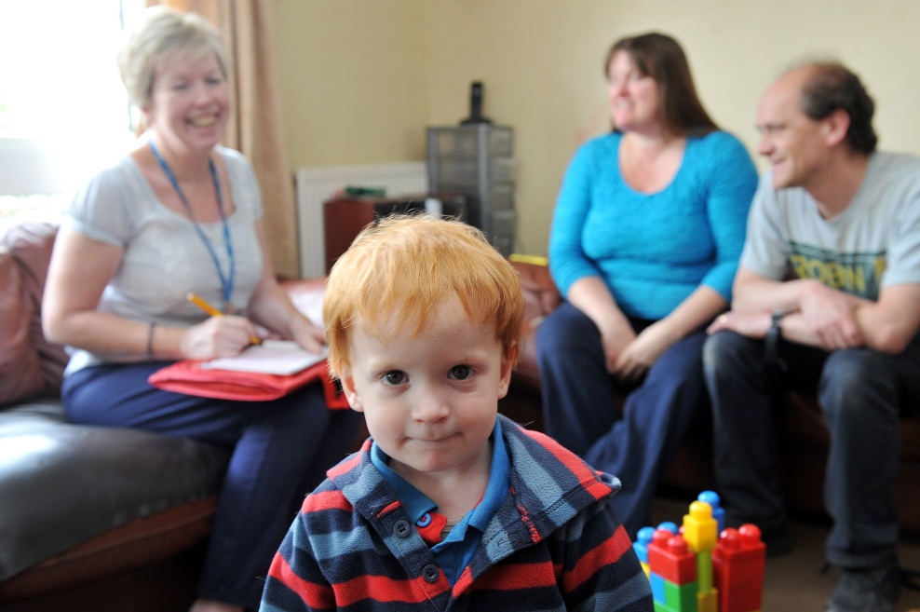
What is a Health Visiting Service?
The health visiting service is a universal early intervention and prevention service designed to promote family wellbeing, stability and good physical health.

Slide 3
Who are Health Visitors?
Qualified Nurses or Midwives
Post registration qualification at Degree or Masters Level
Specialist Public Health Nursing
Work in a social model of health with a focus on prevention and health promotion
They demonstrate care, compassion, competence, courage, commitment , communication and make every contact count.

Slide 4
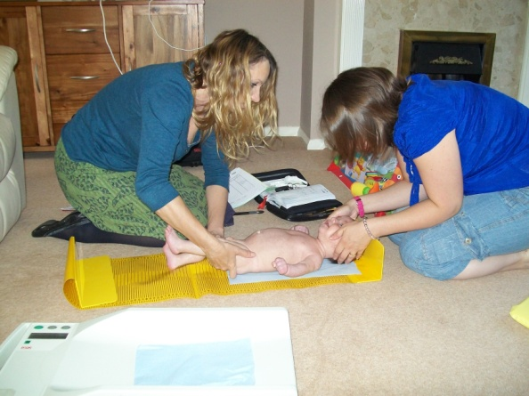
What do Health Visitors do?
Search for Health Needs
Stimulate the awareness of Health Needs
Influence policies affecting health
Facilitation of health enhancing activities

Slide 5
Your Community
Has a range of services including some Sure Start services and the services families and communities provide for themselves. Health visitors work to develop these and make sure you know about them.
Building Community Capacity projects are key to delivering this level of the offer.

Slide 6
Universal Offer
Delivery of the Healthy Child Programme to every child pre school age within a defined population.
5 core contacts:
Antenatal
New Birth Visit by Day 14
6-8 week developmental review and maternal mental health assessment.
1 year review
2-2.5 year review

Slide 7
Universal Plus
Gives parents a rapid response from Health Visiting Teams when specific expert help is needed.
For Example
Post Natal Depression,
Sleepless baby,
Weaning or answering any concerns about parenting.
This will be delivered using evidenced based tool such as the Solihull Approach

Slide 8
Universal Partnership Plus
Provides ongoing support from Health Visiting Team and a range of local services working together and with parents to deal with more complex issues over a period of time. These include services from Sure Start Childrens Centres and other community services including charities.

Slide 9
What next?
Honest , thoughtful and lively discussion.
Think outside the box
Knowledge and skills
Population approach with individual delivery
Public Health principles

Slide 10
Discussion Points
What does Early Intervention mean in your service/organisation?
What could Health Visitors do differently?
What could be delivered in a more integrated way?
What do you see as the gaps?
If you could do just one thing to improve services and outcomes for children what would it be?
Final Pearl of wisdom.

